Slide 1
The 18 th of September

Slide 2
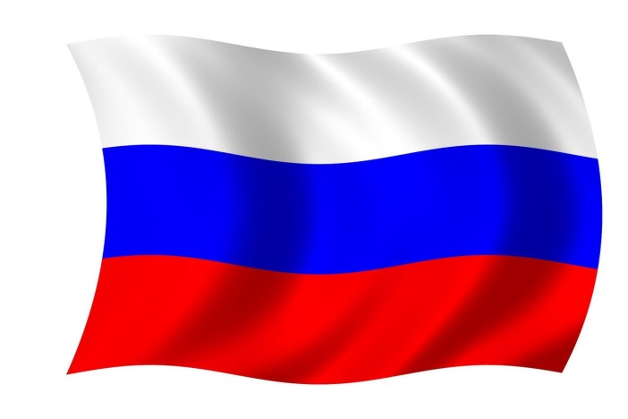

Slide 3
Hello. My name is…….
I am from….
It is….
The capital city of….is…
There are ….in my country.
Tourists can visit…..
… is a wonderful place to live but also to visit.

