Slide 2
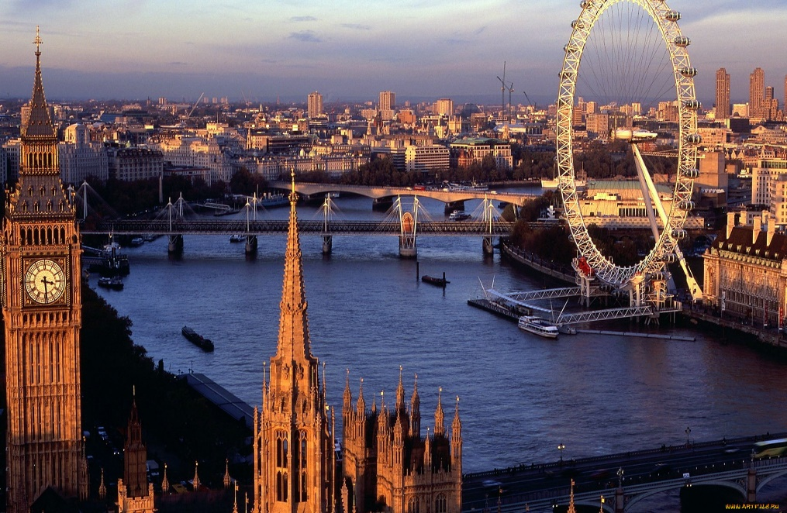
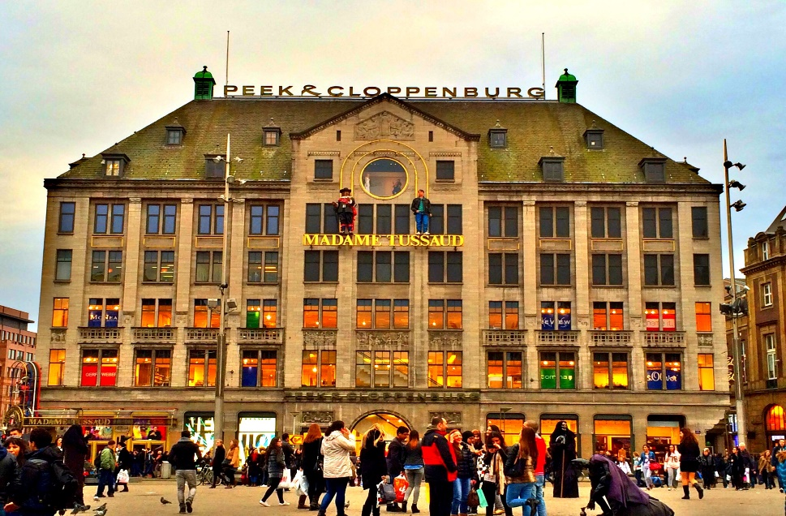
Landmarks in London

Slide 3
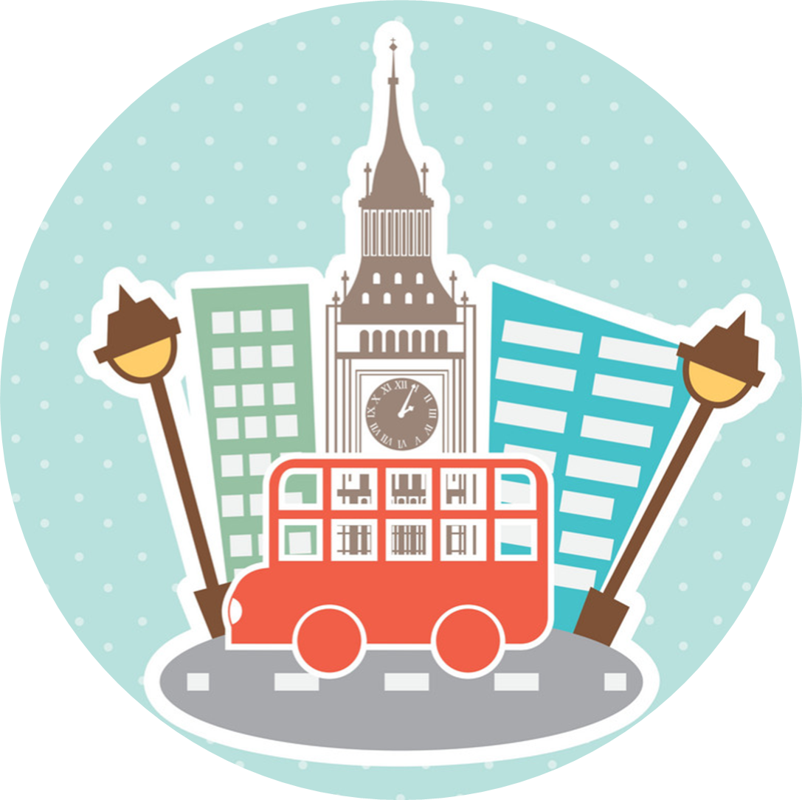

Slide 5
Top tourist attraction: Big Ben

Slide 6
Aim:
To know more about Big Ben

Slide 7
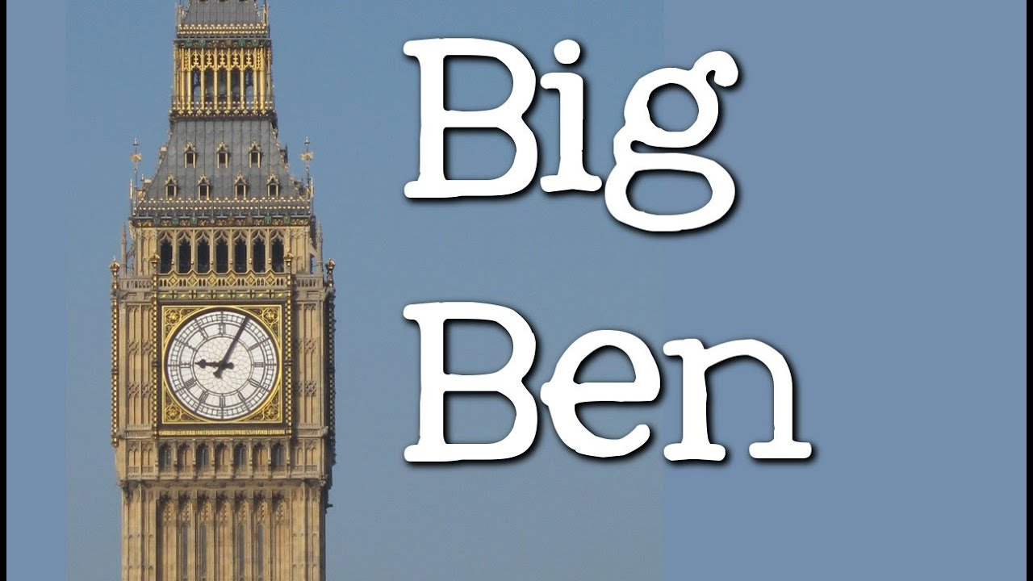

Slide 8
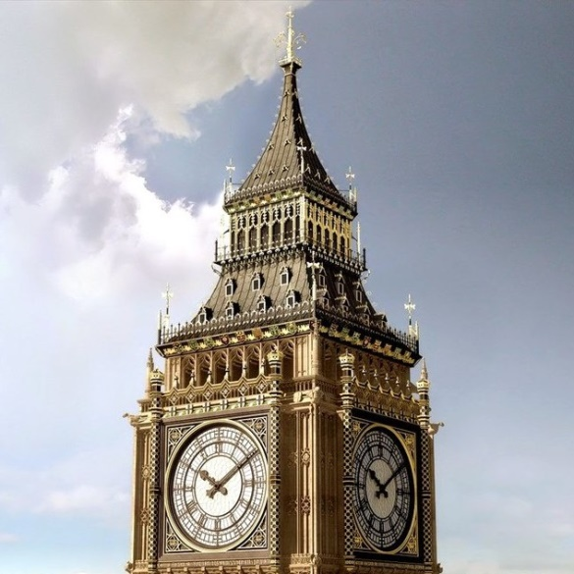
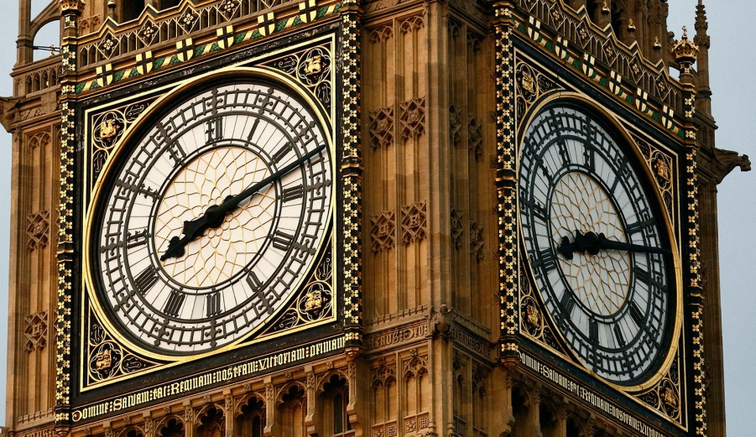
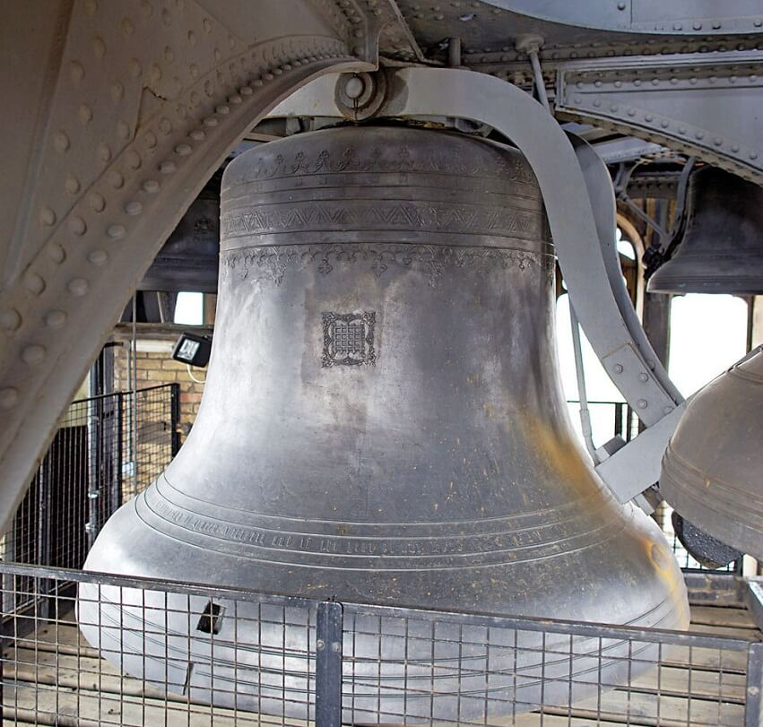
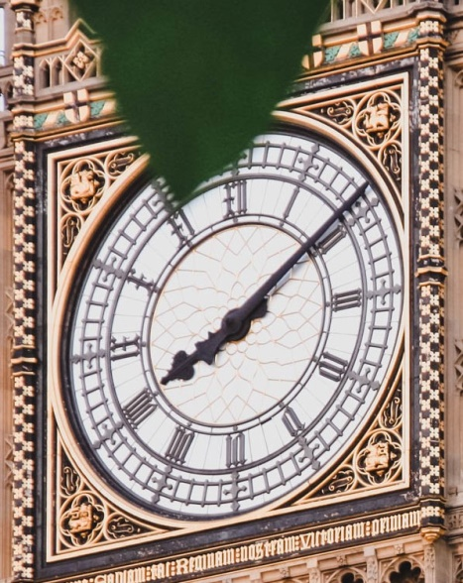
The parts of the tower
BELFRY
CLOCKFACE
SHORT (HOUR) HAND
LONG (MINUTE) HAND
BELL

Slide 9
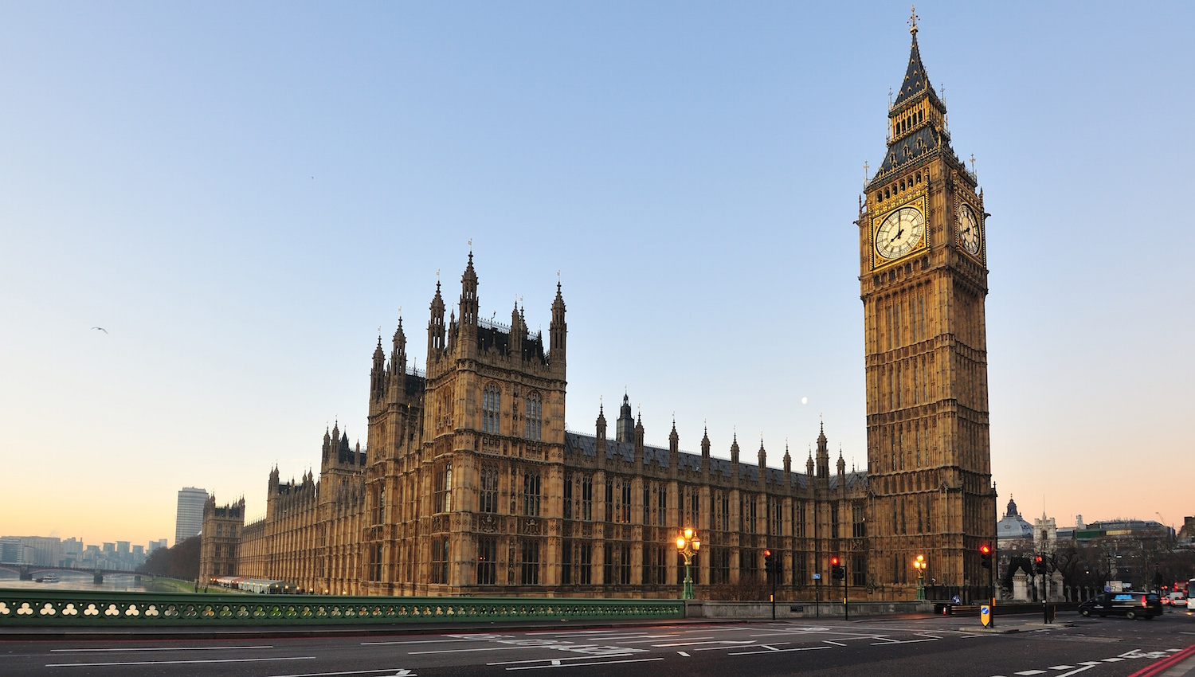
Big Ben is not a person,
Big Ben is not a clock,
Big Ben is not a tower,
It’s a bell. Ding – Dong!

