Slide 1
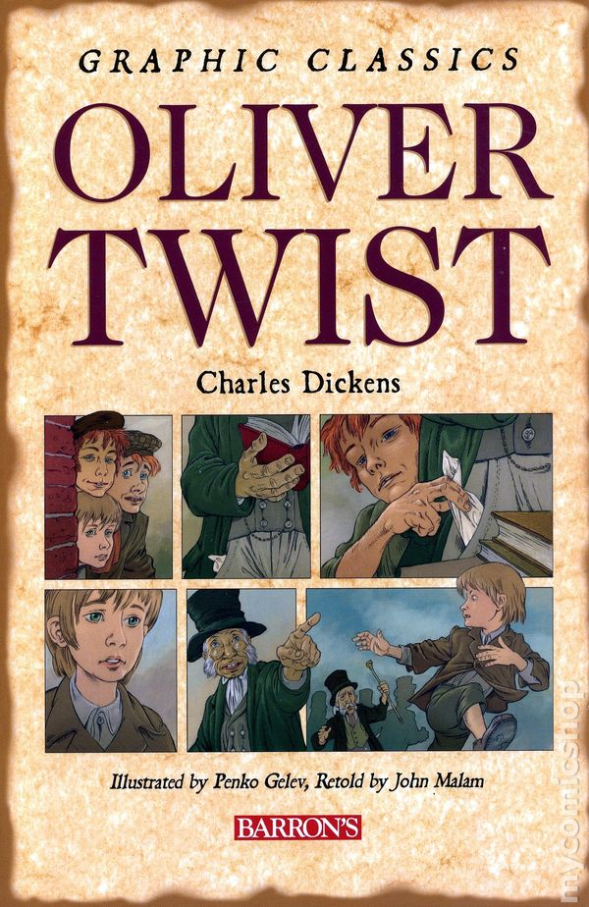
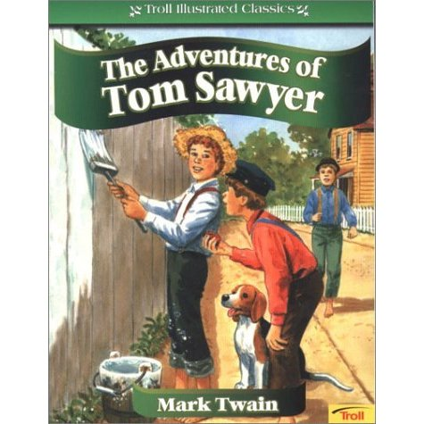
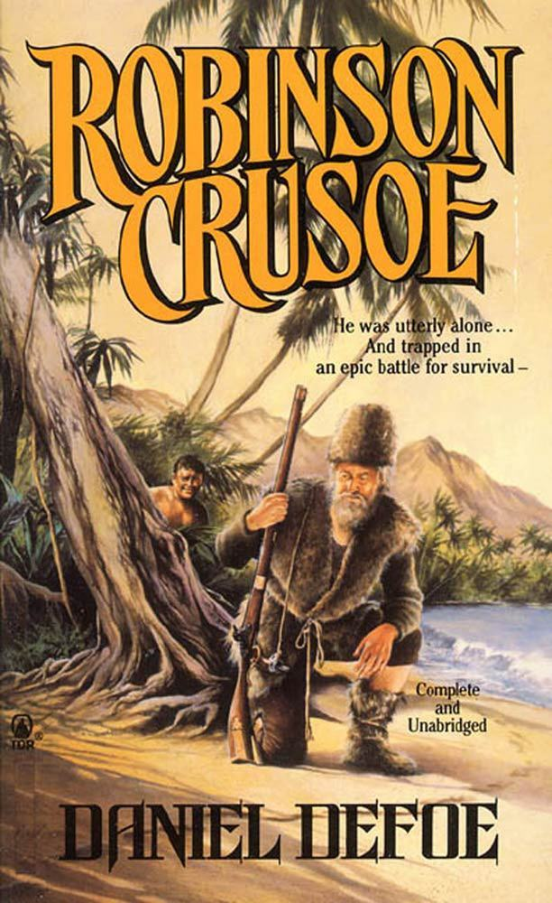
Books in our life

Slide 2
Samuel Clemens
Pamela Travers
Roald Dahl
Jonathan Swift
Sir Arthur Conan Doyle
Sir Walter Scott
Lewis Carroll
Joanne Rowling
Robert Louis Stevenson
Daniel Defoe
Herbert George Wells
Charles Dickens

Slide 3
I disagree
I’m afraid I have to disagree
I don’t support this idea
I totally disagree
I can’t agree with you
Sorry, but I think you are wrong
I don’t think so
I don’t share your opinion
You are mistaken
Certainly, not

Slide 4
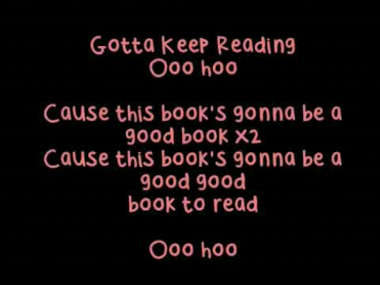

Slide 5
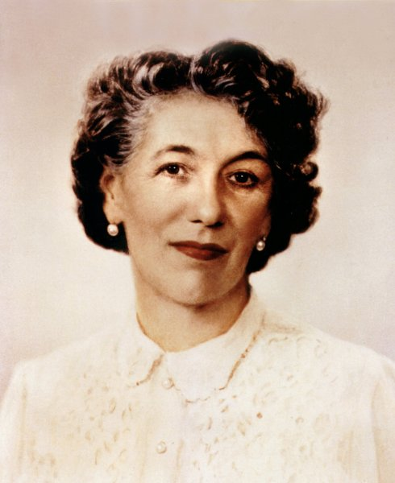
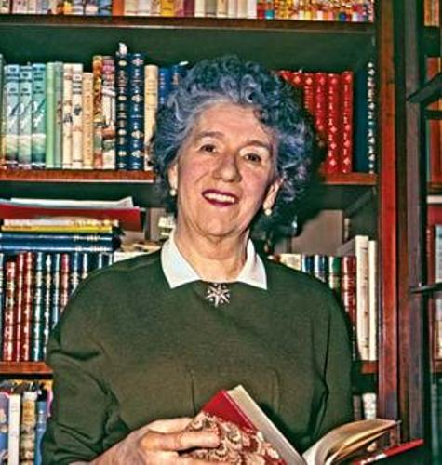
ENID MARY Blyton

Slide 6
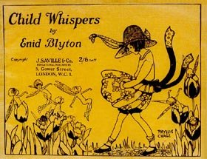
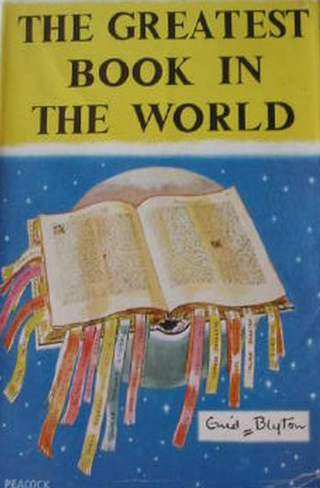
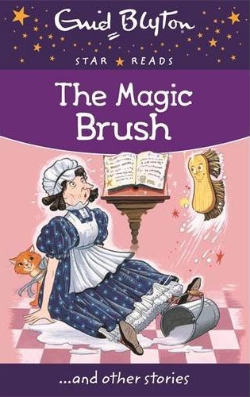
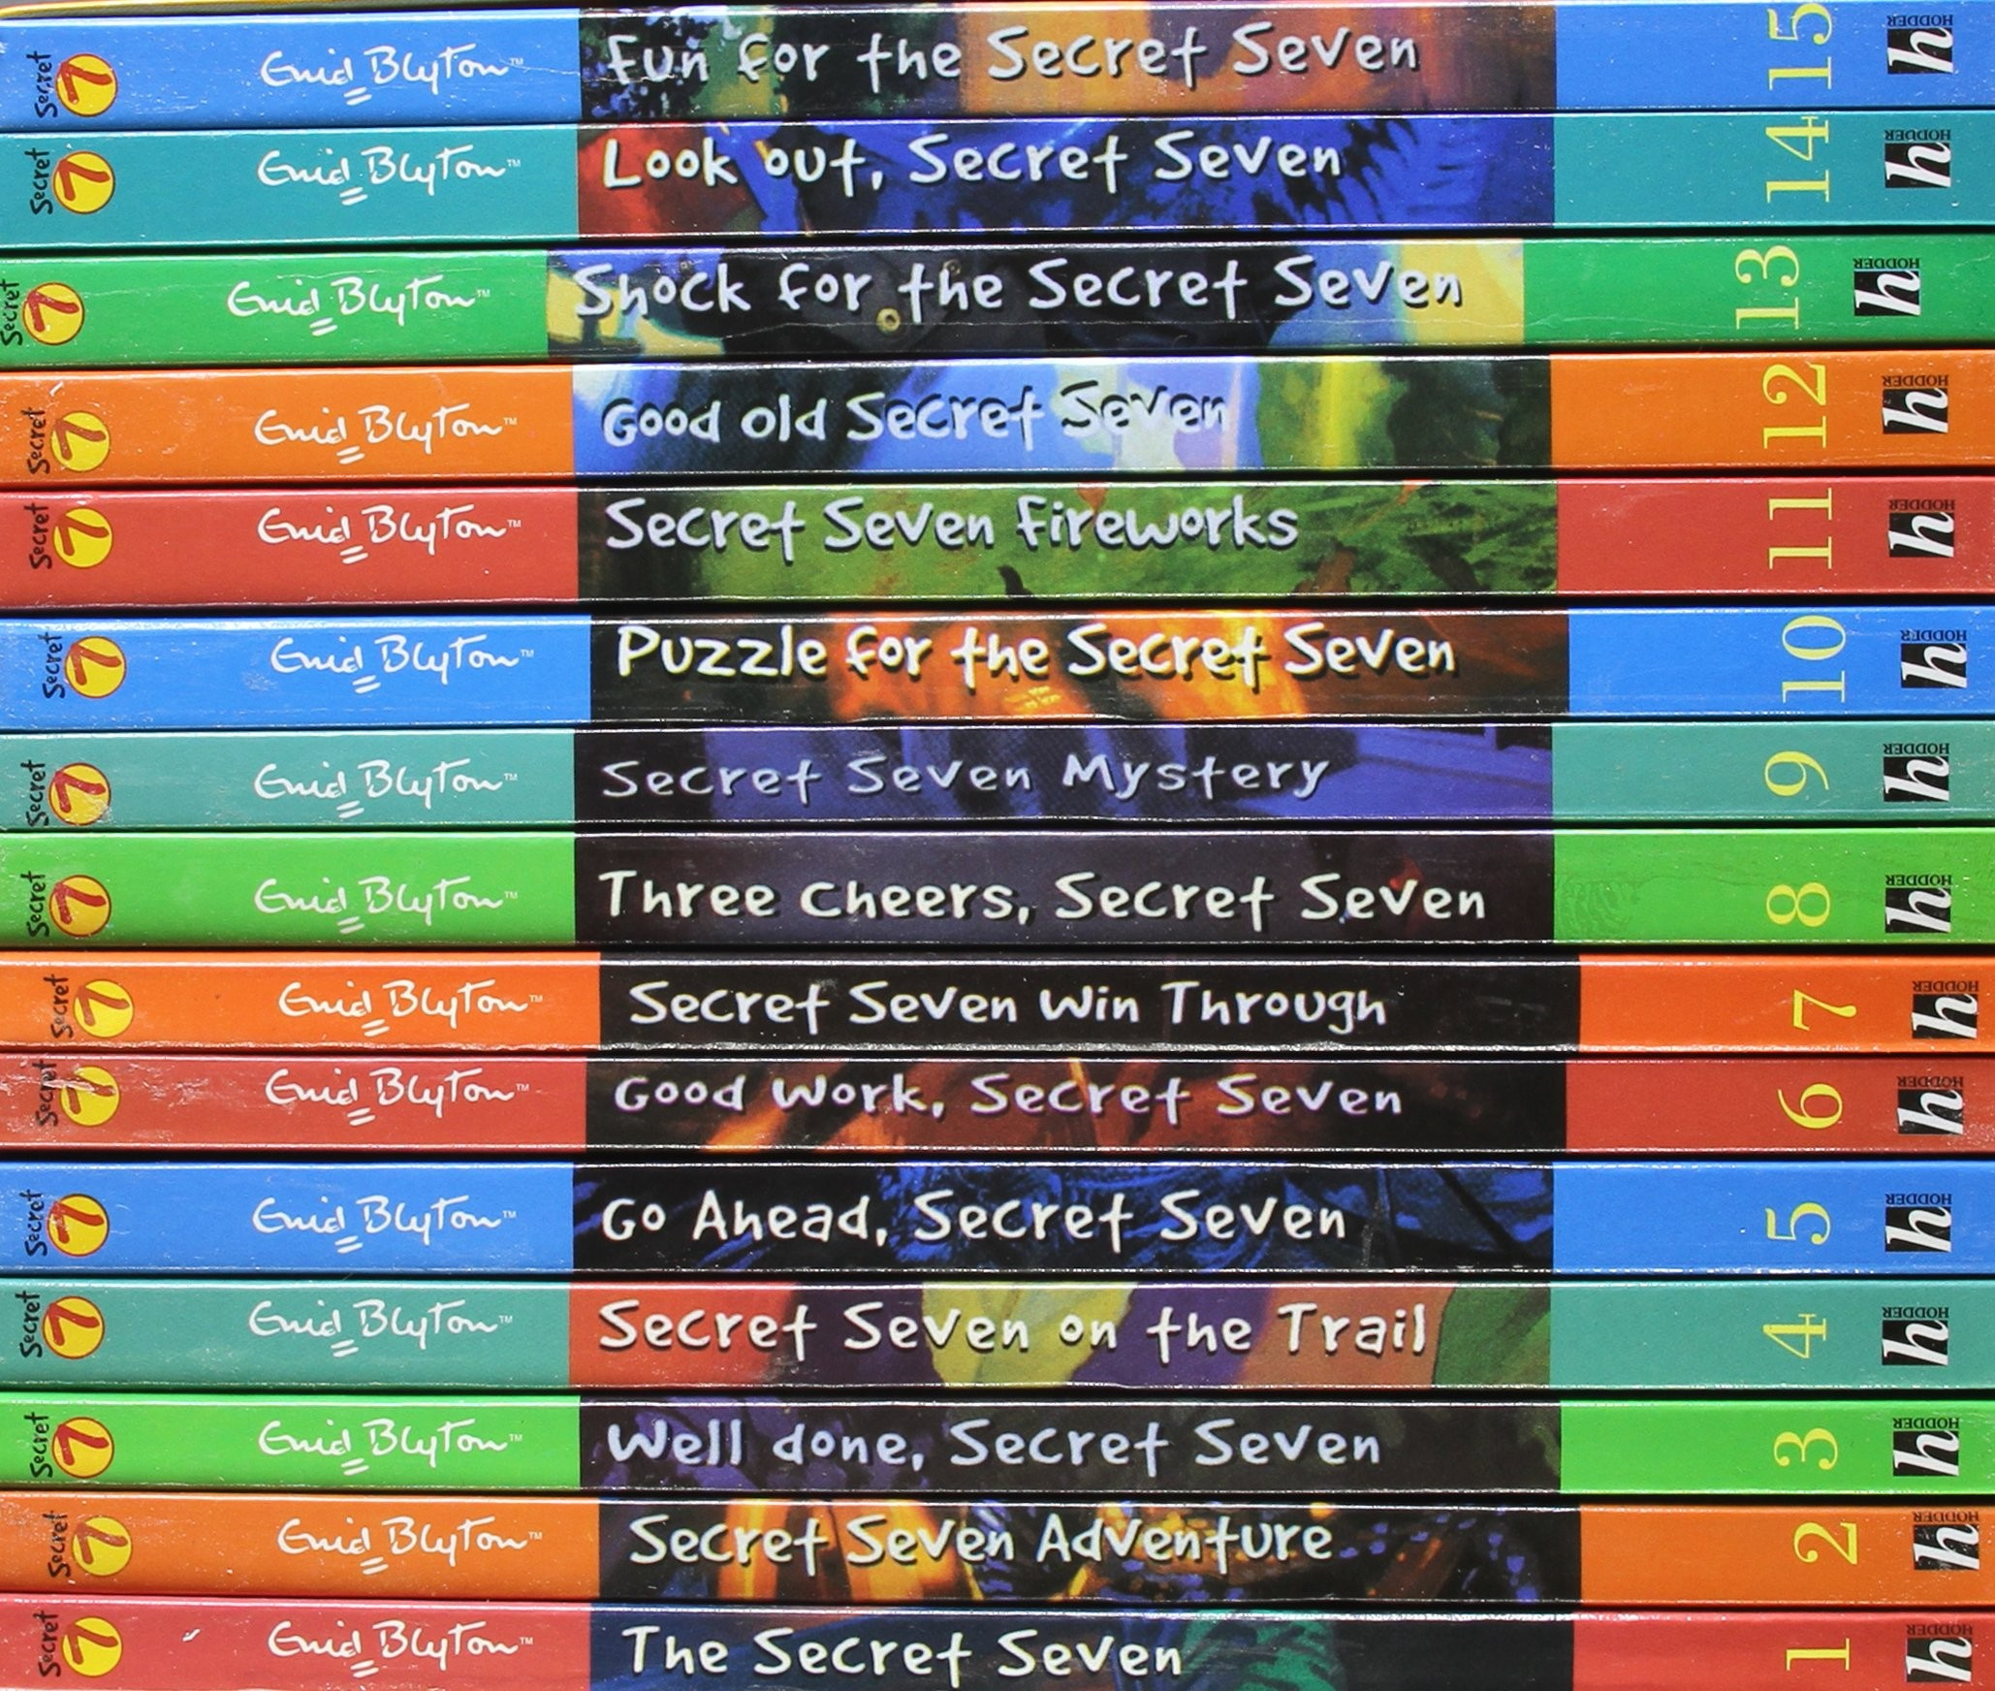

Slide 7
Subject matter of her books
Adventures, solving crimes
  Famous Five, Secret Seven and Adventure series
Boarding school story (day-to-day life at school)
  the Malory Towers stories, the St Clare’s stories, the Naughtiest Girl series
Fiction
  the Wishing-Chair books and The Faraway Tree

Slide 8
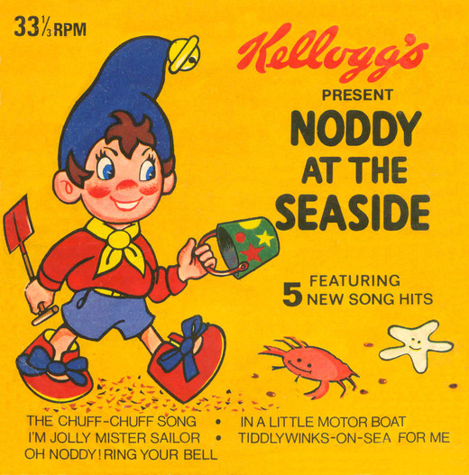
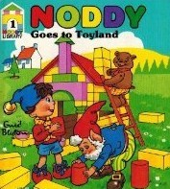
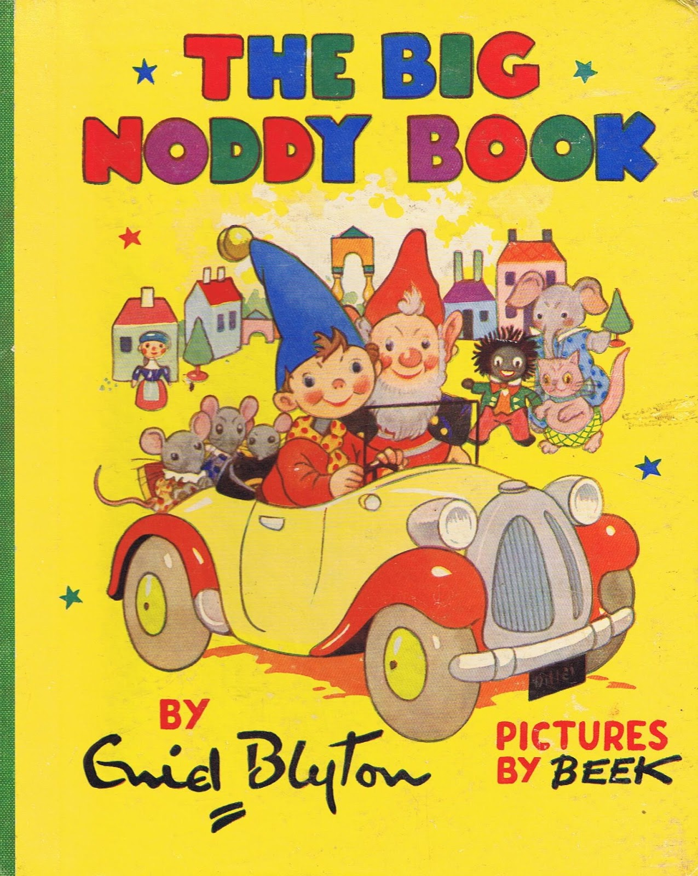
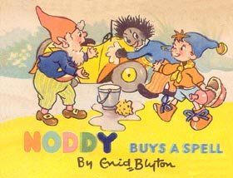
The noddy

Slide 9
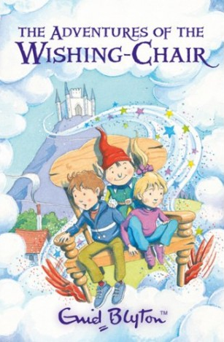
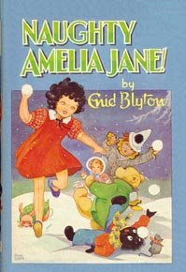
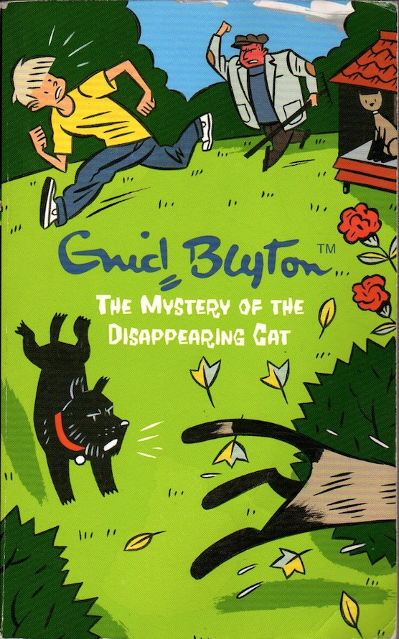
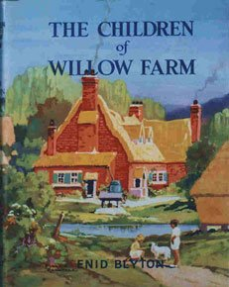
The famous stories

Slide 10
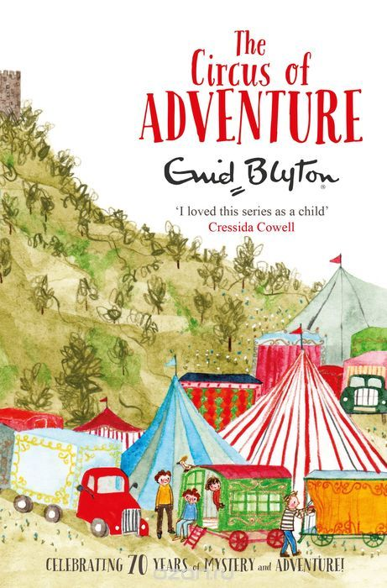
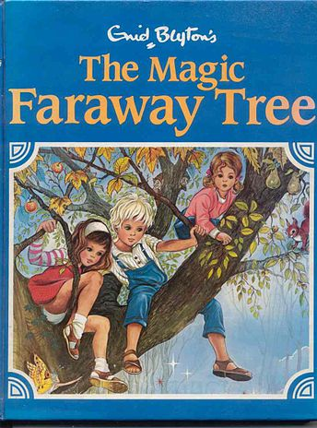
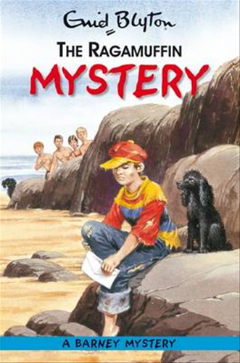
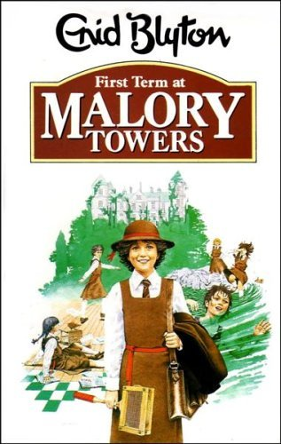
The most famous stories

Slide 11
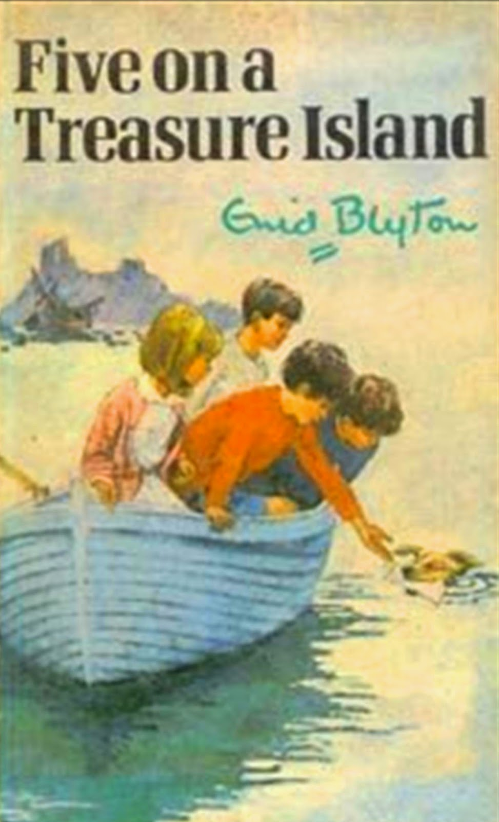
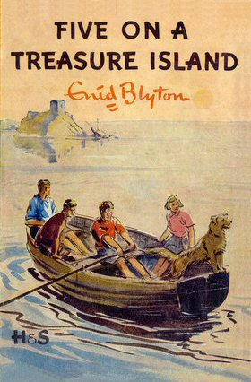
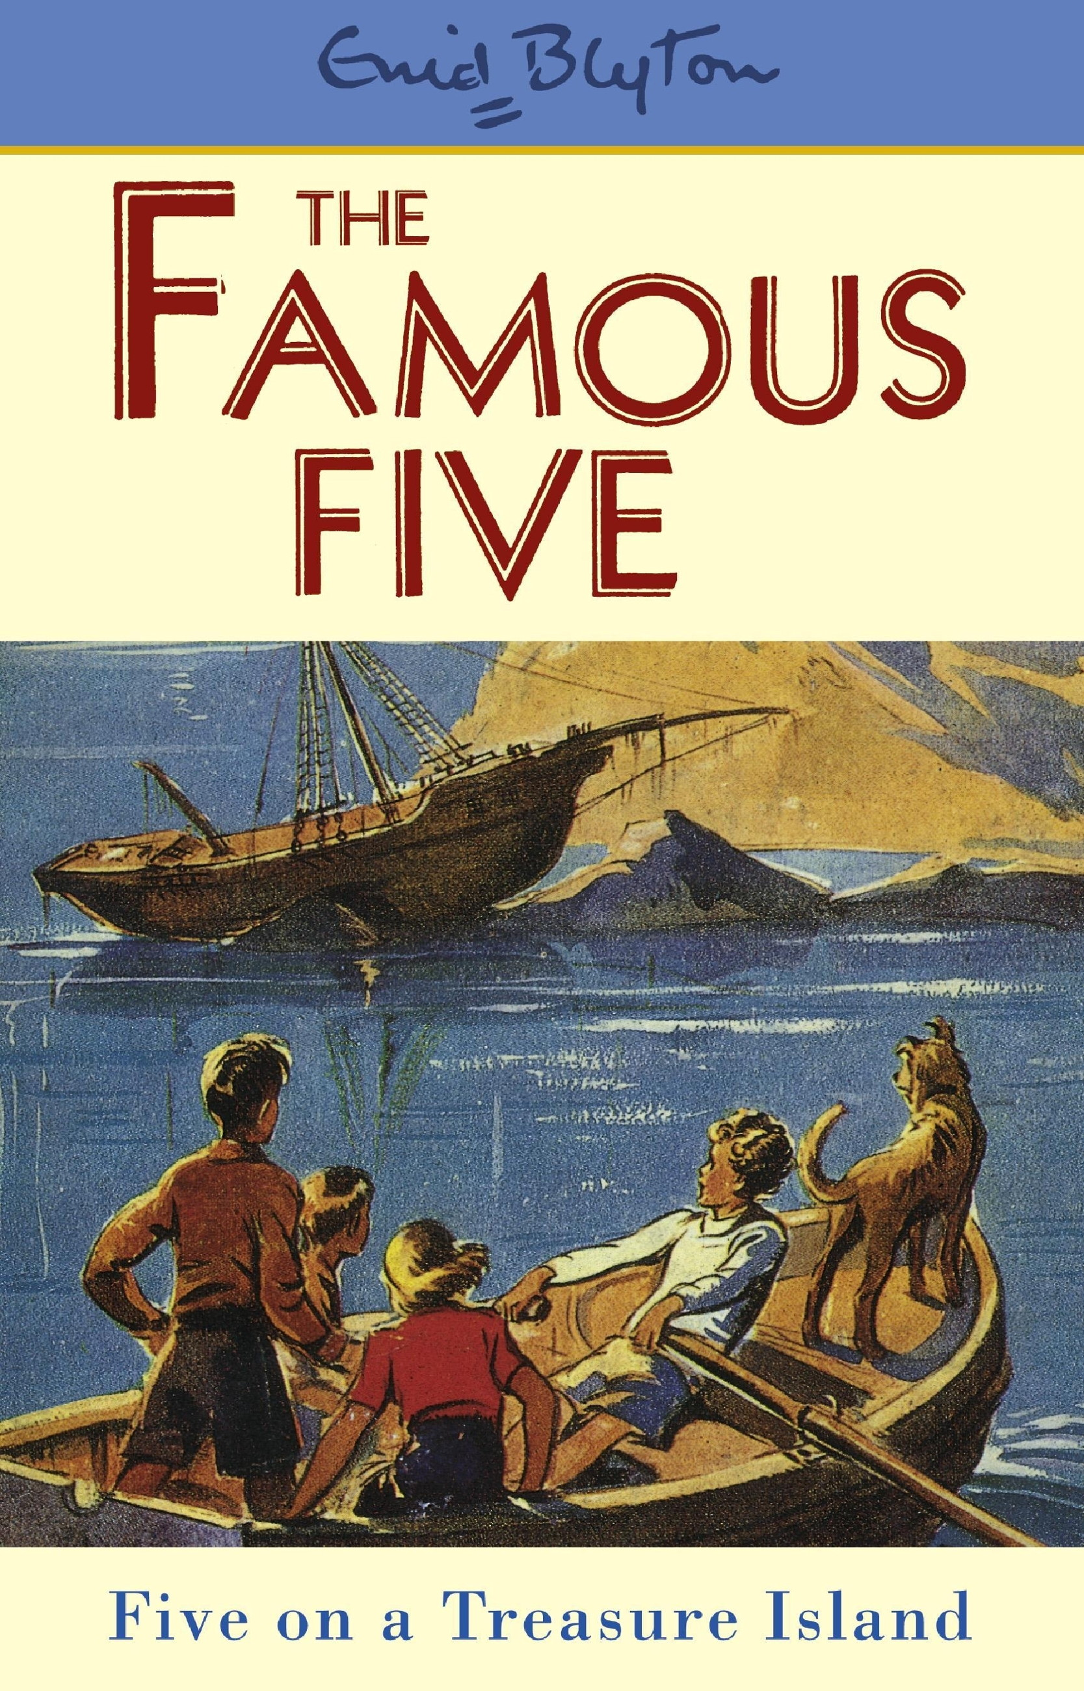
Five on a treasure island

Slide 12
As for me,…
As far as I’m concerned,…
In my opinion,…
To my mind,…
From my point of view,…
I think/believe/consider/reckon…
Personally, I think…
It seems to me that…
I’m convinced that…

