Slide 2
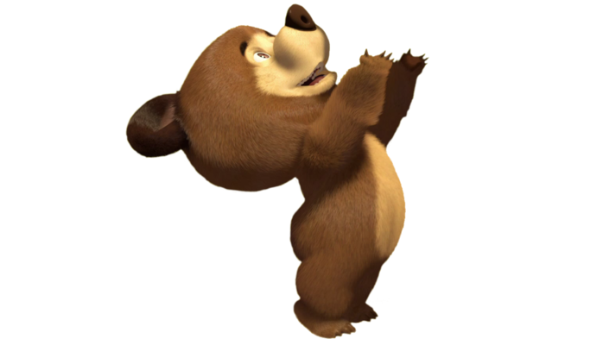

Slide 3
8 – 5 =
7 + 1 =
7 – 4 =
6 + 2 =
6 – 5 =
5 + 2 =
5 – 3 =
9 – 6 =
4 + 2 =
4 – 3 =
3 + 2 =
3 – 1 =
2 + 6 =
2 – 1 =
1 + 6 =
9 – 2 =

Slide 4
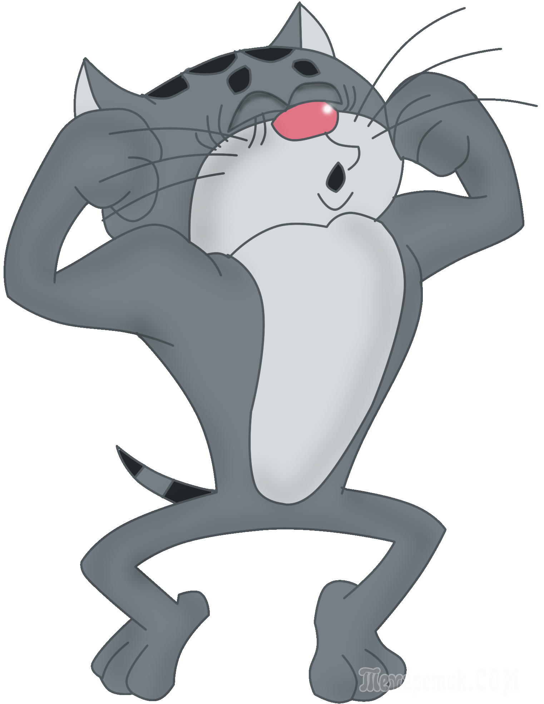
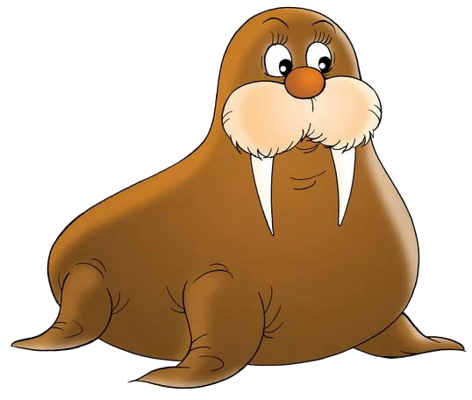
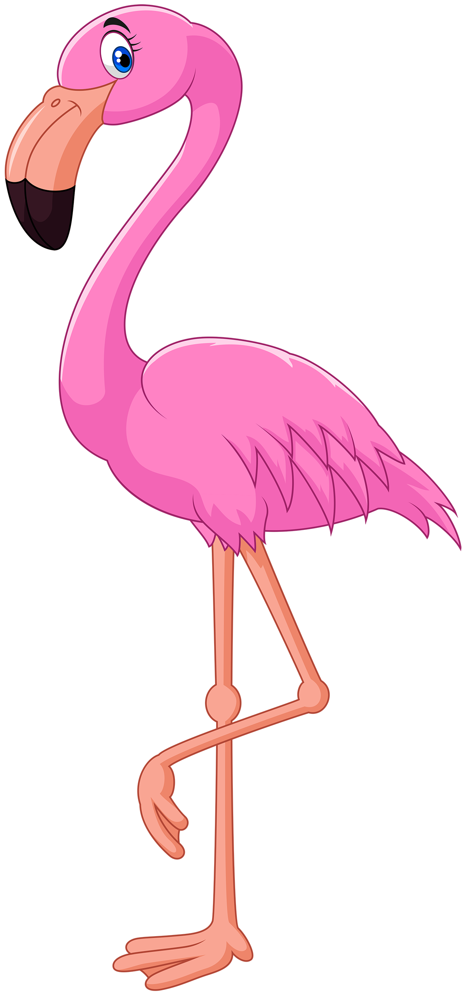

Slide 6
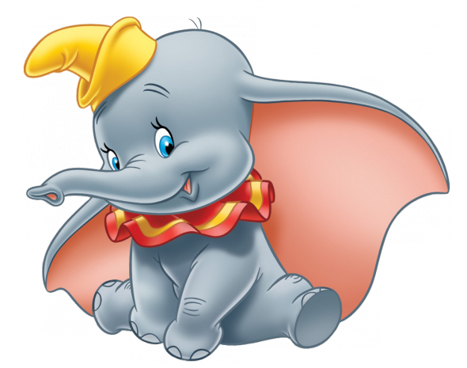

Slide 7
7 – 5 =
7 + 2 =
6 – 4 =
8 + 2 =
9 – 5 =
9 + 2 =
7 – 3 =
7 – 6 =
6 + 2 =
5 – 3 =
2 + 2 =
2 – 1 =
1 + 6 =
4 – 1 =
3 + 6 =
5 – 2 =

Slide 9
1 1 4 4
6 6 8 8

Slide 11
1 9 4
6 5 8 3

Slide 13
3 4 9
6 9 7 10

Slide 17
8 – 6 =
7 + 2 =
7 – 6 =
6 + 4 =
6 – 3 =
5 + 4 =
5 – 4 =
9 – 7 =
4 + 5 =
4 – 2 =
3 + 1 =
3 – 2 =
2 + 4 =
2 – 1 =
1 + 9 =
9 – 7 =

Slide 18
РАЗМИНКА

