Slide 1

Государственное автономное профессиональное образовательное учреждение
Свердловской области «Асбестовский политехникум»
Студент: Cтригулина Юлия Алексеевна
Специальность: 43.02.01 «Организация обслуживания общественного питания»
1 курс
Руководитель проекта: Чернова Ольга Александровна

Slide 2
Countries of the language being studied -yesterday, today, tomorrow
Sports traditions in the countries of the studied language

Slide 3
Table of Сontents
Introduction
Sports Traditions in The United Kingdom (England)
  Football (Soccer)
  Cricket
  Rugby
  Sports Traditions in the USA
  Basketball
  American Football
  Baseball
  Sports Traditions in Canada
  Ice Hockey
  Figure Skating
  Sports Traditions in New Zealand and Australia
  Australia and New Zealand – Two Water Sports States
  in OCEANIA
  Sports in New Zealand
  Sports in Australia
  Conclusion

Slide 4
INTRODUCTION
Dear Members of the Comission,
I am pleased to introduce my MPP presentation to you.
Aim of the presentation: studying of sports traditions in English-speaking countries.
When working on the topic I set following objectives:
Objective 1. Reviewing necessary sources on the topic.
Objective 2. Considering the sports that originate from other sports activities.
Objective 3. Demonstrating the rules of some games.
Objective 4. Showing what kinds of sport are the most popular in English-speaking countries.
So, allow me now to present you 5 English-speaking states with their own sports traditions. They are the United Kingdom, the USA, Canada, New Zealand and Australia. The last two of these are great water sports states.

Slide 5

Sports Traditions in the United Kingdom (England)

Slide 6
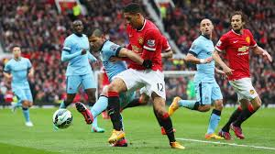
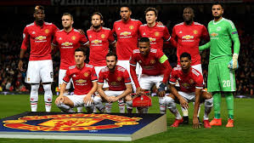
Football (Soccer)
Football is the most popular sport in England, and has been played for hundreds of years.
In the English Football League there are 92 professional clubs. These are semi-professional, so most players have other full-time jobs. Hundreds of thousands of people also play football in parks and playgrounds just for fun.
At its core, football is a game with two teams of eleven players, played over the course of 90 minutes. This period is split into two 45-minute halves. The objective of the game is to score more ‘goals’ than the opposition. The term ‘goal’ refers to two areas either side of the pitch, each one defended by one of the teams. A ‘goal’ is scored by depositing the ball into the opponent’s area.
Interesting fact: almost all ball sports came from England (football, basketball, volleyball, handball).

Slide 7
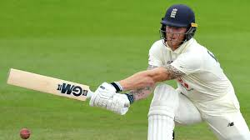
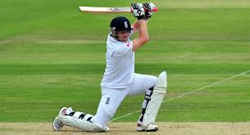
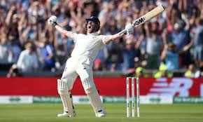
Cricket
Cricket is also a popular game in England. Cricket is played on village greens and in towns/cities on Sundays from April to August.
Teams are made up of 11 players each. They play with a ball slightly smaller than a baseball and a bat shaped like a paddle. Two batters stand in front of wickets, set about 20 meters apart.
Each wicket consists of three wooden rods (stumps) pushed into the ground, with two small pieces of wood (bails) balanced on top. A member of the opposing team (the bowler) throws the ball towards one of the batters, who must hit the ball so that it does not knock a bail off the wicket.
If the ball travels far enough, the two batters run back and forth between the wickets while the fielders on the opposing team try to catch the ball. The game is scored according to the number of runs, which is the number of times the batters exchange places.

Slide 8
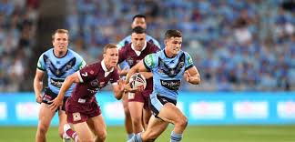
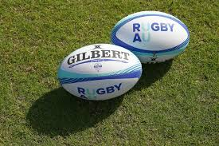
Rugby
It is similar to football, but played with an oval ball. Players can carry the ball and tackle each other. The best rugby teams complete in the Super League final each September.
For many years Rugby was only played by the rich upper classes, but now it is popular all over the country. There are two different types of rugby - Rugby League, played mainly in the north of England, and Rugby Union, played in the rest of England, Scotland, Wales and Ireland. England, Scotland, Wales and Ireland, together with France and Italy, play in an annual tournament called the Six Nations.

Slide 9

Sports traditions in the USA

Slide 10
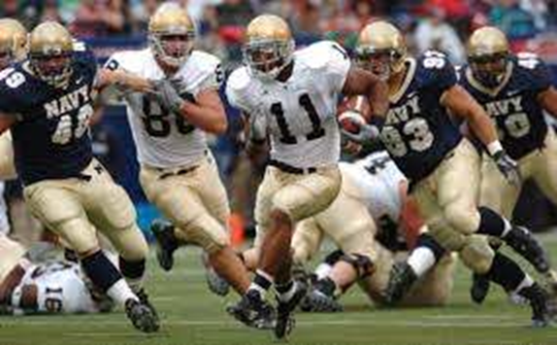
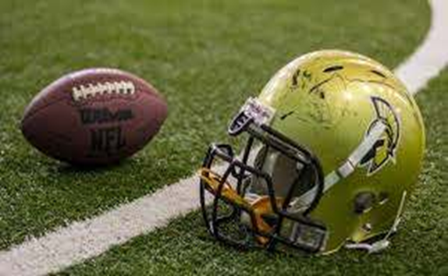
American Football
American football, known in the United States as soccer, is a contact team sport. It is attended by two teams of eleven players on each side.
Football is played with an oval ball on a rectangular with slingshot gates at both ends. A team must have possession of the ball to move it into the goal area by carrying or passing the ball. First, one of the teams must advance the ball 10 yards (4 attempts are given).
American football evolved from the early forms of rugby and soccer commonly referred to as soccer in the United States. It is believed that the first game was played on November 6, 1869, according to one of the soccer rules. In 1880, Walter Camp, known as the "Father of American Football," was the first to change the undefined rules of the game to specific ones: he introduced snap, reduced the number of players to eleven. The new rules legalized the forward pass, the creation of a neutral zone, and the width of the pitch.

Slide 11
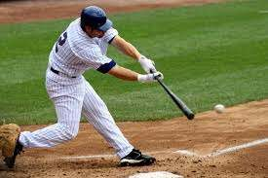
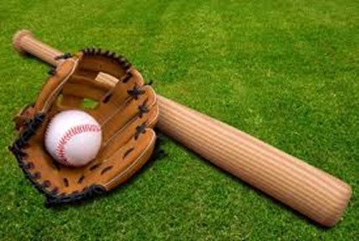
Baseball
Baseball is a nine-a-side game played with bat, ball, and glove, mainly in the U.S.A. Teams consist of a pitcher and catcher, called the battery, first, second, and third basemen, and shortstop, called the infield, and right, center, and left fielders, called the outfield. Substitute players may enter the game at any time, but once a player is removed he cannot return.
The object of each team is to score more runs than the other. A run is scored whenever a player circles all the bases and reaches home without being put out. The game is divided into innings, in each of which the teams alternate at bat and in the field. A team is allowed three outs in each half inning at bat, and must then take up defensive positions in the field while the other team has its turn to try to score. Ordinarily, a game consists of nine innings; in the event of a tie, extra innings are played until one team outscores the other in the same number of innings.
An umpire-in-chief "calls" balls and strikes from his position directly behind the catcher at home plate, and one or more base umpires determine whether runners are safe or out at the other three bases.

Slide 12
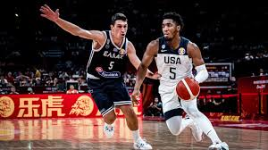
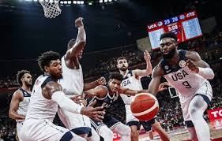
Basketball
(Composed of basket and ball)
The game of basketball was fashioned from fragments of other games, seeking to eliminate flaws of rugby, soccer. Basketball was first played in the United States. In fact, the first game was played at one training school, now called Springfield College.
Basketball is a simple game. The equipment used in the game is also very simple. In addition to the field itself, all that is needed for a game is a ball. The very first ball that was used was a soccer ball until 1894 when an actual «basketball» was invented. The basketball ball was slightly smaller, about 30 inches in diameter. The first baskets that were used, were two peach baskets hung from the balcony of the gymnasium.
By 1898, basketball leagues were starting to form in the United States. In 1898, professional basketball was being played. The league was called the National Basketball League (NBL). The National Basketball League was made up of four teams like New York, Philadelphia, Brooklyn and New Jersey.
At this time, basketball was increasing in popularity. Nowadays it is played by 176 nations.

Slide 13

Sports Traditions in Canada

Slide 14
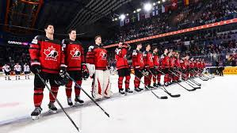
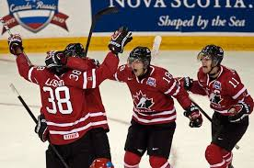
Ice Hockey
Ice hockey is one of the most action-paced of sports, demanding skillful skating, expert stick-handling, and masterly puck control.
The game developed in the frozen expanses of North America, and a hundred years ago became the national winter sport of Canada. It also became very popular in the northern states of the United States, and later spread to Europe, Japan, and even to Australia.
Originally the leagues and national competitions in Canada were amateur. In 1917 the first professional league was formed, the National Hockey League (or NHL), with four clubs - Montreal Canadians, Montreal Wanderers, Ottawa Senators, and Toronto Arenas. Later clubs were formed in American cities, and the NHL spread to the United States. In 1972 a rival professional organisation was formed, the World Hockey Association (or WHA).
In 1893 Lord Stanley, the Governor-General of Canada, presented a silver trophy, the Stanley Cup to the winners and play-offs for the Stanley Cup began, which then became the symbol of professional hockey supremacy.

Slide 15
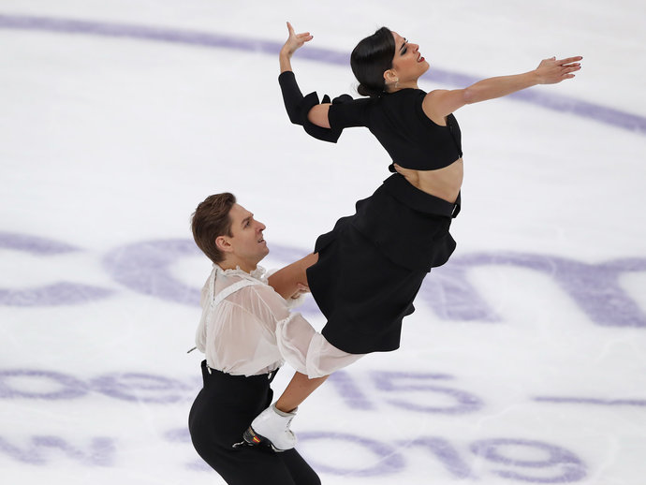
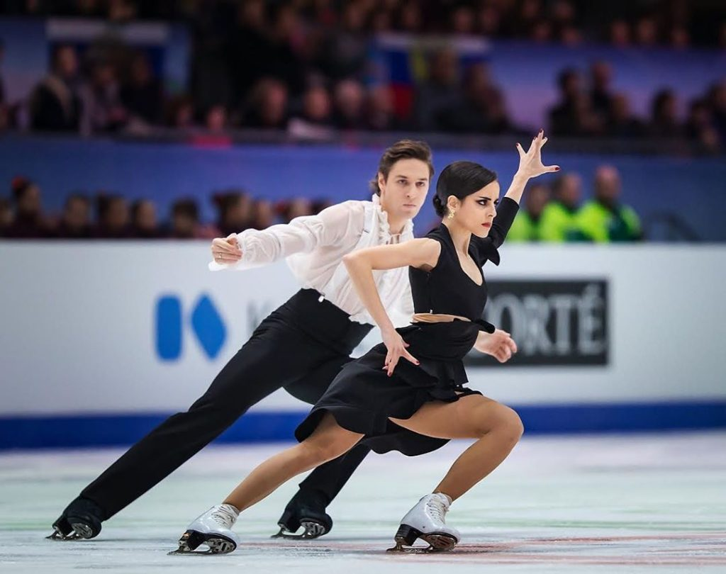
Figure Skating
Figure skating is certainly a special kind of sports. It is famous for its artistic beauty. There are three types of figure skating: single skating, pair skating, and ice dancing. Of special significance are the so-called compulsory movements.
Marks are awarded for technical merit and for artistic impression. Judges give marks to each competitor individually and the winner in each part is the skater or pair or dance couple placed first by majority of judges.
Single scating consisits of: original programme that includes compulsory movements and free skating. As to pair skating, it consists of: an original programme and free skating. There are certain movements that are forbidden. For example, lifting is permitted only with the hands.
People often have their favorites and they watch every move of the competitors. They are strict about the compulsory programme movements. Scandals happen but very rarely because everyone is so attentive.

Slide 16
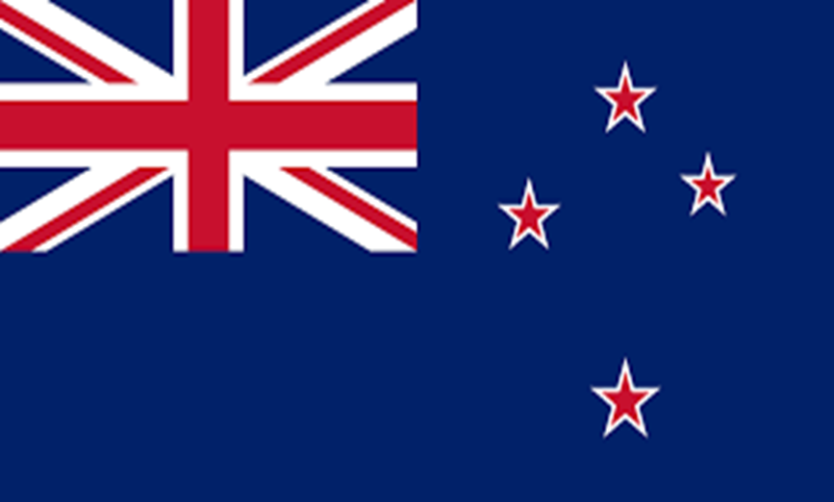

Sports traditions in
New Zealand
Australia

Slide 17
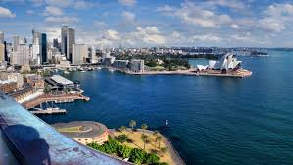

Australia and New Zealand
Two Water Sports States
in OCEANIA

Slide 18
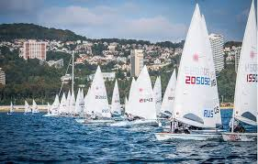

Sports in New Zealand
New Zealand is an island country located in the southwest of the Pacific Ocean. It is therefore quite predictable that water activities such as swimming, diving, surfing, windsurfing and water skiing are very popular with New Zealanders.
However, sailing takes a special place among all of the water sports activities. The world-famous New Zealand city of Auckland alone has around 30 ocean beaches and over 10 harbor beaches.
One of Auckland's nicknames, the "City of Sails", is derived from the popularity of sailing in the region. 135,000 yachts and launches are registered in Auckland, and around 60,500 of the country's 149,900 registered yachtsmen are from Auckland, with about one in three Auckland households owning a boat.

Slide 19

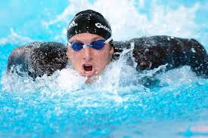
Sports in Australia
Sport plays an important role in the lives of Australians. In most cases, Australians prefer swimming, diving, soccer, cricket and netball. Swimming is probably the most common activity among youth, with about 50% of the country’s pre-teens taking part. Children are encouraged to swim at an early age, so they usually take swimming classes while in primary school.
Water sports are especially popular because so many people live near to the sea and in 10 per cent of Australian gardens there is a swimming pool.
Almost everyone learns to swim, and Australia has had some great swimmers. The most recent was Ian Thorpe, who began swimming for Australia at the age of fourteen, and later won six Olympic gold medals.

Slide 20
Conclusion
When working on the topic, I reviewed and studied much different information.
I also learned that games such as rugby and American football originated from English football.
My examination of the rules of English football, cricket and baseball let me come to the conclusion that the games of cricket and baseball are in general similar sports activities.
In the study of the issue I have concluded that people from English-speaking countries are great sports lovers. In the Olympics they are usually awarded many gold medals. The great swimmer Ian Thorp from Australia is one of them.
As for me, I play volleyball and take swimming classes. Doing these sports activities helps me build my character.
I think if you understand the importance of good health and fitness and you work out hard every day, you can become a man of discipline.
In addition, we all know that a healthy mind lives in a healthy body, that is why so many people are engaged in exercising and sports.

Slide 21
Thank you very much for your attention!

Slide 22
Источники информации
https://multiurok.ru/files/sportivnyie-traditsii-vielikobritanii.html
http://www.learnenglishbest.com/topic-ice-hockey.html
https://may.alleng.org/engl-top/366.htm
https://online-teacher.ru/study/sport-in-australia
https://s-english.ru/topics/klass-11/figure-skating
http://tooday.ru/?l=eng&r=8&t=tennis-tennis-81
http://www.correctenglish.ru/reading/topics/golf/
http://www.esuhorses.com/razvitie-konnogo-sporta-kanady-ot-aborigenov-do-segodnya/
https://en.wikipedia.org/wiki/Auckland

