Slide 1
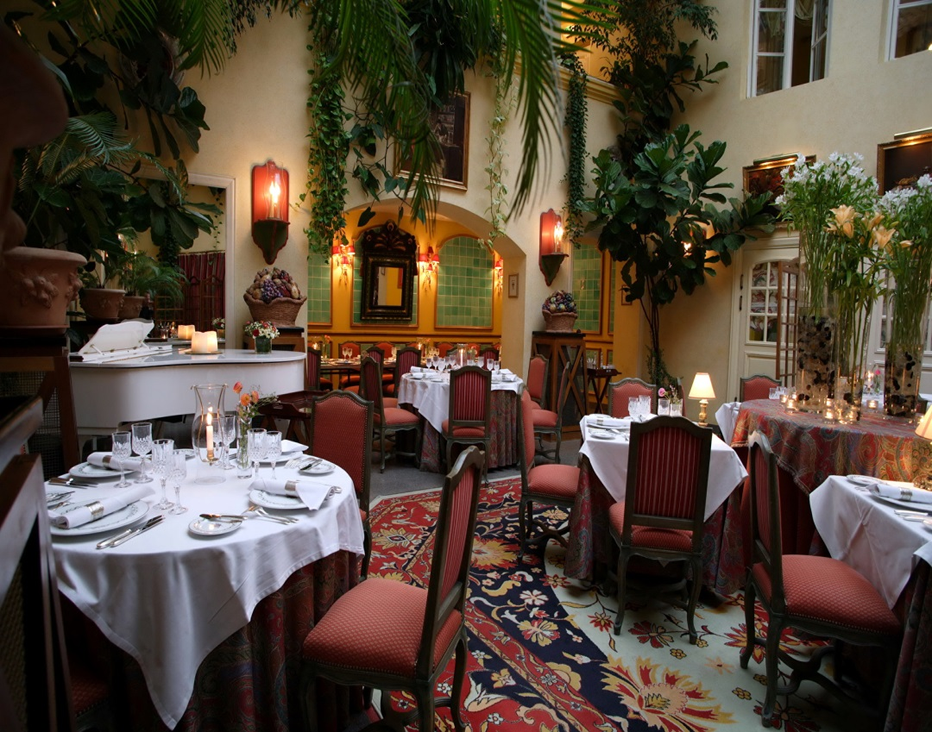
How to Write a Restaurant Review
Материал подготовлен по УМК «Spotlight 10» О.В Афанасьева
Module: 6e
Тема:« Как написать отзыв о ресторане».
Составила: Учитель МАОУ «СОШ № 40»
Трибунская Е.В.

Slide 2
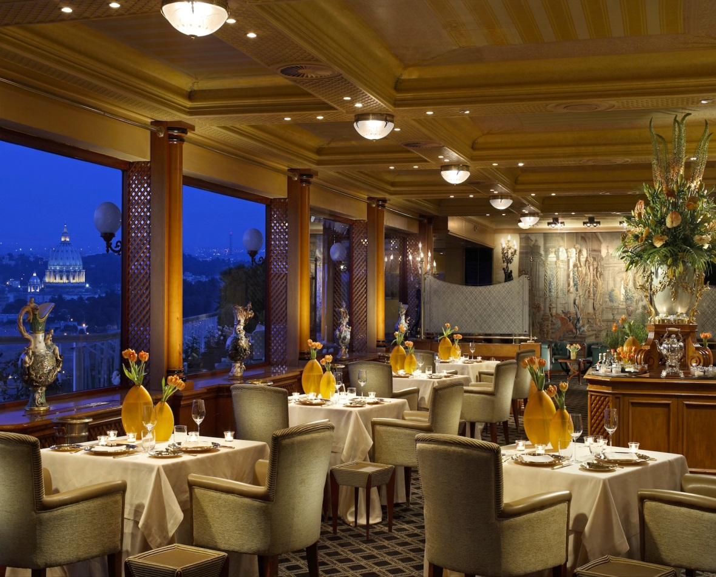
Plan
Introduction
Food and Prices
Service
Atmosphere
Conclusion

Slide 3
Introduction
I would like to tell about my favourite restaurant which is called Tripadvisor. This French restaurant is located in one of the central streets. It is a very cosy place with a quiet and relaxing atmosphere. In front of the entrance there is a summer terrace where guests can enjoy a light business lunch or a cup of delicious French coffee.

Slide 4
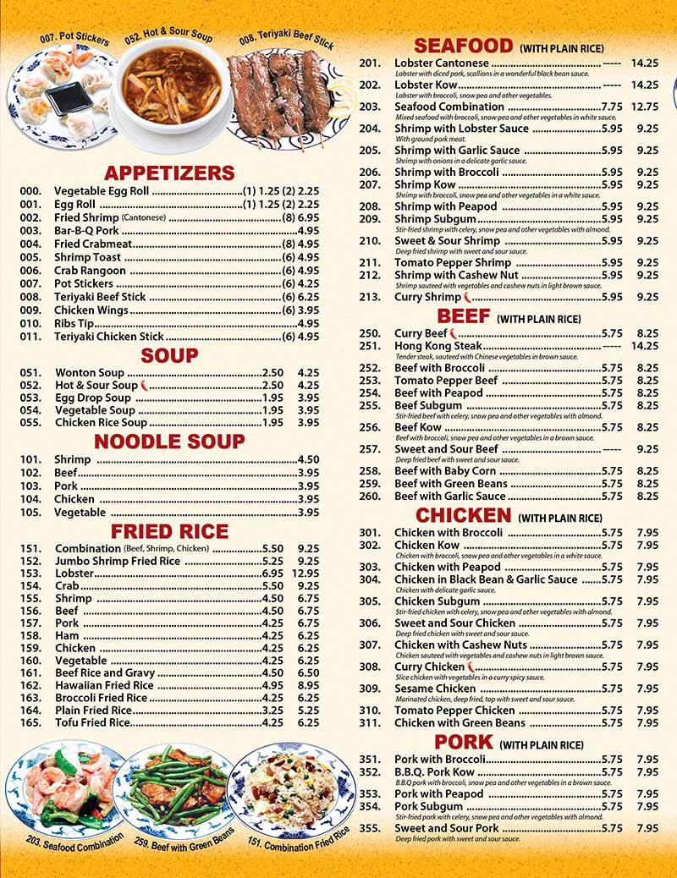
Food and Prices
Mainly there are dishes on the menu. Guests can order fresh pizza, delicious pasta as well as excellent meat and fish specialties. A wide range of salads and snacks is also served here. After a lunch or dinner, you will be offered to try one of the wonderful desserts. Prices in this restaurant are affordable.

Slide 5
Food and Prices
Mainly there are French dishes on the menu. Guests can order fresh pizza, delicious pasta as well as excellent meat and fish specialties. A wide range of salads and snacks is also served here. After a lunch or dinner, you will be offered to try one of the wonderful desserts. Prices in this restaurant are affordable.

Slide 6
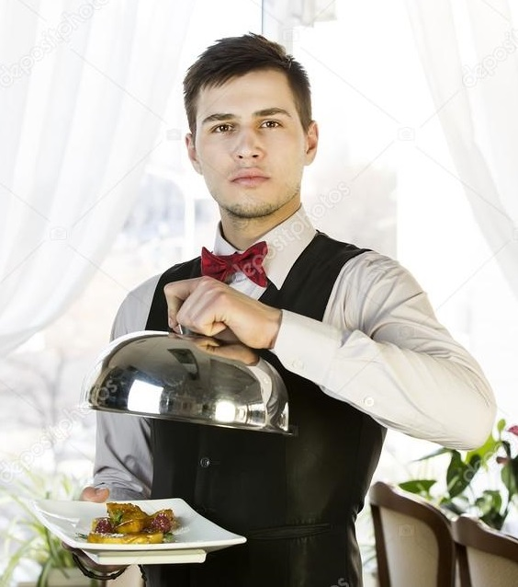
Service
The waiting staff will be happy to give all the information about new and specialty dishes.

Slide 7
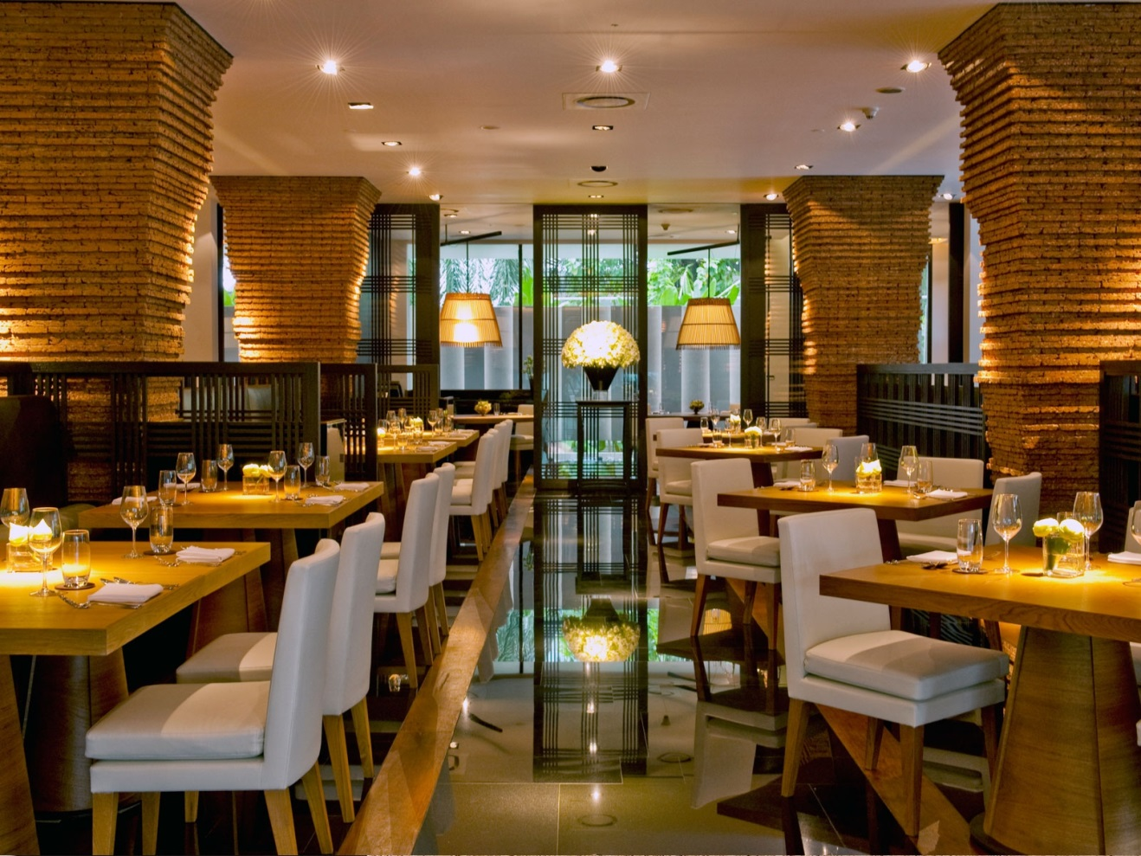
Atmosphere
The air-conditioned spacious dining room is elegantly decorated in warm tones. Quiet music is played in the background.
The appeal of Tripadvisor is its informal and relaxed atmosphere. Although it can get somewhat busy at times this is unavoidable for such a popular place.

Slide 8
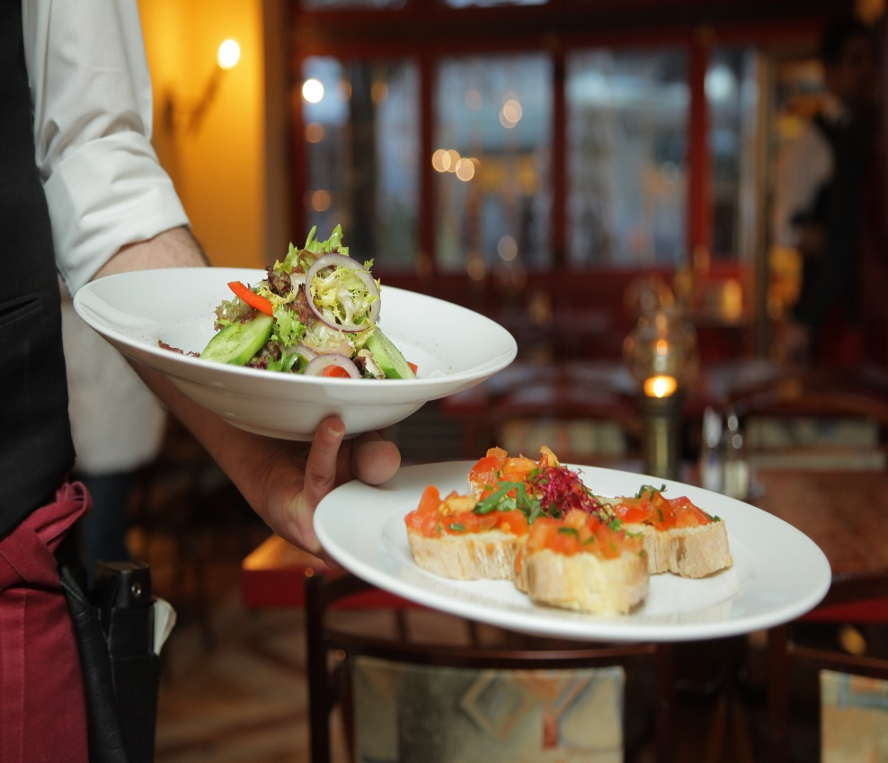
Conclusion
It offers outstanding food, great service and unforgettable entertainment!

