Slide 1

Breakthrough
Technologies

Slide 2
Quantifiers and countable/
uncountable nouns
A quantifier is a word or phrase which is used before a noun to indicate the amount or quantity: 'Some', 'many', 'a lot of' and 'a few' are examples of quantifiers.
Quantifiers can be used with both countable and uncountable nouns.
Example: He's got only a few dollars.

Slide 3
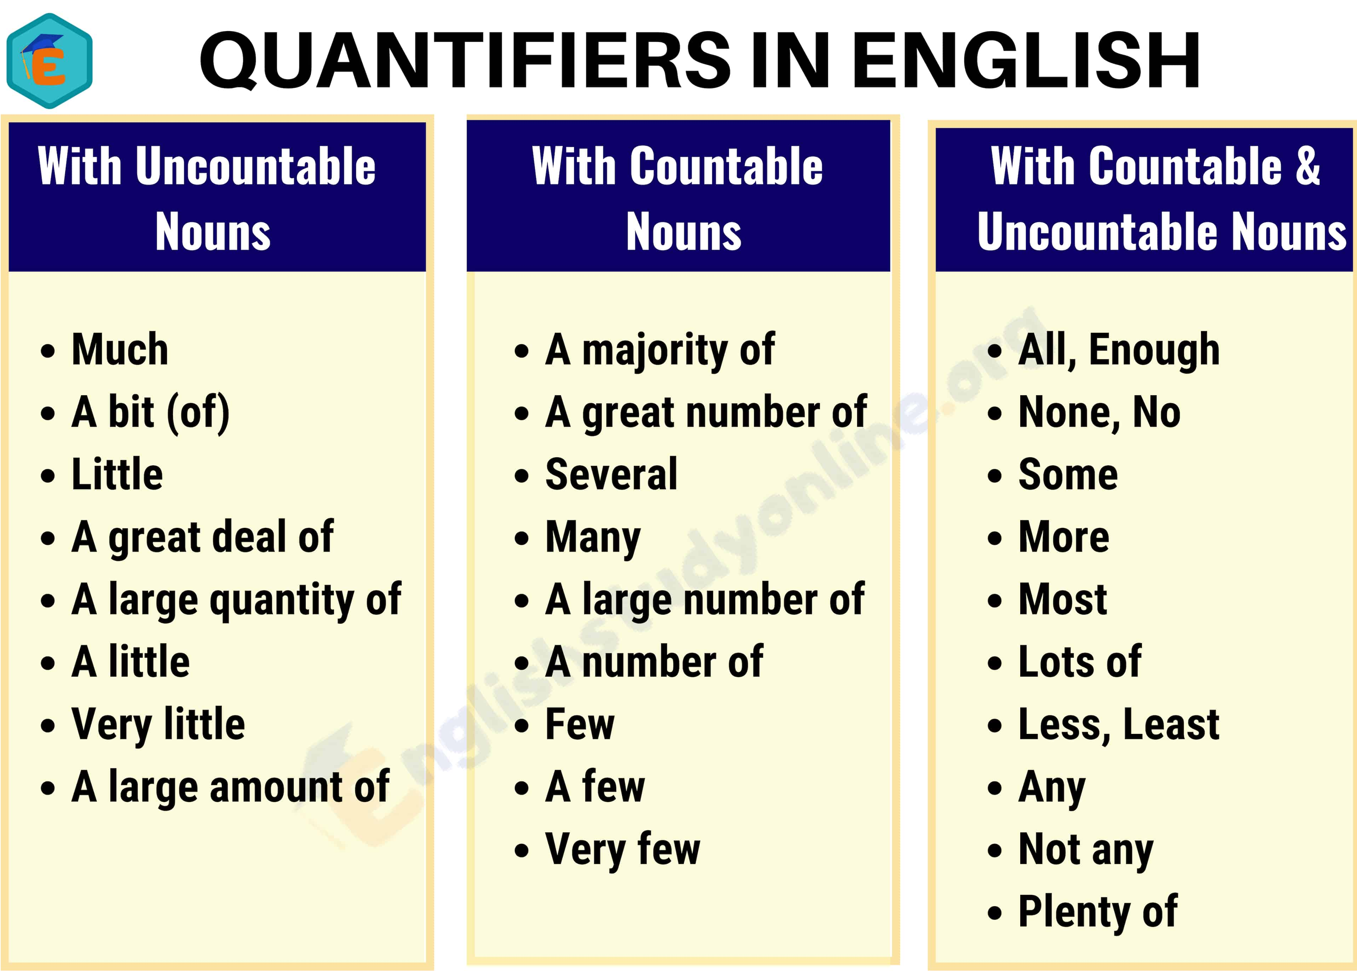

Slide 4
How do you use quantifiers with countable and uncountable nouns?
Quantifiers can be used with both countable and uncountable nouns.
Examples:
There are some books on the desk
He's got only a few dollars.
How much money have you got?
There is a large quantity of fish in this river.
He's got more friends than his sister.

Slide 5
Указатели количества
many, much, (a) few, (a) little.
much с неисчисляемыми, а
many с исчисляемыми существительными в значении «много»;
аналогично little / few в значении «мало, недостаточно»,
аналогично a little / a few в положительном смысле в значении «немного»,
much/ a lot / little после глагола в качестве наречий.

Slide 6
Fill the gaps with
many, much, few, little
It was not a secret, very ______ people knew about it.
I was a secret, very ____ people knew about it.
She ate so ______ apple pie yesterday that she is never going to eat it again.
They ate so _____ oranges that they had a stomachache.
We can’t get into the taxi, we are too ______
They were _____ and decided not to attack.
My sister did a lot of shopping and spent
________ money.
many
few
much
many
little
few
much

Slide 7
Write your opinion to the topic:
‘Will robots have an ability to think?’ Write 1 detailed paragraph.
Tips for writing:
Write your opinion
Include reasons and examples
Use linking words
Use topic-related vocabulary accurately
Use future active and/or passive and/or Future Continuous forms

Slide 8
Future Continuous
- будущее длительное время
Время Future Continuous указывает на процесс, который будет длиться в определенный момент в будущем.
В отличие от времени Future Simple , этот момент в будущем должен быть назван прямо (tomorrow at 4 o’clock, when we meet) или быть очевидным из контекста.
We will be cooking breakfast the whole morning

Slide 9
Правила образования
Future Continuous
Время Future Continuous образуется при помощи вспомогательного глагола
will (shall) + be c причастием настоящего времени (to be + глагол с окончанием -ing).
Will + be V ing

Slide 10
Когда употребляется
Future Continuous?
Future Continuous употребляется для выражения какого-то действия в определенный заранее известный момент в будущем. Это может быть конкретное время или день или даже год.
This time next week Mary will be playing piano
I will be washing the car when he leaves
They will be driving home the whole next day

Slide 11
Topic 1. Robots in the Future
Three teenagers answered the question ‘Would you be happy to have robots in your life in the future?’
Write the response that will present your own ideas.
You can use some ideas from the table.
Pay attention at the usage of linking devices.
Jessica | I think it would be really cool to have a robot to do all the housework in my home. Robots could do all those jobs I hate like doing the washing up and tidying my room. Remember about the 3 d’s – Robots tend to do work that is dirty, dangerous or dull.
Steve | I find the idea of robots looking like, and even acting like humans, pretty scary. It is like one of those disturbing futuristic science fiction films.
Kim | It’s like any new technology. You have to learn to use it wisely. We will soon get used to more robots in our lives.

Slide 12
Topic 2. Capability of Human Brain.
Look at the text below. Write the response that will present your own ideas if it is a good or bad idea to change something in human brains.
Pay attention at the usage of linking devices.
You can use some ideas from the text.
“Researchers found a special gene. It is in mice.
It could help us forget painful memories. Many people have painful memories that make them ill. The illness is called post-traumatic stress disorder (PTSD). Researchers want to change painful memories into nice thoughts and feelings. This would help millions of people with PTSD.”
You can use the following linking words:
Further, furthermore, moreover, in addition, additionally, then, also, too

Slide 13
Choose ONE of the cards
and answer the questions
In your speaking you should:
try to keep the conversation going;
use topic-related vocabulary;
use infinitives and gerunds.
Card 1
What is nanotechnology?
Do you know of any examples of nanotechnology?
When do you think nanotechnology will be a widely used part of our life?
Why do you think people are interested in nanotechnology?

Slide 14
Card 2
What is stress?
What causes stress?
Have you been under stress recently?
How does stress affect you?
Card 3
What images spring to mind when you hear the word 'robot'?
If you had a robot, what would you like it to do?
Will robots ever like identical to humans? Why yes/ Why not?
What will happen if robots take over the world one day?

