Slide 1
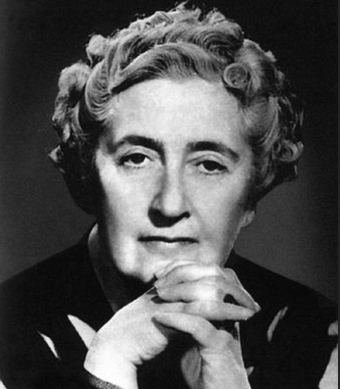
Agatha Christie
Выполнила Шнуровозова Ульяна студентка группы 21 Ихор.

Slide 2
Agatha Christie is known all over the world as the Queen of Crime. She wrote 78 detective novels, 19 plays, and 6 romantic novels

Slide 3
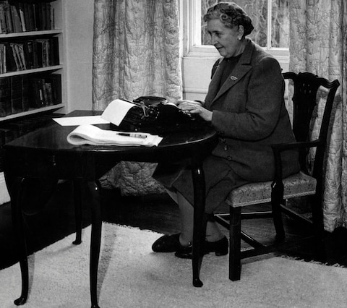
Many of her novels and short stories have been filmed. The Mousetrap, her most famous play, is now the longest-running play in history of world theatre.

Slide 4
Agatha Christie became generally recognized in 1926, after the publishing of her novel "The Murder of Roger Ackroyd". It is still considered her masterpiece.

Slide 5
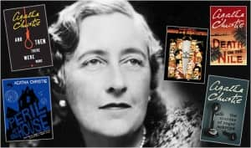
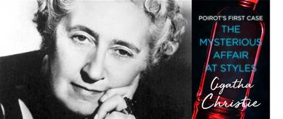
Her books have been translated into 103 foreign languages.

Slide 6
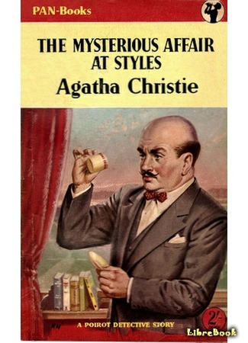
She began writing at the end of the First World War. Her first novel, "The Mysterious Affair at Styles" was published in 1920

Slide 7
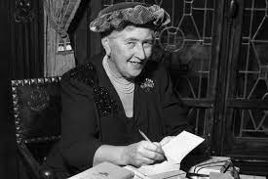
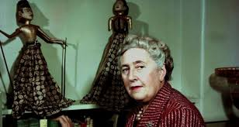
Agatha Christie's success with millions of readers lies in her ability to combine clever plots with excellent character drawing* and a keen sense of humour with a great observation.

Slide 8
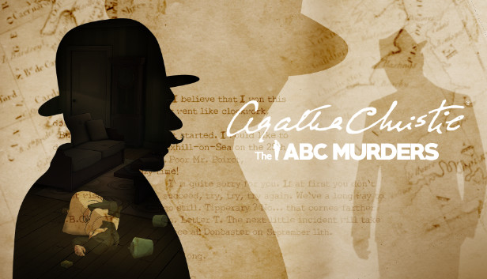
Her plots always mislead the reader and keep him in suspense

Slide 9
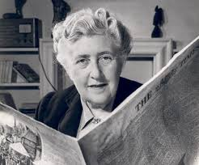
Agatha Christies language is simple and good and it is pleasant to read her books in the original.

Slide 10
http://english-lessons-online.ru/chitalka/topics/znamenitosti-1

