Slide 1
I'm glad to see you.

Slide 2
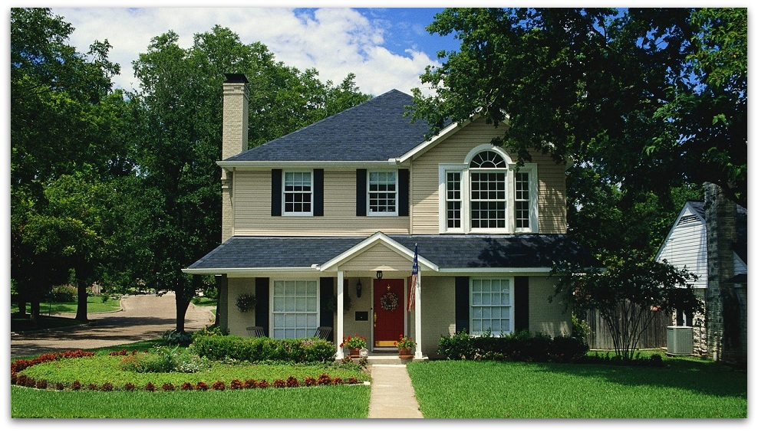
The topic: «Welcome to my house».

Slide 3
East or West, home is best.
2. There is no place like home.
3. My house is my castle.
4. Home, sweet home.

Slide 4
Make the sentences with the construction
«there is, there are».
1. There/ the/ plate / on / apples/ are.
is/ a / on / lamp / the / table/ There.
2. There / on / the / street/ is/ a / dog /on.
in / the /vase /There/ flowers/ are.
3. There/ in /Moscow /are/ hotels / many.
books / There /two /are/ on/ shelf /the.
4. cats /There /not / the / are / in street.
is/ car /There /a/ in /the /street.

Slide 5
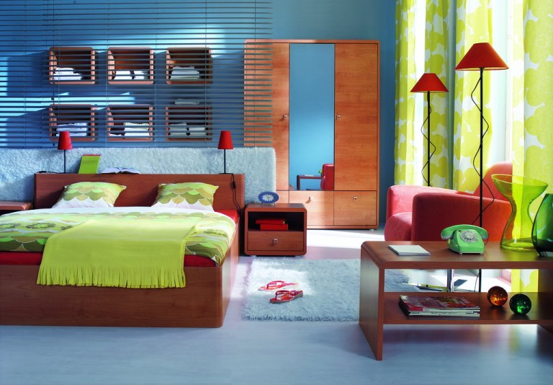

Slide 6
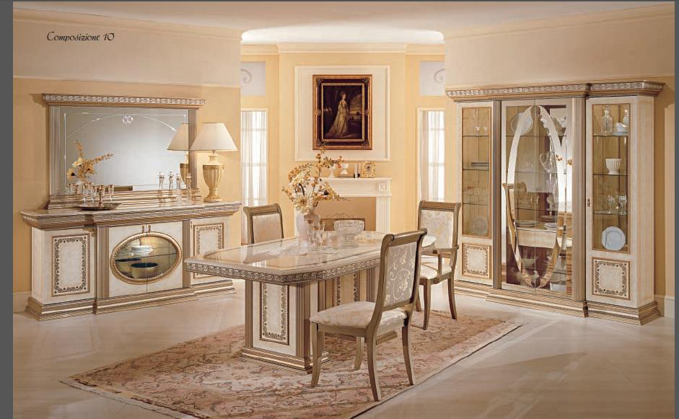

Slide 7
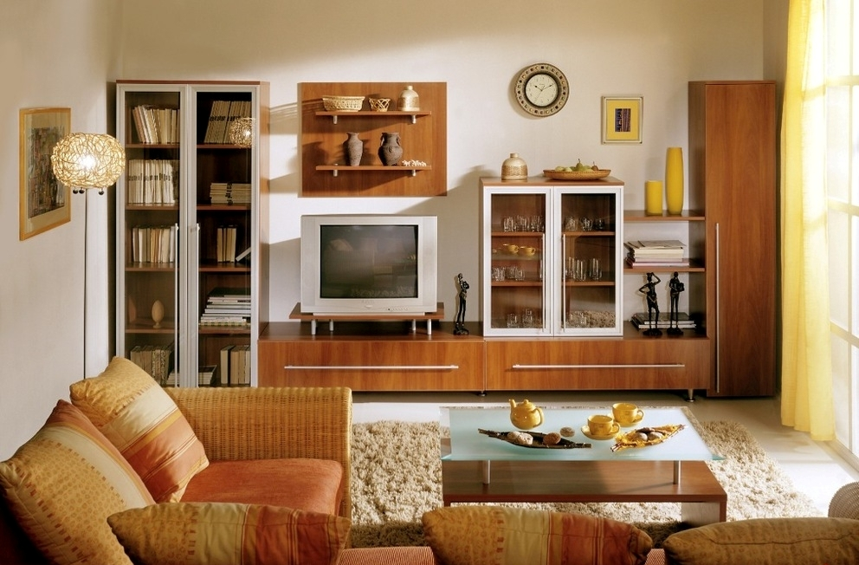

Slide 8
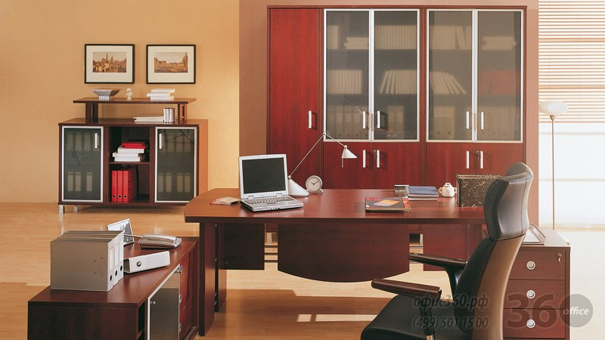

Slide 10
I like the lesson, because it was…
(interesting, happy, good).
I don’t like the lesson, because it was not… (interesting, happy, good).

Slide 12
Thank you for the lesson.

