Slide 1
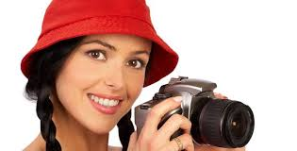
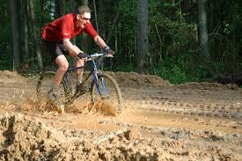
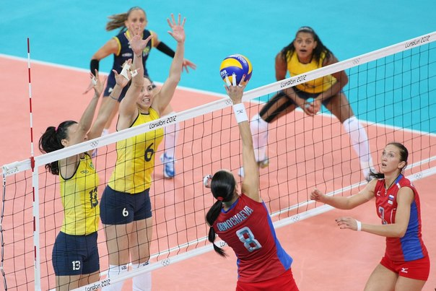
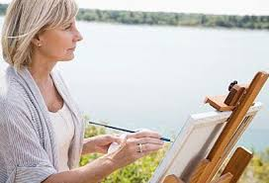
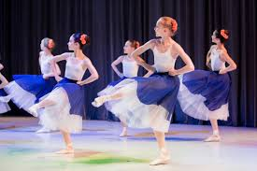
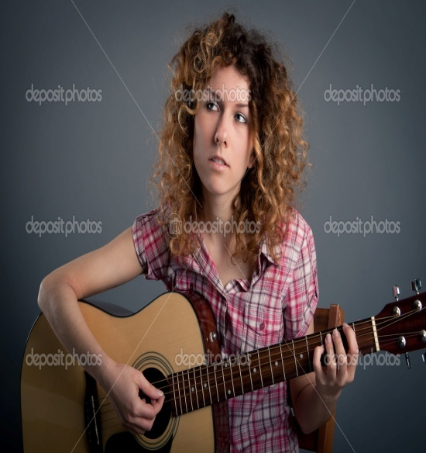
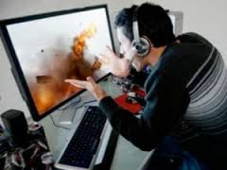
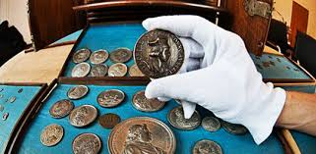
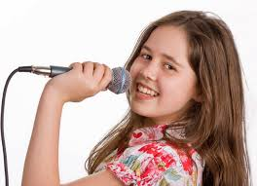

Slide 2
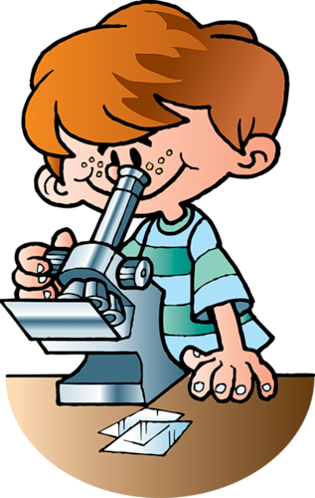
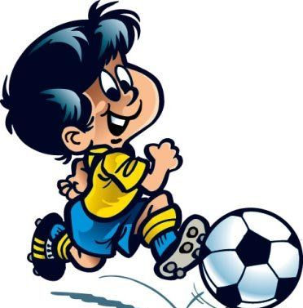
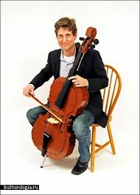
Hobbies and interests

Slide 3
What hobbies are popular among American children?

Slide 4
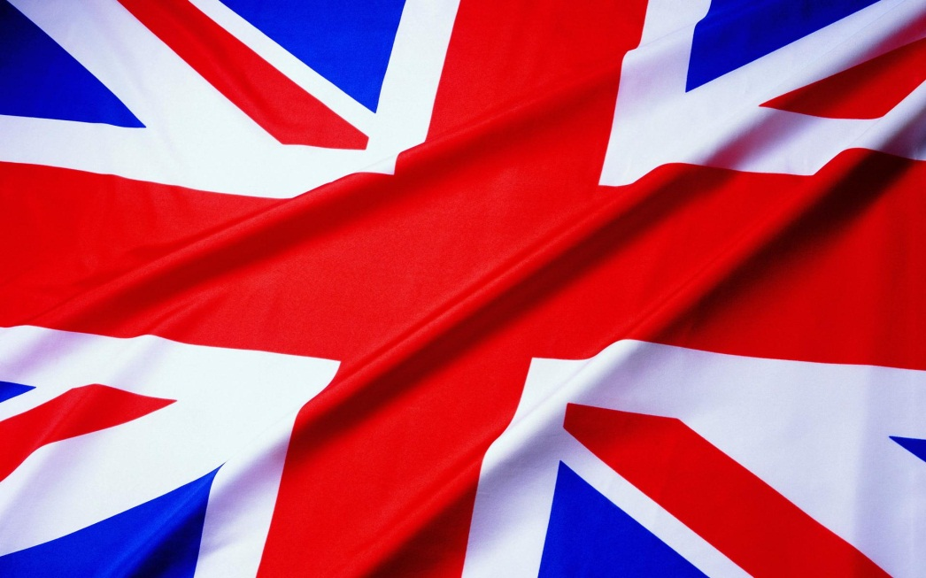
What hobbies are popular among English children?

Slide 5
The ABCs BAND (Jan,Mish,Dima and Louise)
Listen to ……
….. the guitar
Read an exciting…….
Play the …..
Go out (ride) on the …… …….sport on TV
Go out with friends
Chat on the …….
Relax at home
….. the bass
……. soccer cards
Visit cool ……

Slide 6
https://www.youtube.com/watch?v=tzFESmpc6mo
Песня

Slide 7
Listen to music
Play the guitar
Read an exciting book
Play the drums
Go out on the bike
Watch sport on TV
Go out with friends
Chat on the phone
Relax at home
Play the bass
Collect soccer cards
Visit cool museums
The ABCs BAND (Jan,Mish,Dima and Louise)

Slide 8
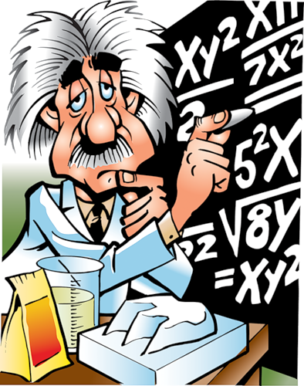
Do we have the same hobbies with American and English children ?
???

Slide 9
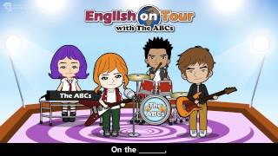
What musical instruments can they play?

Slide 10
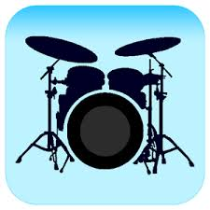
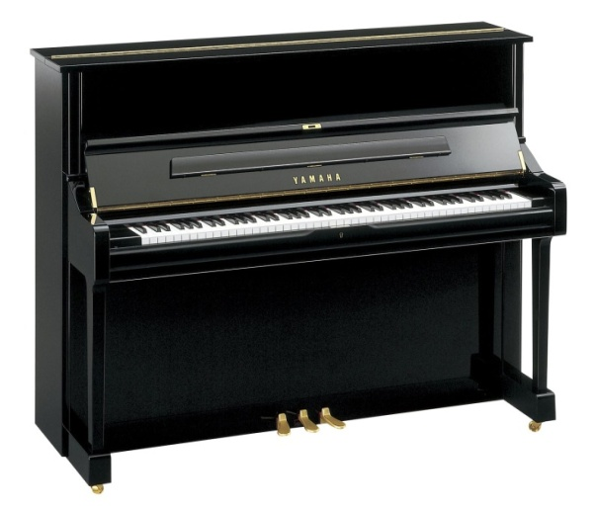
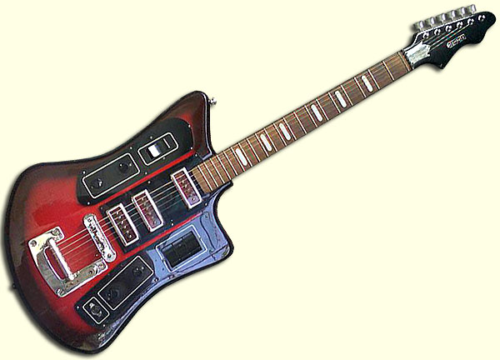
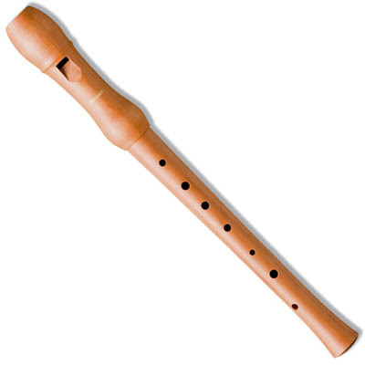
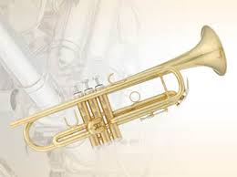
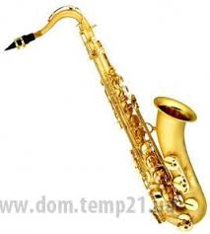
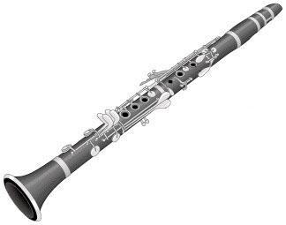
Trumpet
Flute
Cello
Piano
Drums
Clarinet
Electric guitar
saxophone

Slide 11
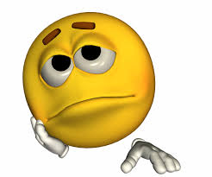
INTEREST METER
1
Be
2.
a) Not very interested in
b) Mad about
C )Very interested in
d) Not interested in
e) Interested in
3…………
4………..
5………….

Slide 12
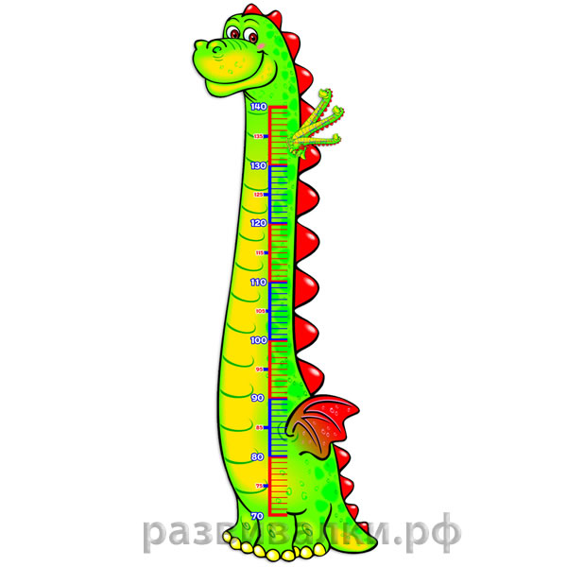
INTEREST METER
1.Mad about
Be
2.Very interested in
3.Interested in
4.Not very interested in
5.Not interested in

Slide 13
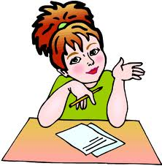
Homework
Draw a picture of your room and write about your hobbies and interests (use an interest meter)
Write down words into your vocabularies ( p.20).

Slide 14
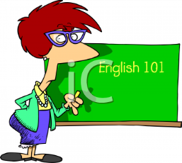
THANK YOU FOR THE LESSON!
I really liked the lesson!!!!!
It was boring……

