Slide 1
Meet the queen
Лютикова А.А.
2021

Slide 2
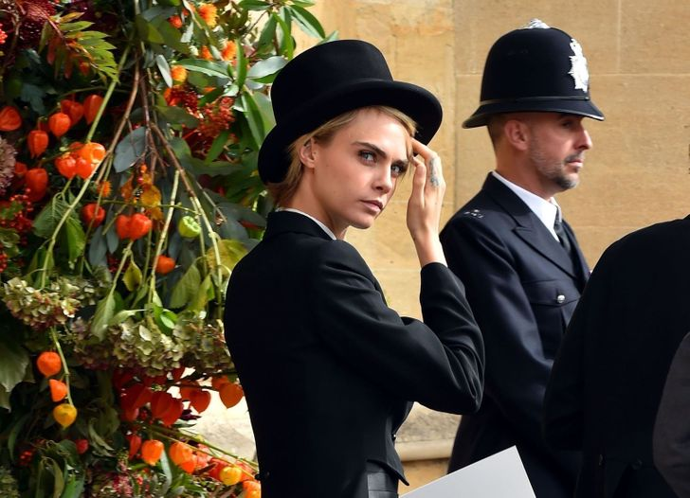
Don't mess with security
What are the chances that you will be honored to meet the Queen of England or another monarch? Just do not rush to say that they are equal to zero, because neither Jennifer Lopez, nor Angelina Jolie, nor even Beyonce at the time and could not think that they would have such an opportunity. And if this is quite realistic in the future, then you should prepare for the meeting properly, so that you don't get into a mess at the crucial moment.

Slide 3
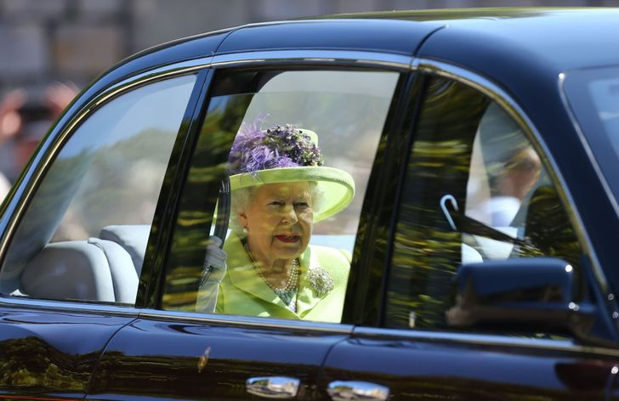
Come in advance — it's safer this way
According to the rules, the Queen must be the last to arrive at the event. For example, at the wedding of Prince Harry and Meghan Markle, the head of the British monarchy arrived just 5 minutes before the bride.

Slide 4
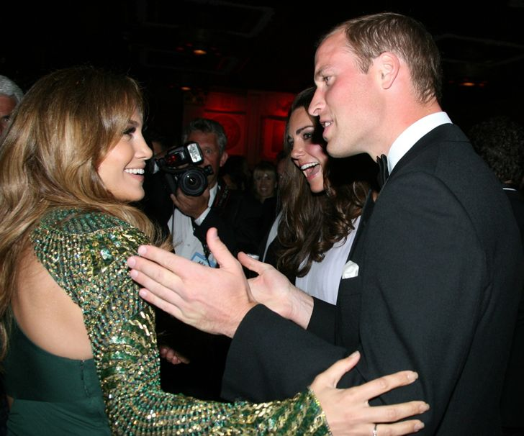
Never touch royalty
What would be a friendly conversation you have started to touch royalty without permission is a serious breach of Protocol. Jennifer Lopez probably forgot about it when she met the Duke and Duchess of Cambridge.

Slide 5
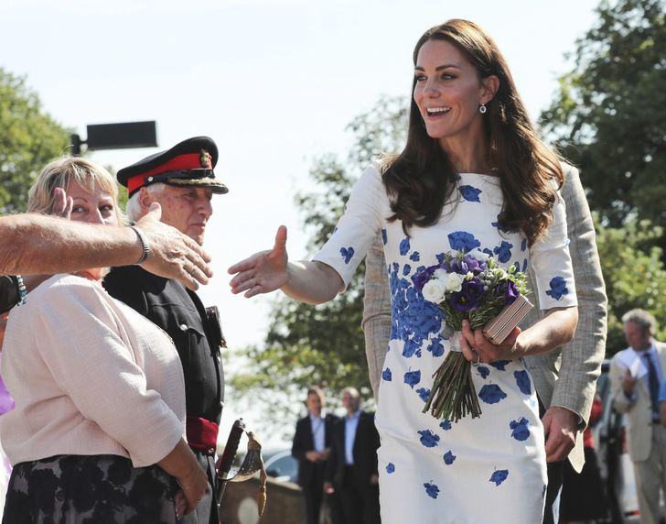
If in doubt, shake hands
The Royal family's website says there are no strict guidelines on how to greet the monarch. If we are talking about her Majesty's subjects, then depending on the gender, you need to nod your head (if you are a man) or make a shallow curtsy (if you are a woman). For citizens of other countries, it will be enough to shake hands. If, for example, a celebrity and a member of the Windsor family crossed paths many times, it is likely that when they meet, they will hug or kiss each other on the cheek. However, even in this case, the initiative must come from the monarch.

Slide 6
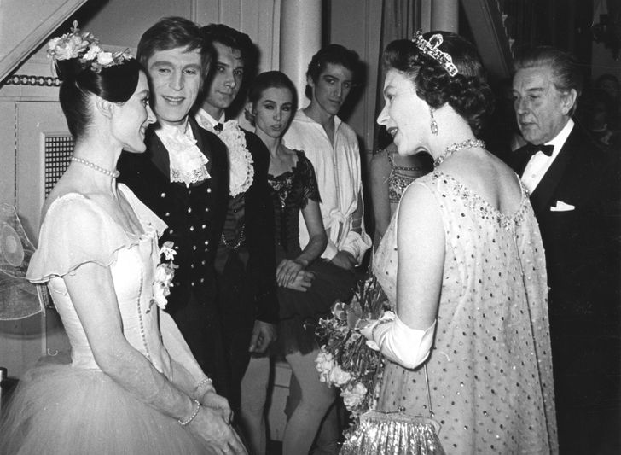
Keep quiet until someone speaks to you
According to Protocol, you should not start a conversation with a member of the British Royal family until you shake their hand. Usually monarchs greet each other first. Actor Billy Aigner on a talk show said that the day before the meeting with Prince Harry and Meghan received a letter in which all these theatures were spelled out in detail.

Slide 7
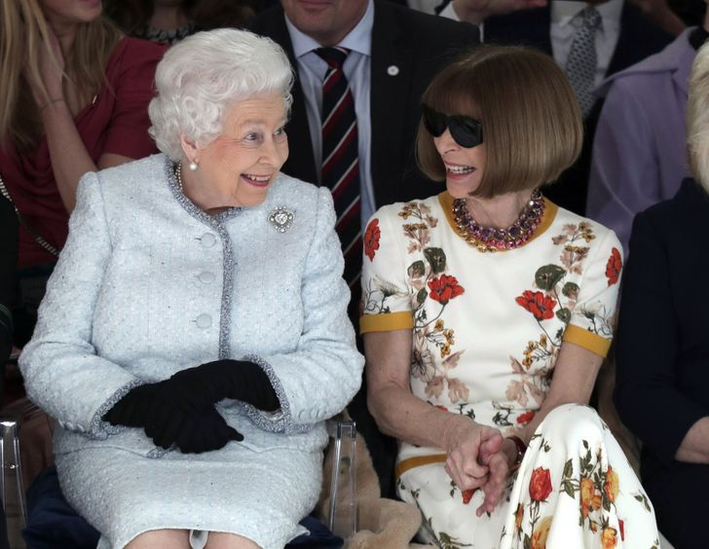
Keep eye contact while talking
It is customary for monarchs to maintain eye contact with the other person during a conversation. Therefore, you should do the same as a sign of respect. Many media outlets trumpeted this point of Royal Protocol after the editor-in-chief of American Vogue, Anna Wintour, was seen chatting with Elizabeth II in her sunglasses. Many considered this disrespectful. However, judging by the photo, they had a pleasant conversation: Her Majesty was even smiling.

Slide 8
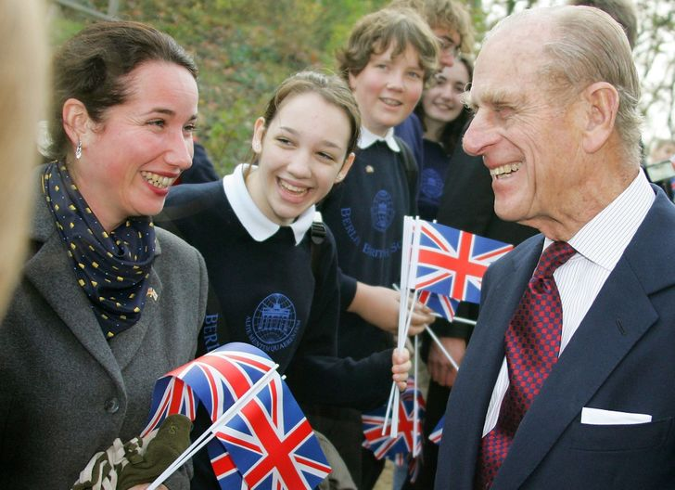
Never address a Royal by first name
When first introduced, a member of the Royal family should address them as " Your Majesty "(in the case of the Queen) or" Your Royal Highness "(in the case of everyone else), and then switch to the more neutral" mam "or"sir".

Slide 9
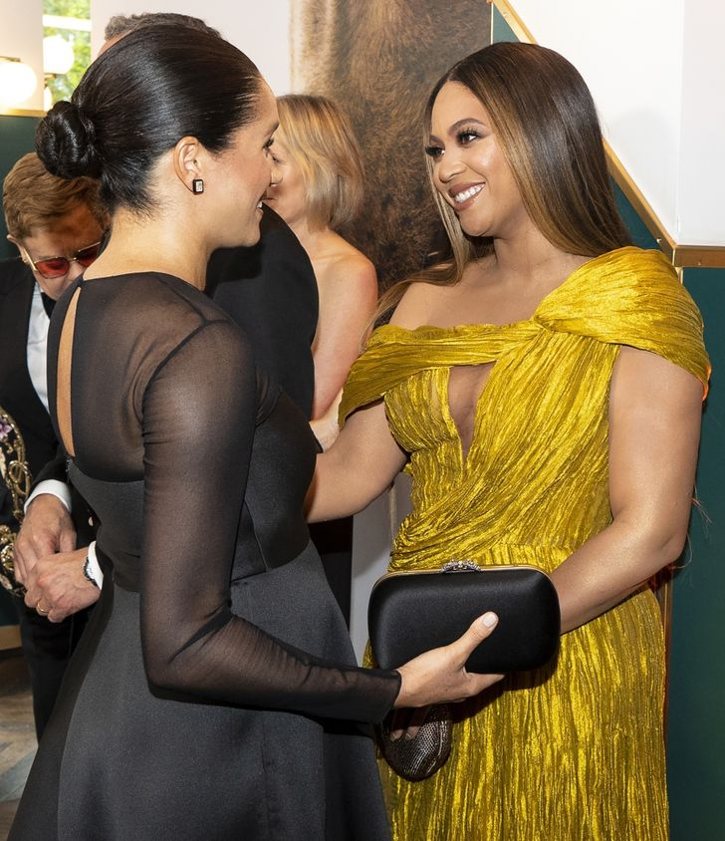
Nicknames are also banned
You probably know that members of the Royal family have nicknames for each other. For example, Prince Philip calls his wife "my cabbage". But no matter how famous you are, you are not allowed to address the Queen in this way. However, as well as other deviations from the course: you don't want to cause a fuss, like Beyonce did when she called Meghan Markle "my Princess" at the Lion King premiere, or, funnier, like Allison Janney, who referred to Kate Middleton as " darling»

Slide 10
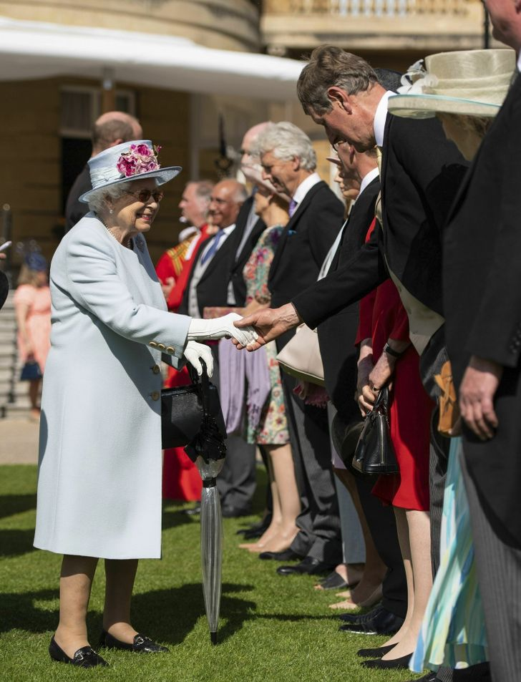
Your "+1 " should be behind you
Often, the meeting of royals with guests is scheduled every minute, so they may not have time to personally say Hello to everyone in the room. So if you take another person with you to a similar event, they will have to stand behind you. And he can only speak to members of the Royal family if they speak to him first.

Slide 11
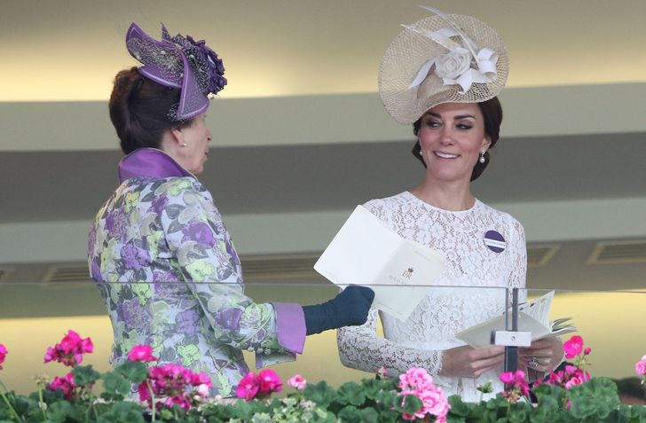
Some words and phrases should be avoided
In the Royal family, it is not customary to use certain words. For example, a bathroom or toilet is always called a restroom. This is an optional rule, but if you want to make a good impression, you should follow it.

Slide 12
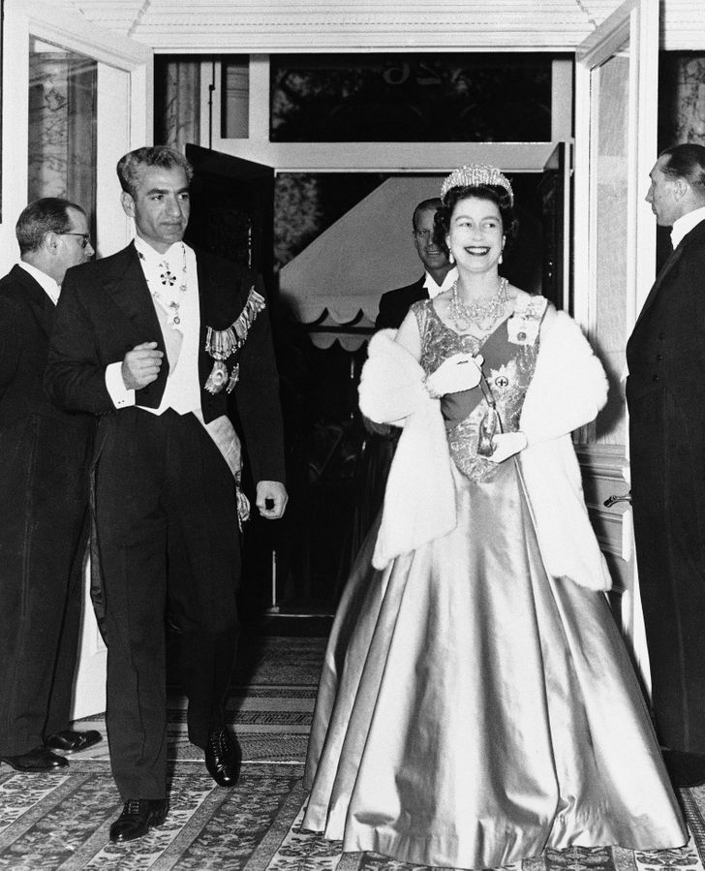
Always stand when the Queen is standing
If you ever find yourself in a room with Elizabeth II, follow her example: when she gets up, you should get up too. If you happen to be at dinner with Her Majesty, then after she finishes the meal, you and the rest of the people sitting at the table are strongly advised not to touch the food.

Slide 13
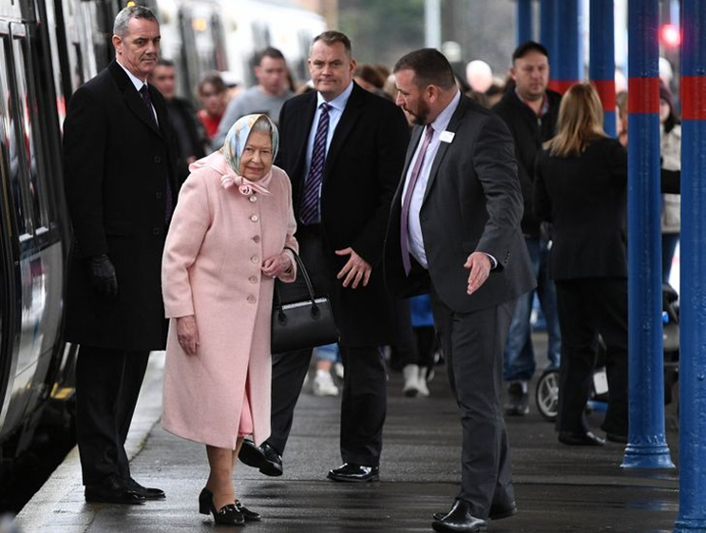
Never turn your back to the Queen
The rules of etiquette forbid turning your back on the Queen and the rest of the Royal family. This is a gross violation of Protocol. Actress Emilia Clarke in an interview admitted that before meeting with Prince William, she was warned not to do so.

Slide 14
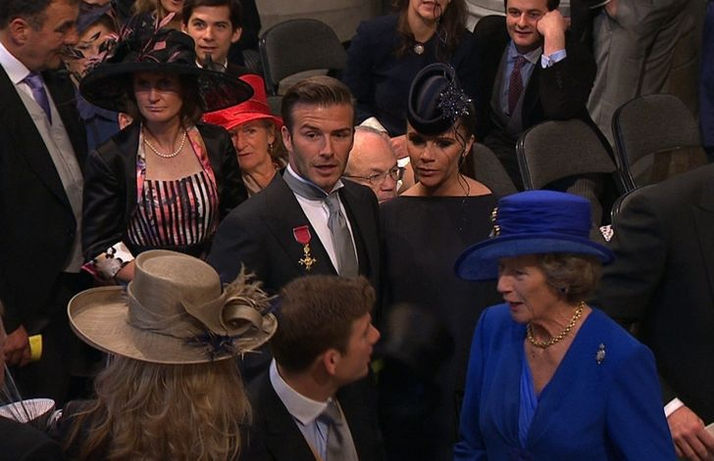
Never leave an event before the Queen
You can't just drop by an event, meet a Royal and leave. Guests must remain on it until members of the Royal family have given permission to leave

Slide 15
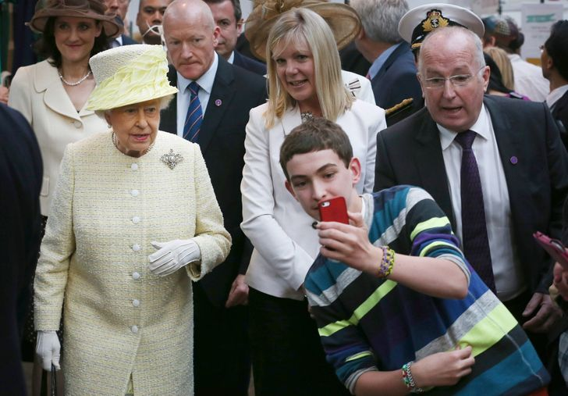
Don't ask for a selfie, forget about an autograph
For security reasons, members of the Royal family are not allowed to take selfies with fans (even if some of them are very famous). An autograph session is also out of the question. Monarchs of great Britain are forbidden to sign autographs and sign anything other than official documents. Most likely, in response to such a request, you will hear: "I'm sorry, I can't." This rule was created in order to avoid any fakes and scandals.

Slide 16
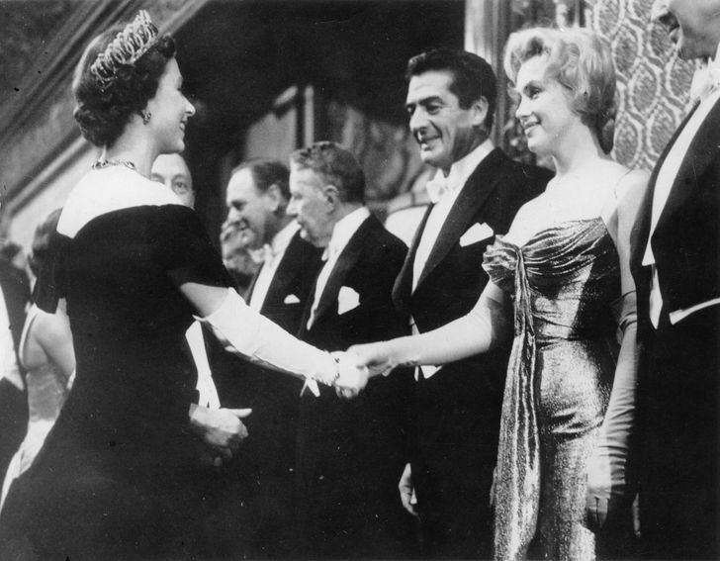
Modesty and style above all else
There is no dress code for meetings with the Queen, but there is one rule — you need to choose more conservative images. Marilyn Monroe clearly listened to this information when she was going to meet Elizabeth II in 1956. By the way, the dress code applies even to journalists. When choosing an outfit, you should also avoid bright colors, as they are most often worn by British monarchs to stand out from the crowd.It is also recommended to avoid bare feet. All women in the Royal family are required to wear tights in public, as Protocol prohibits their absence. Celebrities and mere mortals do not have to follow this rule, but it is worth it.

Slide 17
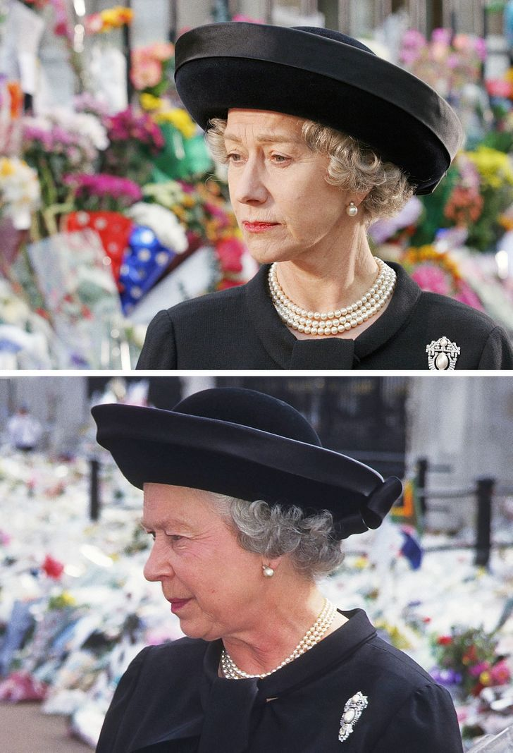
Do not decline the Royal invitation (unless you have a really good reason to do so)
Above: a shot from the movie "the Queen" starring Helen Mirren. Below: Elizabeth II.If you can't accept an invitation from members of the Royal family for a really important reason, it's excusable. But be extremely careful, because refusal can be interpreted by them as neglect. When actress Helen Mirren refused to come to dinner with Elizabeth II at Buckingham Palace because of filming, the story became national news.

