Slide 2
When was the last time you went shopping?

Slide 3
Last week Ann went shopping and she bought a beautiful dress.

Slide 5
Last week Ann went shopping and she bought a beautiful dress. She needed it.

Slide 6
На прошлой неделе Анна ходила в магазин и купила красивый зонт. У каждого есть зонт осенью.
Last week Anna went shopping and bought a beautiful umbrella. Everyone else has an umbrella in the autumn.

Slide 7
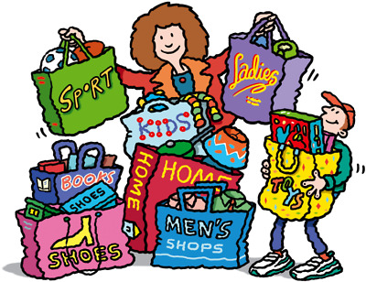
ex.2
Read the tittle of the text.
What do you think it is about?
«CHOICES
YOU MAKE THEM»

Slide 8
This dress fits me in size.
The T-shirt doesn't match your jacket. Too bright…
This coat suits you.

