Slide 2
Grammar
10
20
30
40
50
Holidays
10
20
30
40
50
Vocabulary
10
20
30
40
50
Around the world
10
20
30
40
50
Rebus
10
20
30
40
50
Idioms
10
20
30
40
50

Slide 3
Grammar
10
Name 3 forms of these irregular verbs:
bring
catch
forget

Slide 4
Grammar
10
bring-brought-brought
catch-caught-caught
forget-forgot-forgotten

Slide 5
Grammar
20
Which modal verb expresses obligation or duty?
1.can, 2.may, 3.must, 4.might, 5.could

Slide 6
Grammar
20
MUST

Slide 7
Grammar
30
Choose the correct form of the adjective.
She is _____ than her brother.
a). sociable
b). more sociable
c). the most sociable

Slide 8
Grammar
30
more sociable

Slide 9
40

Slide 10
Grammar
40
Choose the correct answer.
She _____ a new job soon.
a) will look for
b) is going to look for

Slide 11
Grammar
40
She is going to look for a new job soon.

Slide 12
Grammar
50
Complete the pairs of sentences. Use the Past Perfect in one sentence and the Past Perfect Continuous in the other.
The vase ______(break) when it fell off the table.
He ______(break) branches off the trees all day.
a) had broken
b) had been breaking

Slide 13
Grammar
50
1 had broken
2 had been breaking

Slide 14
Holidays
10
Choose the noun which is not connected with Christmas decorations.
Lights, ornaments, mistletoe, freckles, wreath, stocking.

Slide 15
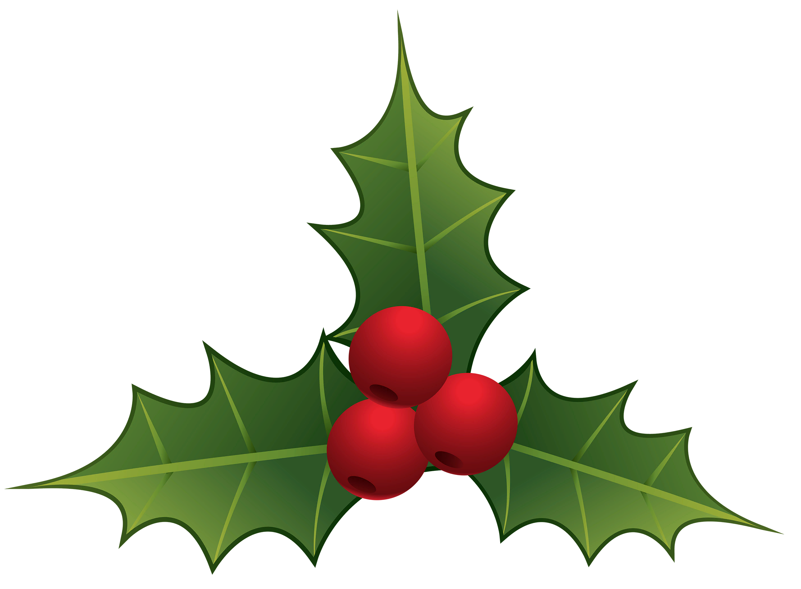
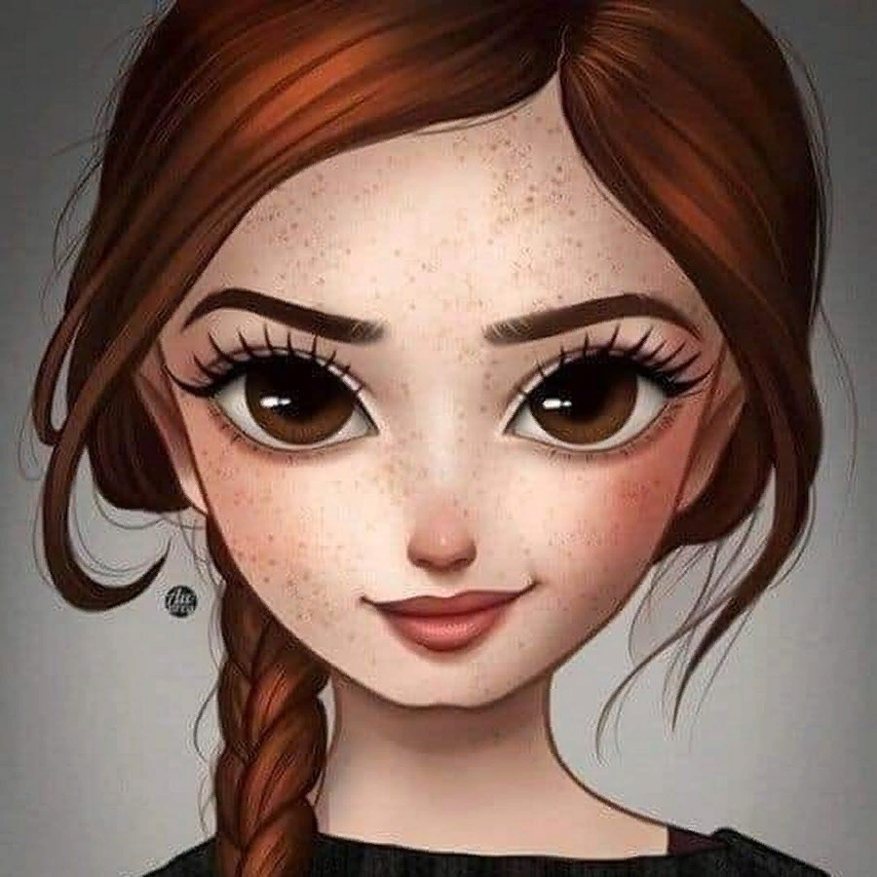
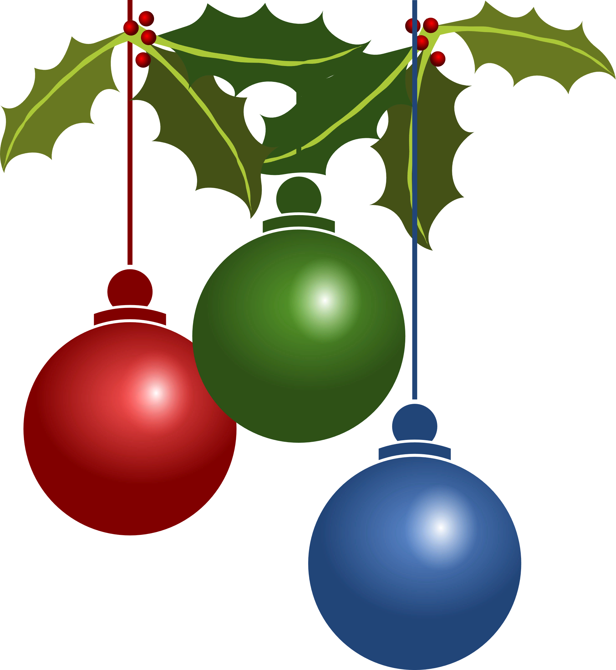
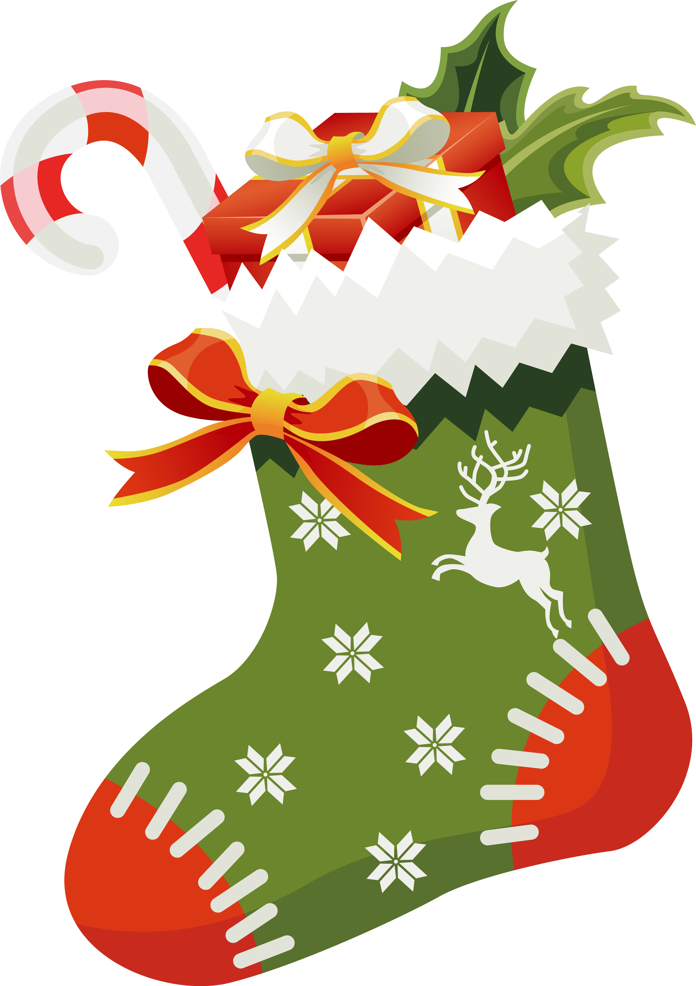
Holidays
10
Freckles –
веснушки
lights
mistletoe
wreath
ornaments
stocking

Slide 16
Holidays
20
It is a global day celebrating the social, economic, cultural, and political achievements of women.

Slide 17
Holidays
20
International
Women's Day

Slide 18
30

Slide 19
Holidays
30
It is a day of joy and celebration to commemorate that Jesus Christ is risen, according to Christian belief. People usually dye eggs and bake special cakes.

Slide 20
Holidays
30
Easter

Slide 21
Holidays
40
This holiday is common for couples to express the love exchanging gifts and going out for dinner together. It is usually celebrated with red roses, bouquets of flowers, chocolates, teddy bears and some special cards.

Slide 22
Holidays
40
St. Valentine’s Day

Slide 23
Holidays
50
The tradition of celebrating this holiday originated with the ancient Celtic festival of Samhain, when people would light bonfires and wear costumes to ward off ghosts.

Slide 24
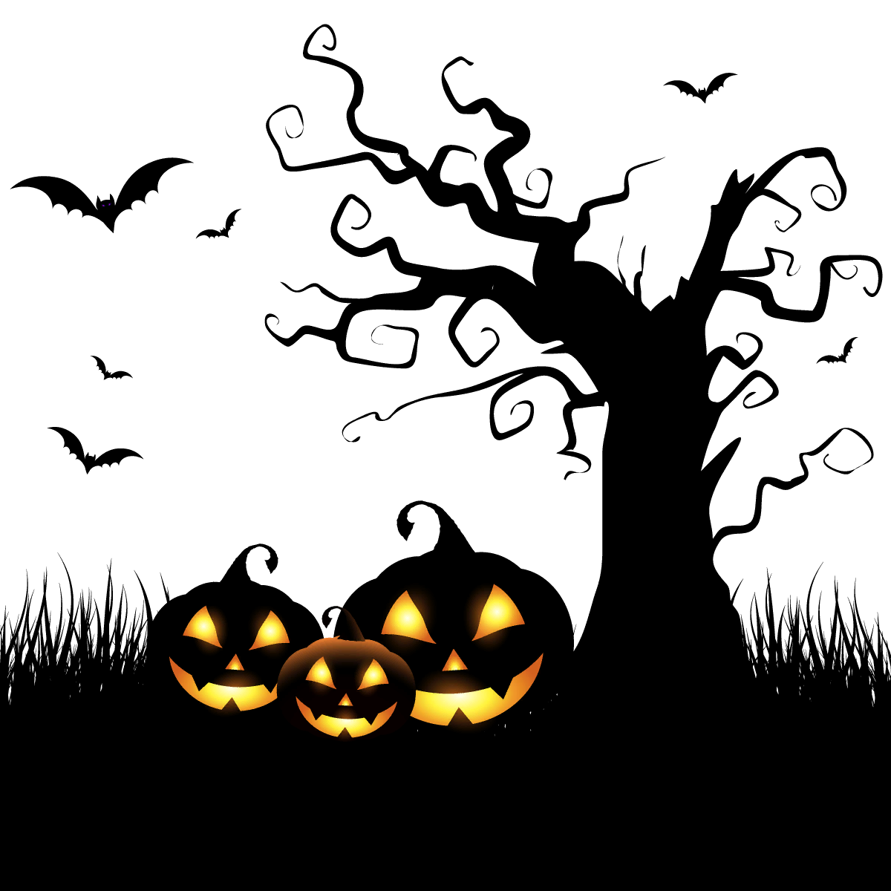
Holidays
50
Halloween

Slide 25
Vocabulary
10
Find the mistake and name the word correctly.
Cloud, frost, showre, storm

Slide 26
Vocabulary
10
SHOWRE - SHOWER

Slide 27
Vocabulary
20
Choose a noun from these words:
Provide, invite, advice, protect

Slide 28
Vocabulary
20
ADVICE

Slide 29
Vocabulary
30
Transform the verb into a noun.
Repeat (повторять)-___ (повторение)
Appear (появляться)-___(внешний вид)
Defend (защищать)-___(защита)

Slide 30
Vocabulary
30
Repeat (повторять) - repetition (повторение)
Appear (появляться) – appearance (внешний вид)
Defend (защищать) - defence (защита)

Slide 31
Vocabulary
40
Match synonyms:
Pride
Capture
Shake
Search
Vanity
Catch

Slide 32
Vocabulary
40
Pride – vanity
Capture – catch
Shake - search

Slide 33
50

Slide 34
Vocabulary
50
Match the words
Scorching
Heavy
Huge
Snowstorm
Rain
Sun

Slide 35
Vocabulary
50
Scorching sun
Heavy rain
Huge snowstorm

Slide 36
10

Slide 37
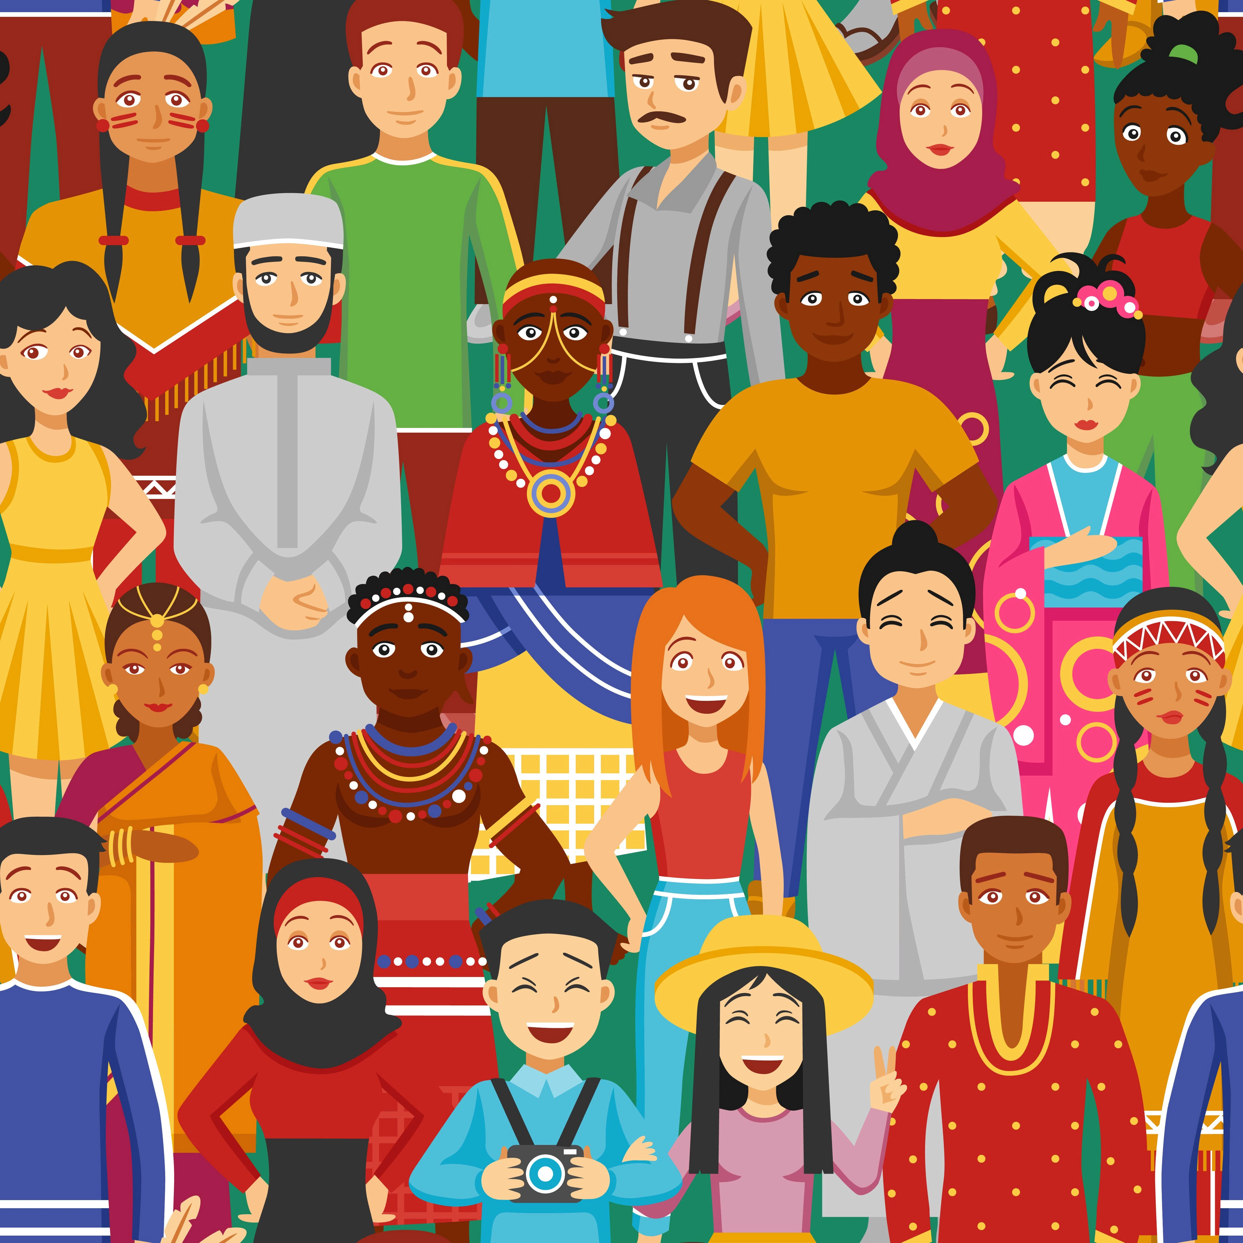
Around the world
10
Name the nationalities of these countries.
1) The UK-___
2) China-___
3) Turkey-___

Slide 38
Around the world
10
1) The UK - British
2) China - Chinese
3) Turkey -Turkish

Slide 39
Around the world
20
Match the writers to their works.
Sir Arthur Conan Doyle
Agatha Christie
Jules Verne
Miss Marple
Sherlock Holmes
Journey to the Centre of the Earth

Slide 40
Around the world
20
Sir Arthur Conan Doyle - Sherlock Holmes
Agatha Christie - Miss Marple
Jules Verne - Journey to the Centre of the Earth

Slide 41
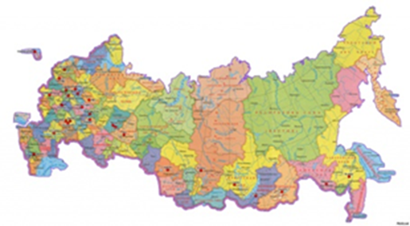
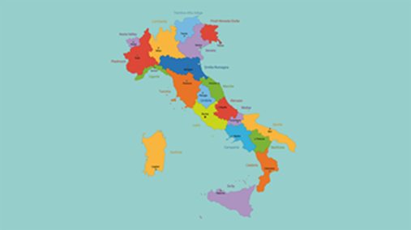
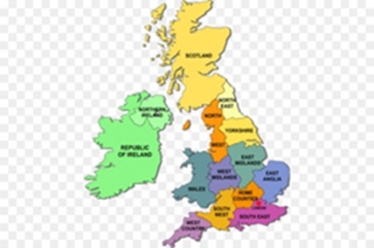
Around the world
30
Choose the map of the UK
a) b) c)

Slide 42
Around the world
30
The UK

Slide 43
Around the world
40
Mexico is situated in the continent…
a) South America
b) North America
c) Africa

Slide 44
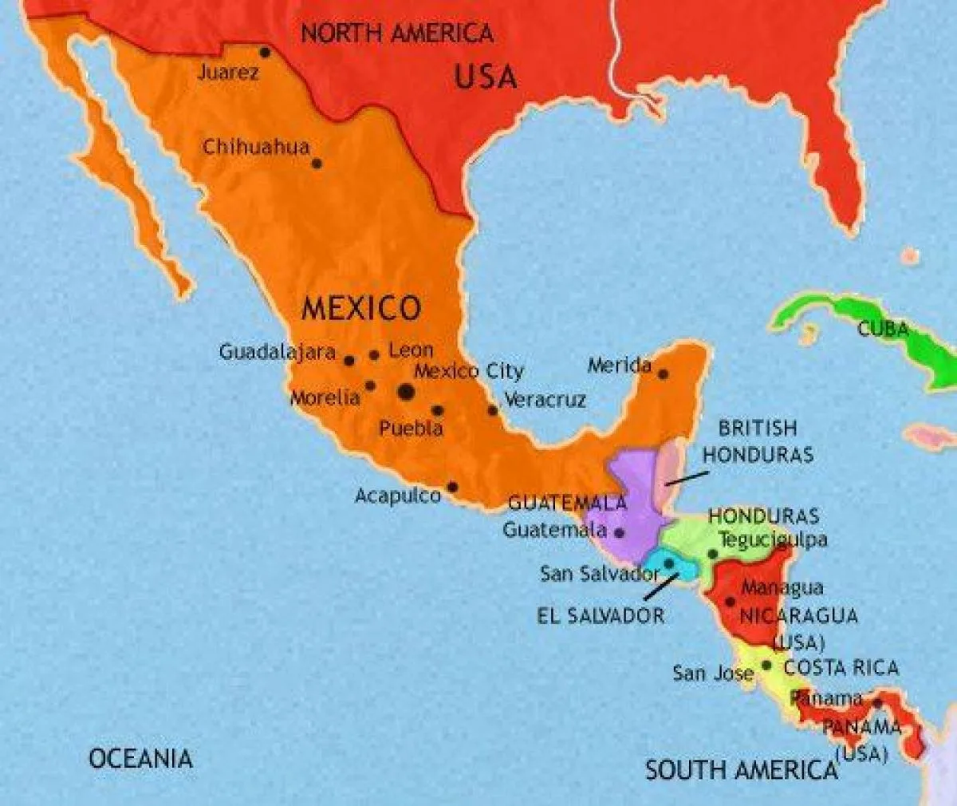
Around the world
40
Mexico is situated in the continent North America

Slide 45
Around the world
50
Which compositions did the writer Oscar Wilde wrote?
1) “Robinson Crusoe”, “The Jungle Book”
2) “Romeo and Juliet”, “Gulliver’s Travels”
3) “The picture of Dorian Gray”, “The Canterville Ghost”

Slide 46
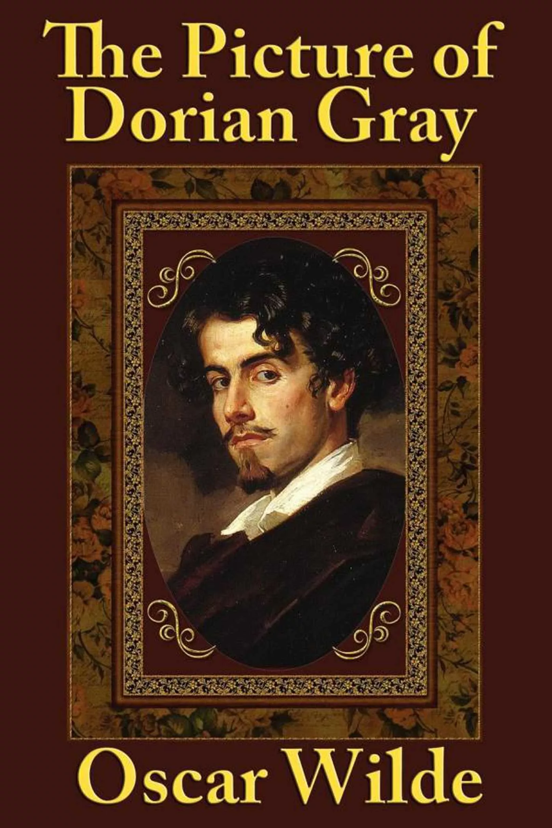
Around the world
50
Oscar Wilde wrote
“The picture of Dorian Gray”, “The Canterville Ghost”

Slide 47
Rebus
10

Slide 48
Rebus
10
Library

Slide 49
20

Slide 50
Rebus
20

Slide 51
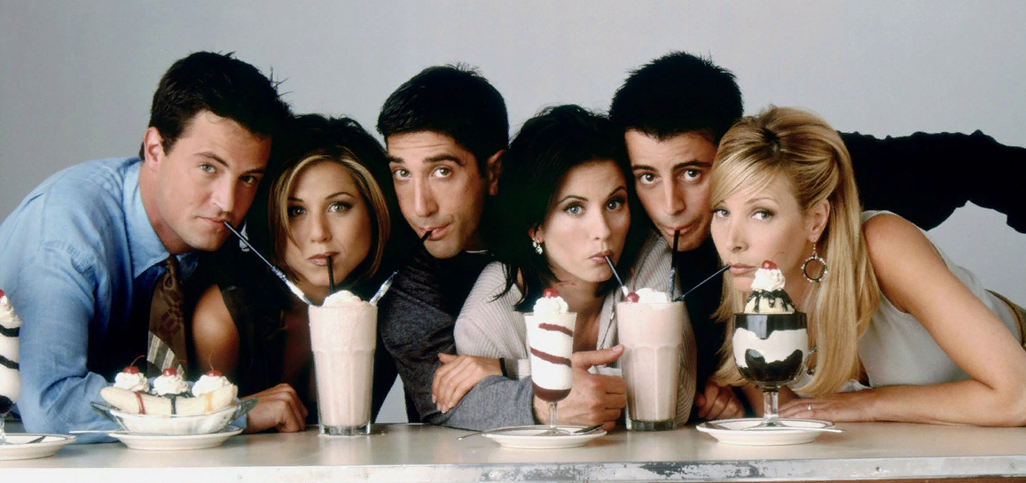
Rebus
20
Friendship

Slide 52
Rebus
30

Slide 53
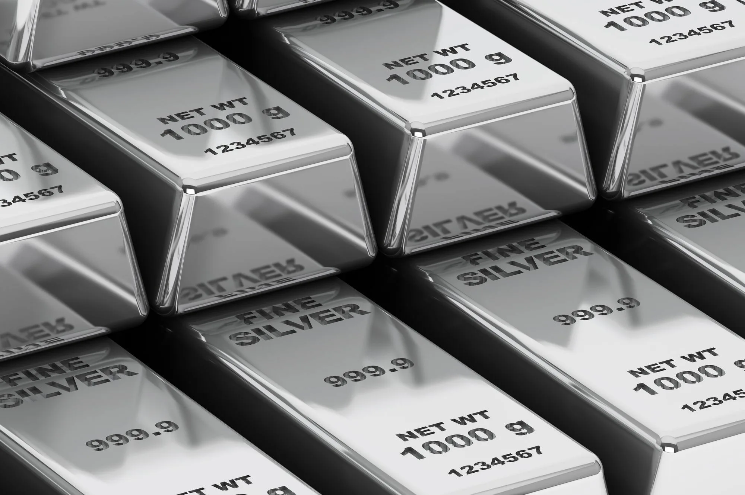
Rebus
30
Silver

Slide 54
Rebus
40

Slide 55
Rebus
40
Collector

Slide 56
Rebus
50

Slide 57
Rebus
50

Slide 58
Idioms
10
Match the idiom with
its meaning:
“step by step”
many times, b) slowly,
c) moving in circles.

Slide 59
Idioms
10
“step by step” - slowly

Slide 60
Idioms
20
Match the idiom with
its meaning:
“round and round”
continue without stopping,
b) slowly,
c) moving in circles.

Slide 61
Idioms
20
“round and round” –
moving in circles

Slide 62
30

Slide 63
Idioms
30
Match the idiom with
its meaning:
“all in all”
considering everything,
b) continue without stopping,
c) moving in circles.

Slide 64
Idioms
30
“all in all” –
considering everything

Slide 65
Idioms
40
Match the idiom with
its meaning:
“He is bad news”
a) It’s important news.
b) Let’s get started.
c) He doesn’t have a good
character.

Slide 66
Idioms
40
He is bad news. –
He doesn’t have a
good character.

Slide 67
Idioms
50
Match the idiom with
its meaning:
“It hit the headlines.”
a) It’s a rumour going round.
b) Let’s get started.
c) It’s important news.

Slide 68
Idioms
50
It hit the headlines. –
It’s important news.

