Slide 1
Holidays to Enjoy
Grade: 5th
English Teacher: Jalilova Surayyo
2023
Notes:
Оригинальные шаблоны для презентаций: https://presentation-creation.ru/powerpoint-templates.html
Бесплатно и без регистрации.

Slide 2
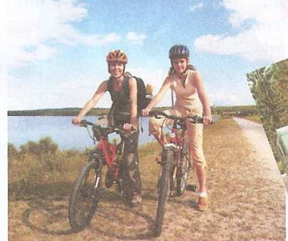
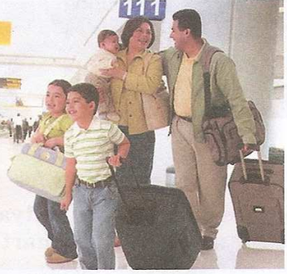
Guess the theme of the lesson!
Notes:
Оригинальные шаблоны для презентаций: https://presentation-creation.ru/powerpoint-templates.html
Бесплатно и без регистрации.

Slide 3
The plan of the lesson:
1
Sing a song
2
Speak about summer holidays
3
Revise grammar “If, When-Sentences”
4
Play a game “Simon says…”
5
Read the text

Slide 4
Let’s sing.
Spring Is Here
Spring is here! Spring is here!
Winter’s gone away.
When the sun is shining bright,
Outside we run and play- Yay!

Slide 5
Holidays

Slide 6
Holidays
Rucksack scarf
Swimsuit money
Bicycle stereo
Sunglasses books
Umbrella tent
Water
cap

Slide 7
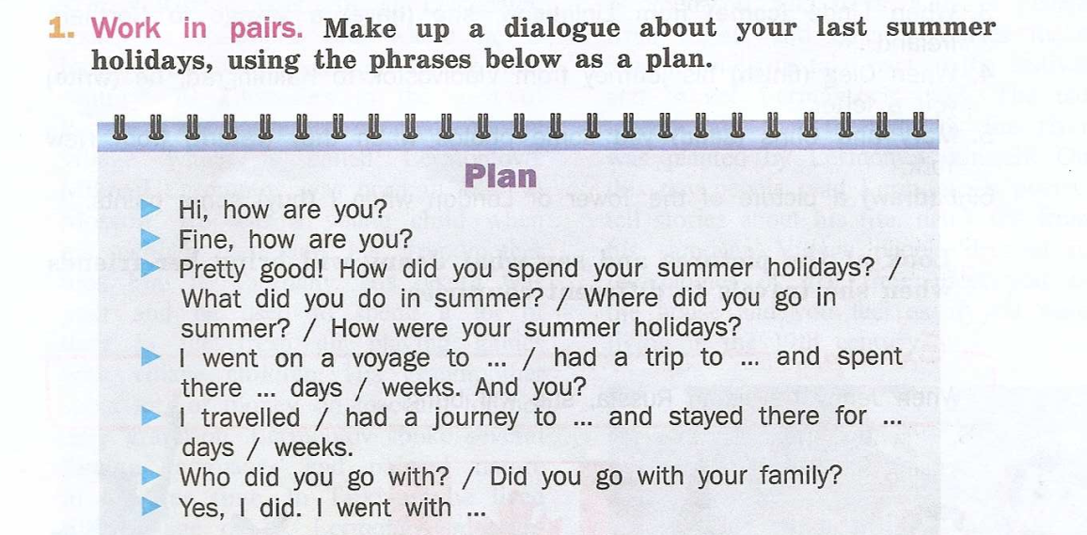
Let’s talk about summer holidays

Slide 8
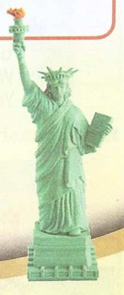
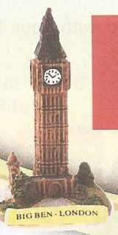
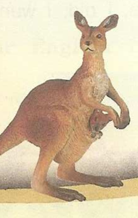
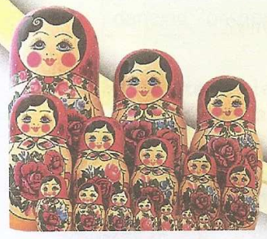
Let’s write.

Slide 9
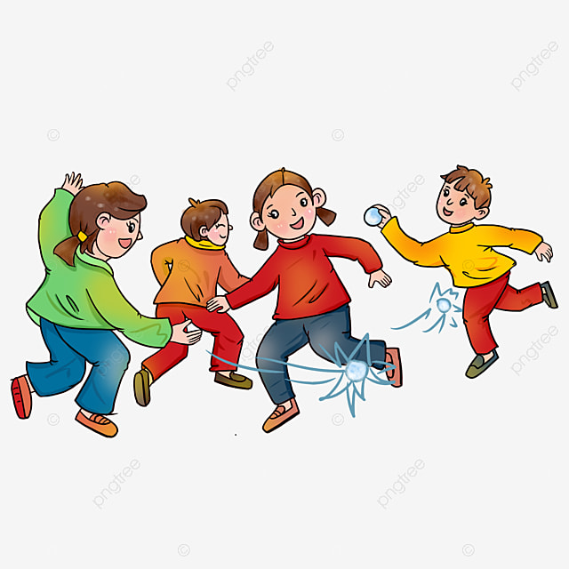
Let’s play a game.
Play a game “Simon says…”
( the whole class)

Slide 10
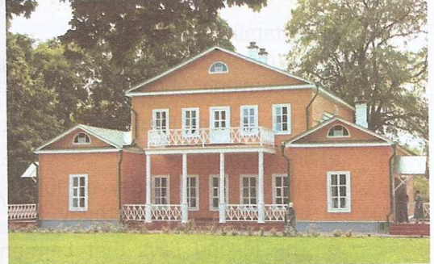
Let’s listen and read.
Ex 5 p 97

Slide 11
Ex 6 p 98
Let’s do the test and check in pairs.
Homework- Ex 2 p 99 ( to write 6 sentences with If/when)
The End of the Lesson
Today you have been very active and now answer the following questions:
What did you remember? ( new words, information)
Did you like the lesson or not?

Slide 12
Resoures
Учебник. Английский язык, 5 класс. С.Г. Тер-Минасова, Л.М. Узунова итд.(часть 2)
Рабочая тетрадь и аудиозапись к учебнику. С.Г. Тер-Минасова В.В. Робустова итд.
Шаблоны для презентаций: https://presentation-creation.ru/powerpoint-templates.html

