Slide 1
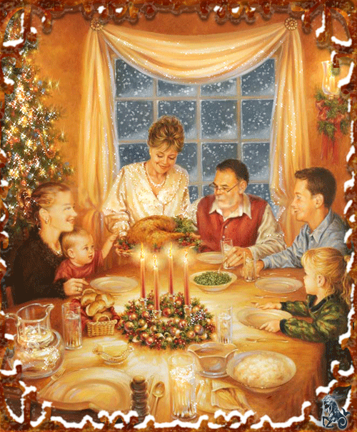
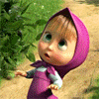
MY FAMILY

Slide 2
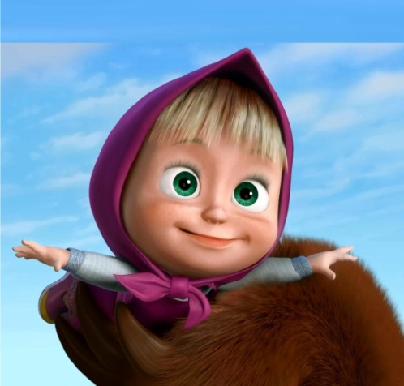
I have got = I`ve got
I have not got = I haven`t got

Slide 3
Найди пять «спрятанных» слов и обведи их.
f | d | m | u | y | x | f
a | g | o | p | s | z | a
m | q | t | r | u | o | t
i | e | h | v | w | r | h
l | u | e | w | t | y | e
y | o | r | b | d | i | r
b | r | o | t | h | e | r
s | i | s | t | e | r | g

Slide 4
Найди пять «спрятанных» слов и обведи их.
f | d | m | u | y | x | f
a | g | o | p | s | z | a
m | q | t | r | u | o | t
i | e | h | v | w | r | h
l | u | e | w | t | y | e
y | o | r | b | d | i | r
b | r | o | t | h | e | r
s | i | s | t | e | r | g

Slide 5
1.I have not got a sister.
2.I have got a mother and a father.
3.I have got a brother and a sister.
4. I have not got a brother.

Slide 6
Dear Wendy,
My name is Mike.
I _____ _____ a mother and a father.
I _____ _____ a sister. She`s kind and smart.
But I _____ not _____ a brother.
We _____ _____ a nice dog.
But we ____ not ____ a cat.
All the best, Mike.

Slide 7
My name is…
I have got a...
Her name is...
I have got a...
His name is…

Slide 8
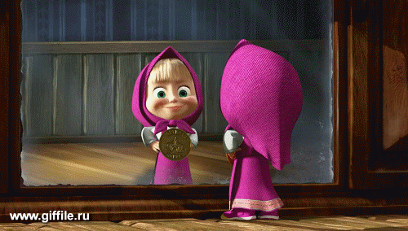

Slide 9
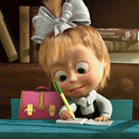
Дом. задание
Sb.p. 16 № 4
Ab. P.52 №2

Slide 10
Goodbye!!!!

