Slide 1
Викторина по английскому языку «Своя игра» для 6 класса
Выполнила: Устенко Оксана Александровна
Педагог дополнительного образования
Центр Ювента

Slide 2
The UK
10
20
30
40
50
Holidays
10
20
30
40
50
Riddles
10
20
30
40
50
Rebus
10
20
30
40
50
Famous people
10
20
30
40
50

Slide 3

What is the full name of “The UK”?
THE UK
10

Slide 4
What is the full name of “The UK”?
Answer: the United Kingdom

Slide 5
How many parts does the United Kingdom consist of?
THE UK
20

Slide 6
How many parts does the United Kingdom consist of?
Answer: 4

Slide 7
Name the extra country: England, Wales, Spain, Northern Ireland and Scotland.
THE UK
30

Slide 8

Name the extra country: England, Wales, Spain, Northern Ireland and Scotland.
Answer: Spain

Slide 9

What is the name of British flag?
THE UK
40

Slide 10
What is the name of British flag?
Answer: The Union Jack

Slide 11
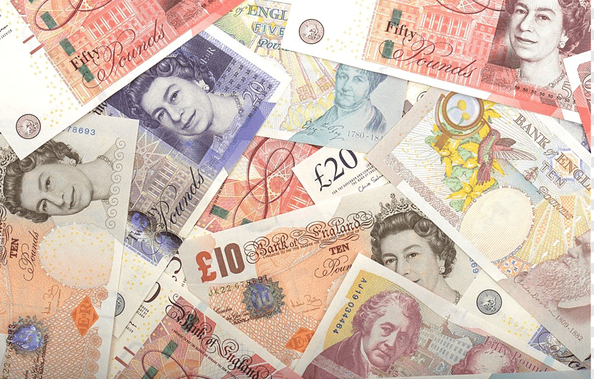
What is the British currency?
THE UK
50

Slide 12
What is the British currency?
Answer: pound and penny (pence)

Slide 13
HOLIDAYS
10
It is a winter holiday when people buy presents and cards.
They send presents and cards to their friends.
Children hang the stockings on their beds and fireplaces.

Slide 14

Answer: Christmas

Slide 15
HOLIDAYS
20
It is an autumn holiday when people make Jack-o-lanterns out of pumpkins.
Some people have parties and dress as witches and ghosts.

Slide 16
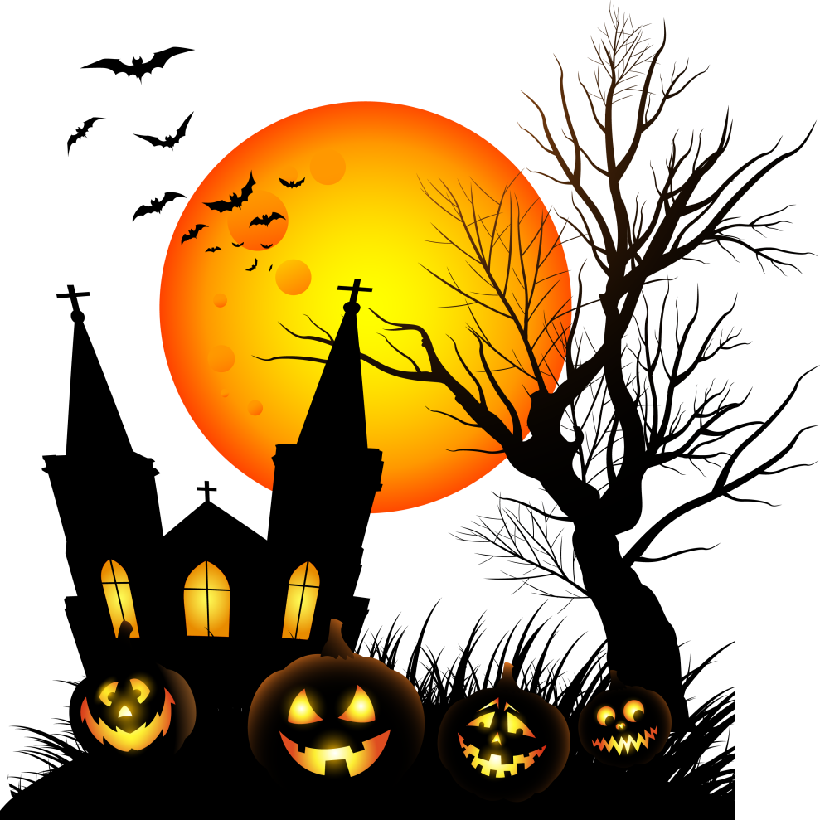
Answer: Halloween

Slide 17
HOLIDAYS
30
It is a holiday when people buy or make cards and send them to people they love.
They should not write their names on the cards.
Persons who get them must guess who sent them.

Slide 18

Answer: St. Valentine’s Day

Slide 19
HOLIDAYS
40
It is a spring holiday when people go to the church and cook dinner for the whole family.
They dye eggs and present their relatives and friends with them.

Slide 20

Answer: Easter

Slide 21
HOLIDAYS
50
It is a winter holiday
when people usually visit their friends.
There is a funny tradition: the First Foot. This is the first visitor who enters the house in the morning.

Slide 22

Answer: New Year

Slide 23
RIDDLES
Сlean, but not water,
White, but not snow,
Sweet, but not ice-cream,
What is it?
10

Slide 24
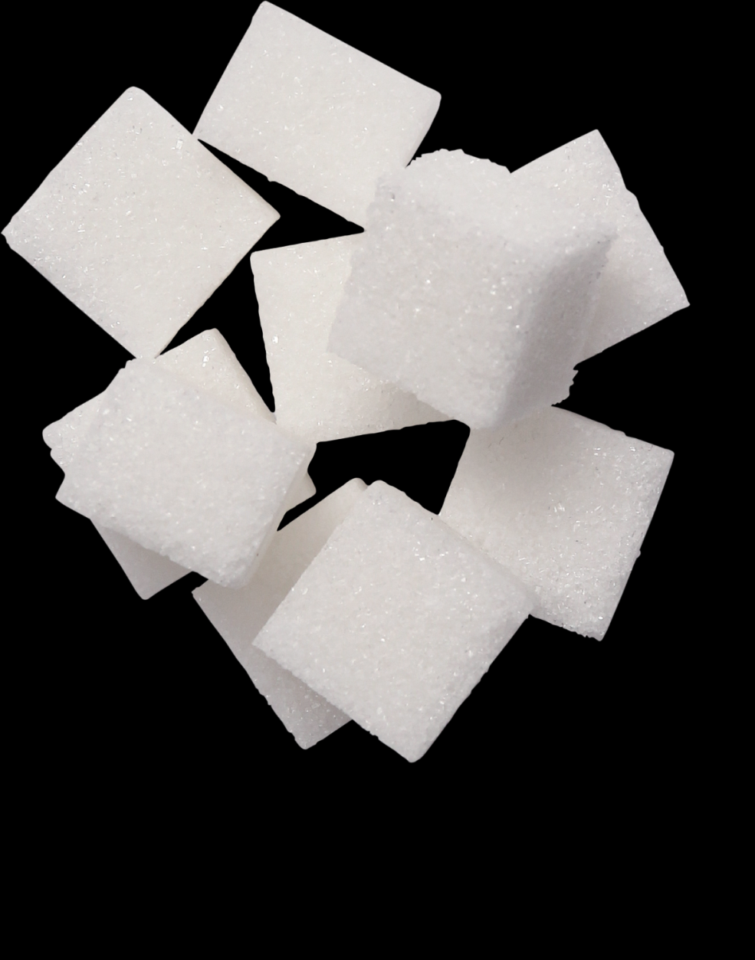
Answer: sugar

Slide 25
RIDDLES
There was a green house. Inside the green house there was a white house. Inside the white house there was a red house. Inside the red house there were lots of babies. What is it?
20

Slide 26
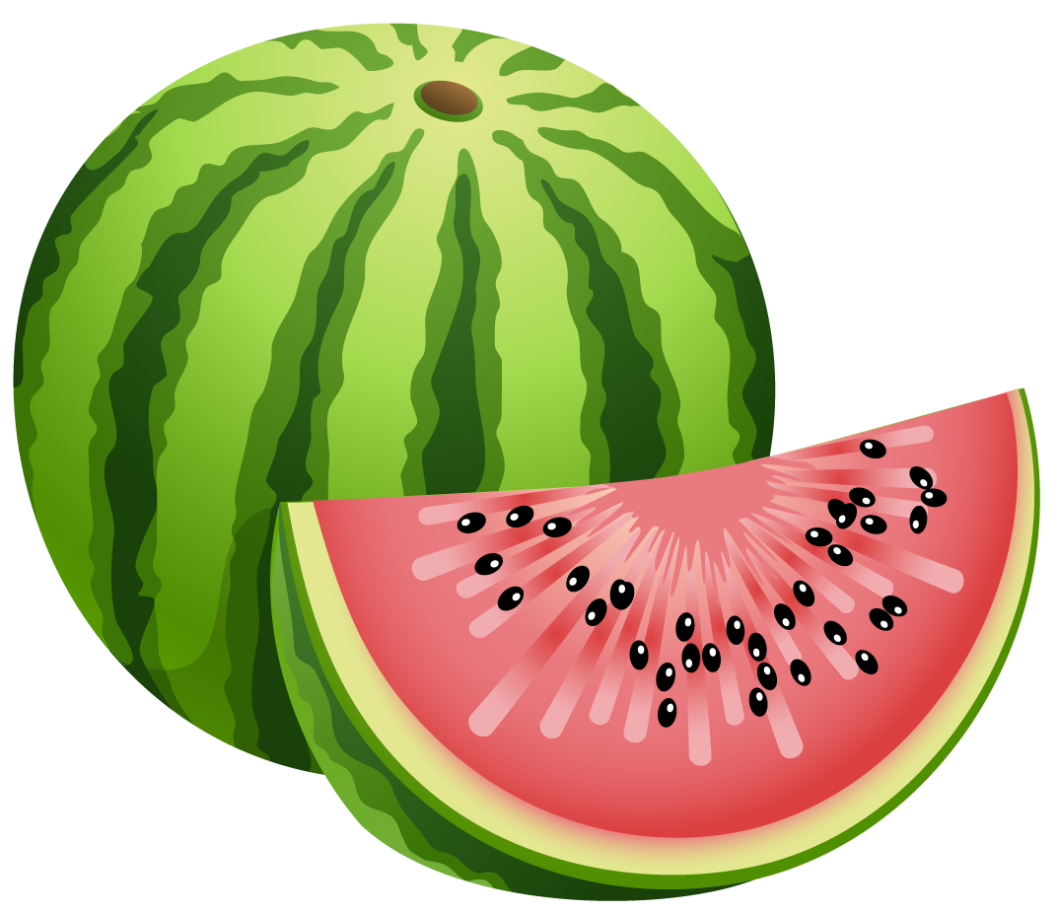
Answer: watermelon

Slide 27
RIDDLES
I am purple, yellow, red, and green
The King cannot reach me and neither can the Queen.
I show my colours after the rain
And only when the sun comes out again
30

Slide 28

Answer: rainbow

Slide 29
RIDDLES
What is found over your head but under your hat?
40

Slide 30
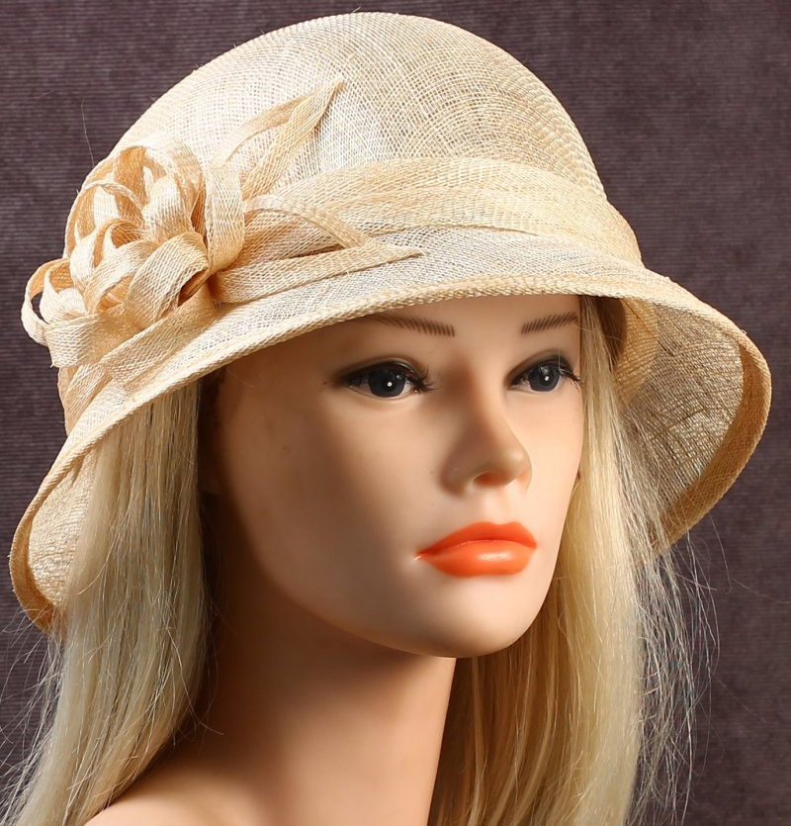
Answer: hair

Slide 31
RIDDLES
Look at my face and you see somebody
Look at my back and you see nobody.
50

Slide 32
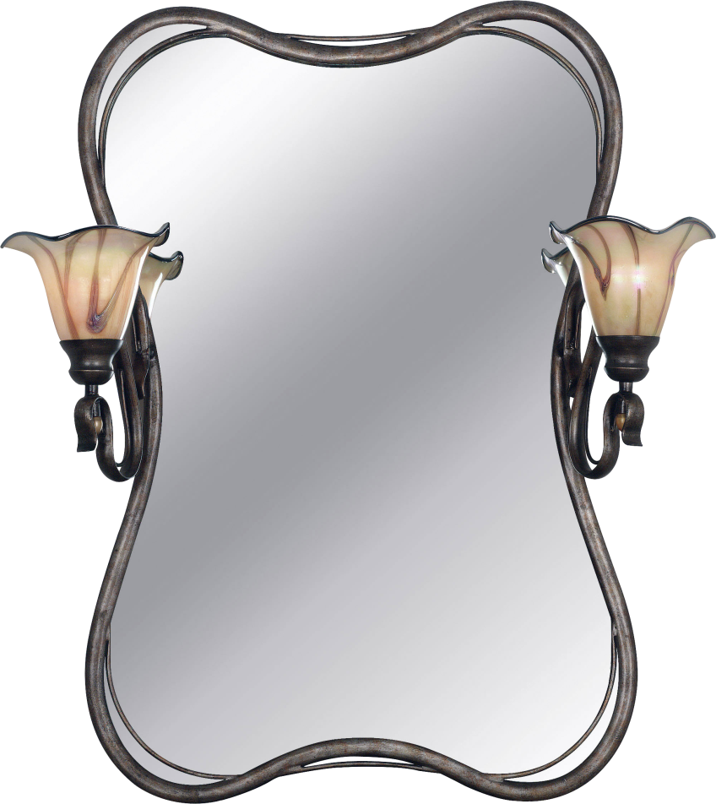
Answer: mirror

Slide 33
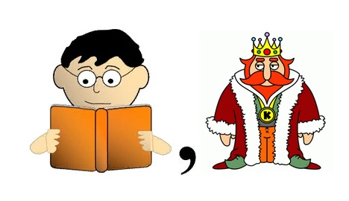
REBUS
10

Slide 34
Answer: reading

Slide 35

REBUS
20

Slide 36
Answer: vegetable

Slide 37

REBUS
30

Slide 38
Answer: road

Slide 39
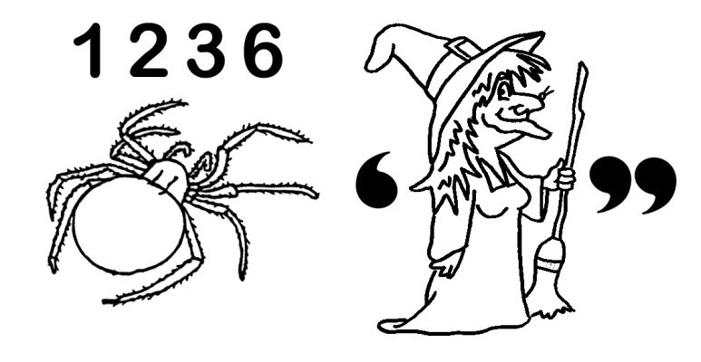
REBUS
40

Slide 40
Answer: spirit

Slide 41
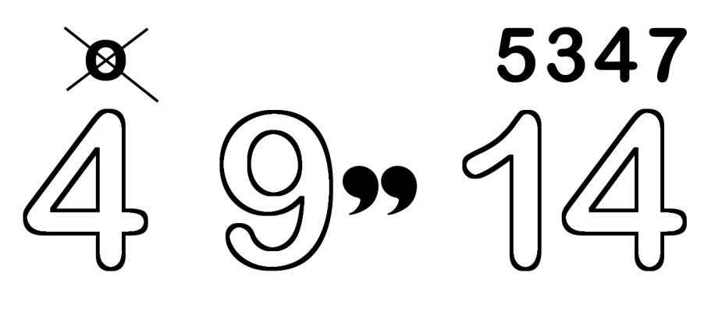
REBUS
50

Slide 42
Answer: furniture

Slide 43
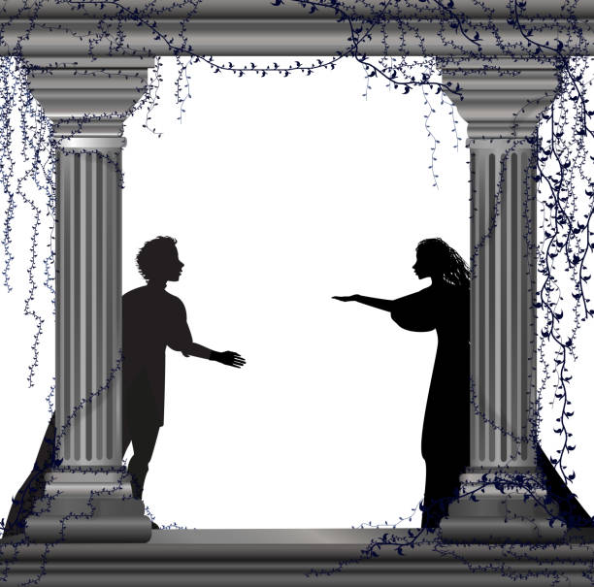
FAMOUS PEOPLE
10
The author of Romeo and Juliet, Hamlet, Othello.

Slide 44
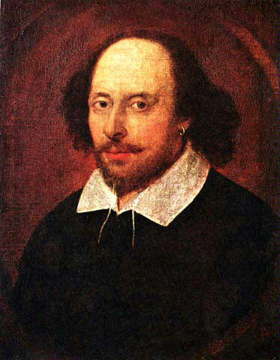
Answer: William Shakespeare

Slide 45
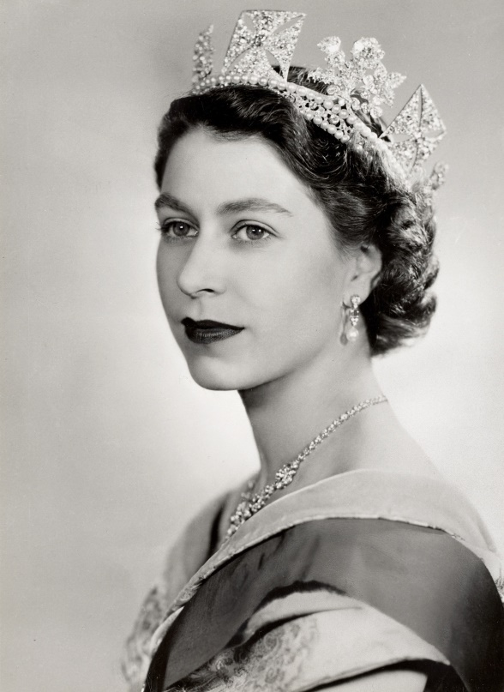
FAMOUS PEOPLE
20
Who is this woman?

Slide 46
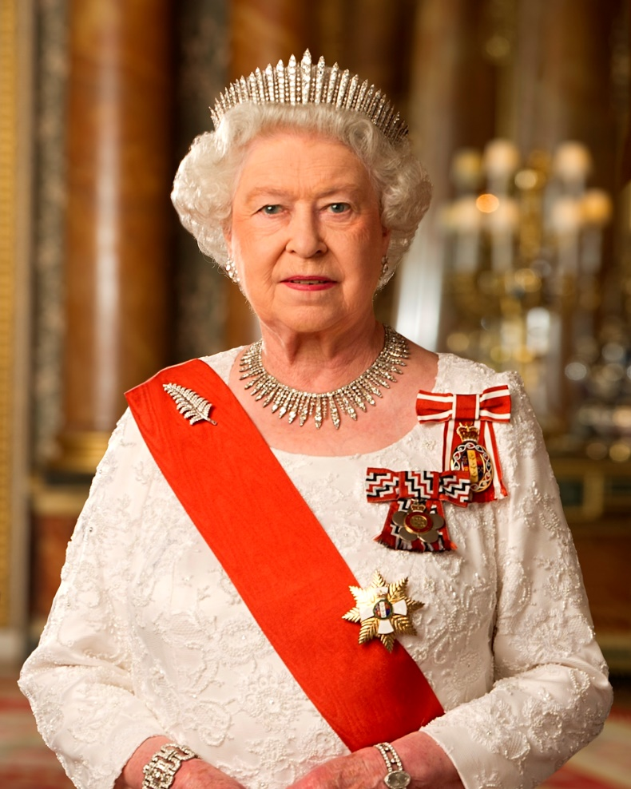
Answer: Queen Elisabeth II

Slide 47
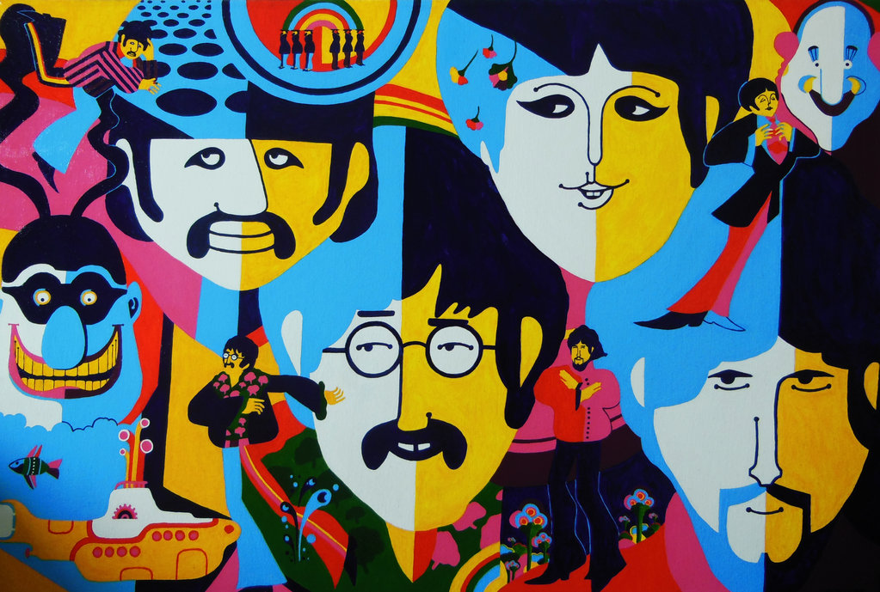
FAMOUS PEOPLE
30
Name the most famous
pop group of 1960s.

Slide 48
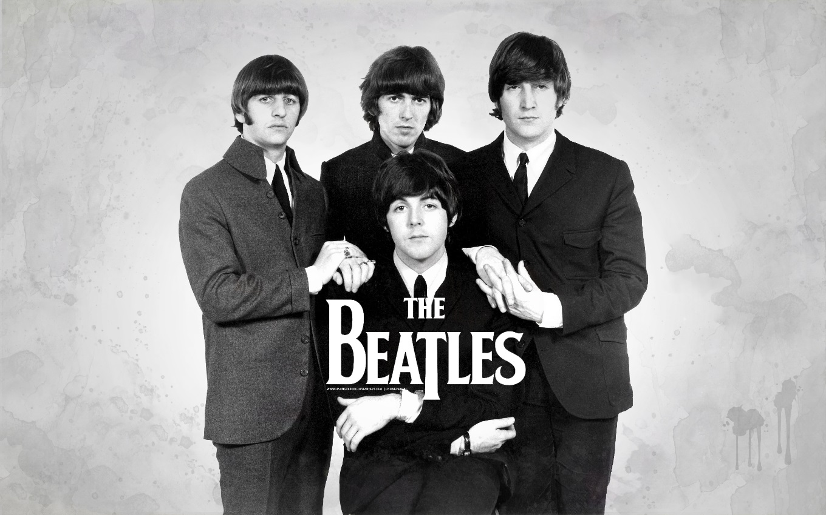
Answer: The Beatles

Slide 49
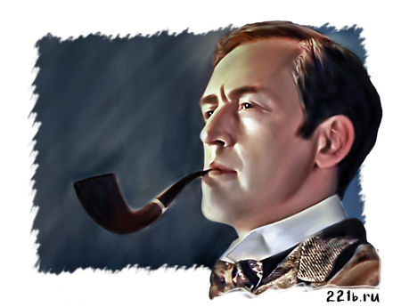
FAMOUS PEOPLE
40
What books did this man write?

Slide 50

Answer: The books about Sherlock Holmes

Slide 51
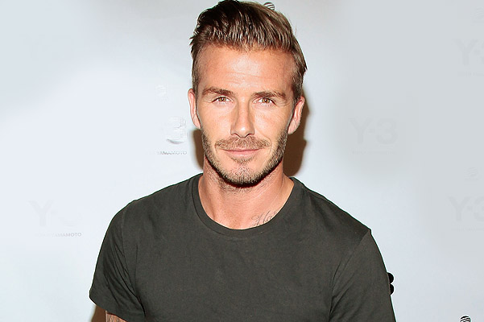
FAMOUS PEOPLE
50
Who’s this man? In what club did he start his career?

Slide 52
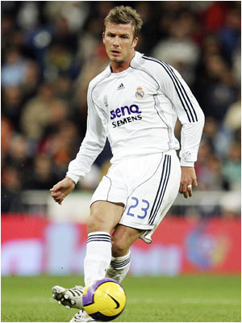
Answer: David Beckham
Manchester United

Slide 53
Интернет-ресурсы:
https://avatars.mds.yandex.net/i?id=2a0000017a0b3610442fcc576ea41bdf45d1-4438849-images-thumbs&n=13&exp=1
https://avatars.mds.yandex.net/i?id=3363d356309f34dc0a3a102180aa8bd9-4033773-images-thumbs&n=13&exp=1

