Slide 2
Grammar
10
20
30
40
50
Holidays
10
20
30
40
50
Vocabulary
10
20
30
40
50
Around the world
10
20
30
40
50
Rebus
10
20
30
40
50

Slide 3
Grammar
10
Name 3 forms of these irregular verbs:
give
come
have

Slide 4
Grammar
10
give-gave-given
come-came-come
have - had - had

Slide 5
Grammar
20
Choose the correct answer
(Present Simple or Past Simple)
1. He (drink)___coffee every day.
a) drinks b) drank
2. He (drink)___coffee last week.
a) drinks b) drank

Slide 6
Grammar
20
1. He drinks coffee every day.
2. He drank coffee last week.

Slide 7
Grammar
30
Choose the correct answer
(Present Simple or Present Continuous)
1) Listen! The birds ... (sing).
a) sing b) are singing c) is singing
2) Diana ususally ...(cook) dinner for us.
a) cook b) cooks c) is cooking

Slide 8
Grammar
30
1)Listen! The birds are singing.
2) Diana ususally cooks dinner for us.

Slide 9
40

Slide 10
Grammar
40
Choose the correct form of adjective
Jane is (smart) ... than other pupils in her class.
smarter
smartest
the smartest

Slide 11
Grammar
40
Jane is smarter than other pupils in her class.

Slide 12
Grammar
50
Choose the correct answer
1) Let’s go to the cinema together. - I’m sorry,
I ...
a) mustn’t b) can’t
2) ... tell me what time it is?
a) Can you b) Must you

Slide 13
Grammar
50
1. Let’s go to the cinema together. - I’m sorry, I can’t
2. Can you tell me what time it is?

Slide 14
Holidays
10
Choose the noun which is not connected with Christmas decorations.
Lights, ornaments, freckles, stocking.

Slide 15
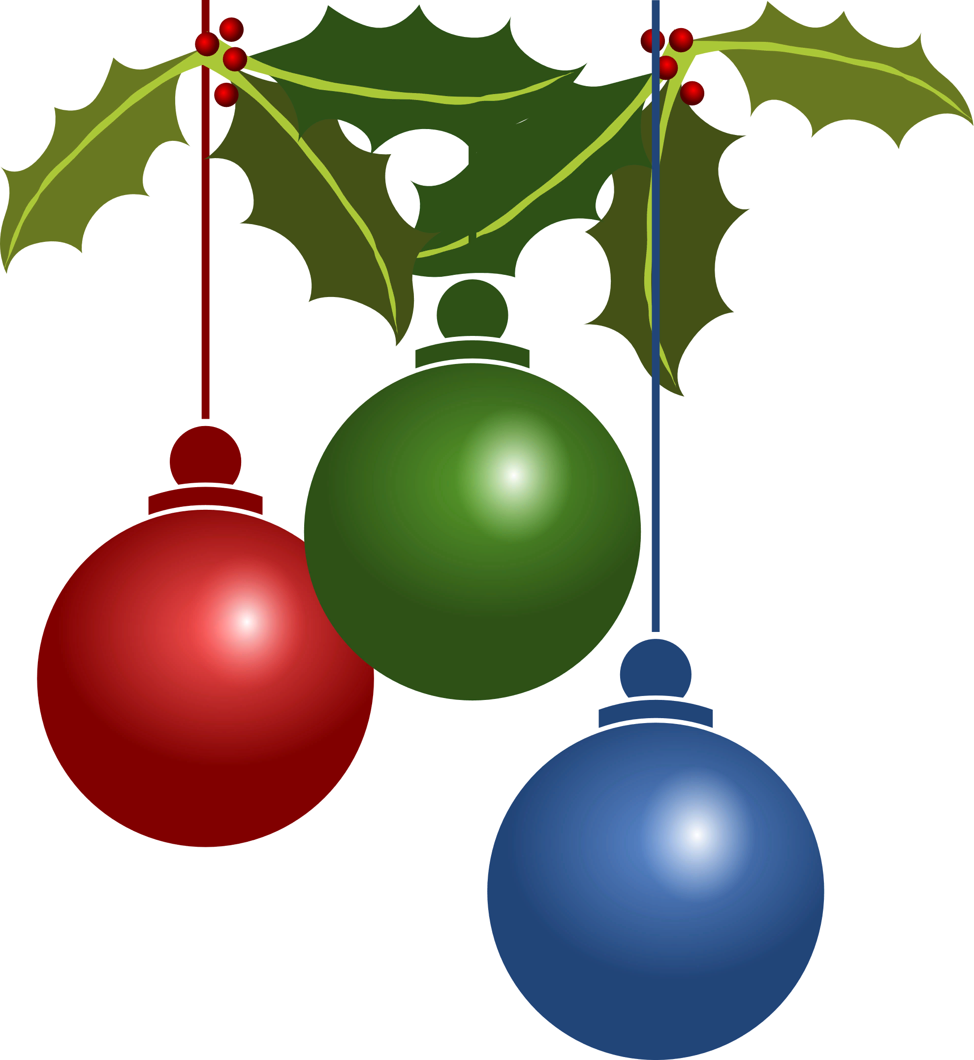
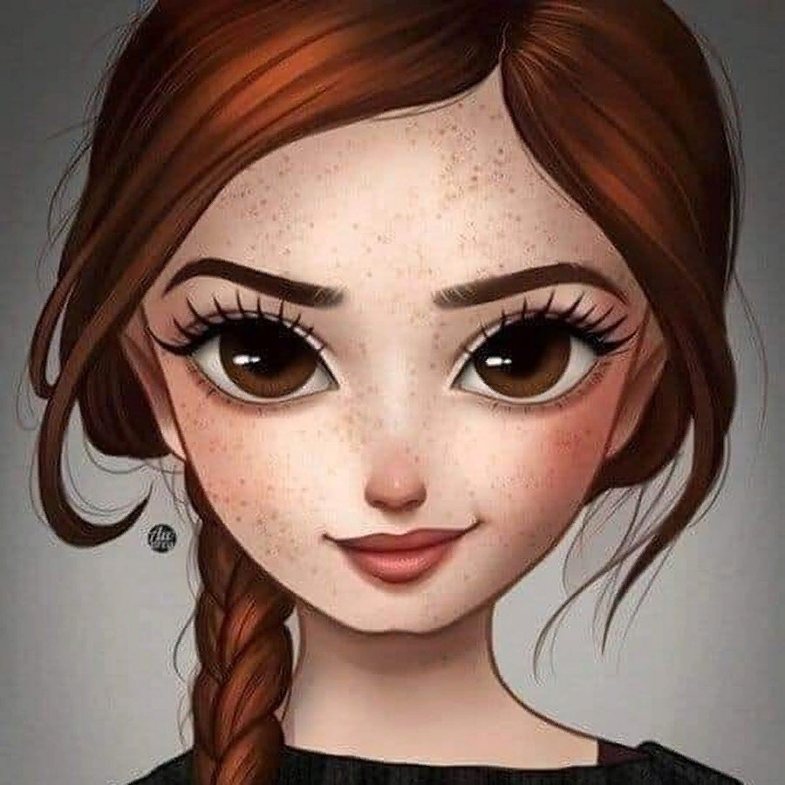
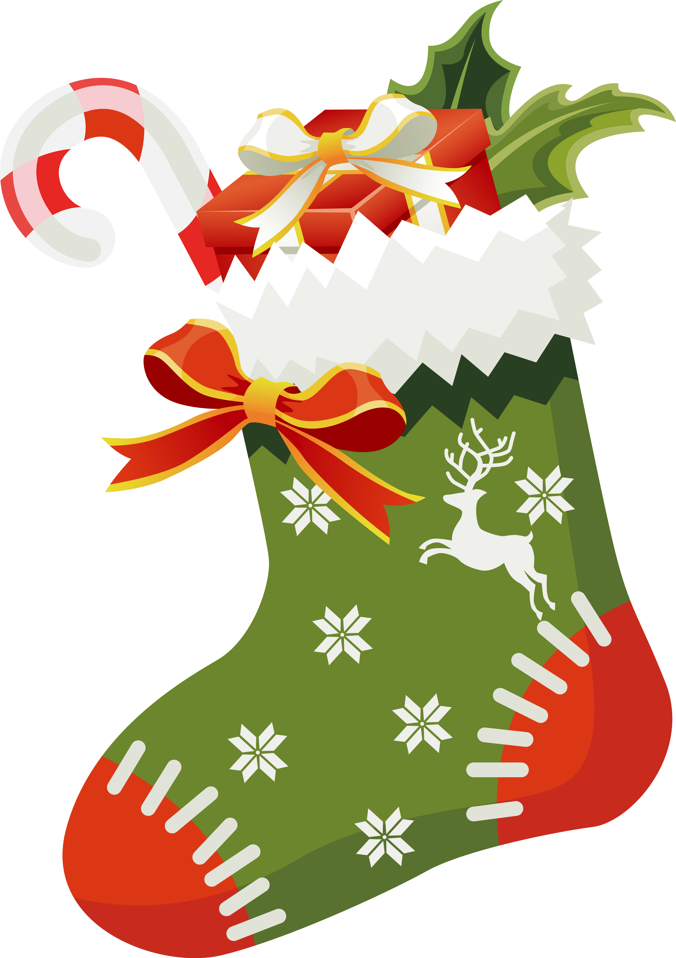
Holidays
10
Freckles –
веснушки
lights
ornaments
stocking

Slide 16
Holidays
20
It is a global day celebrating the social, economic, cultural, and political achievements of women.

Slide 17
Holidays
20
International
Women's Day

Slide 18
30

Slide 19
Holidays
30
It is a day of joy and celebration to commemorate that Jesus Christ is risen, according to Christian belief. People usually dye eggs and bake special cakes.

Slide 20
Holidays
30
Easter

Slide 21
Holidays
40
This holiday is common for couples to express the love exchanging gifts and going out for dinner together. It is usually celebrated with red roses, bouquets of flowers, chocolates, teddy bears and some special cards.

Slide 22
Holidays
40
St. Valentine’s Day

Slide 23
Holidays
50
The tradition of celebrating this holiday originated with the ancient Celtic festival of Samhain, when people would light bonfires and wear costumes to ward off ghosts.

Slide 24
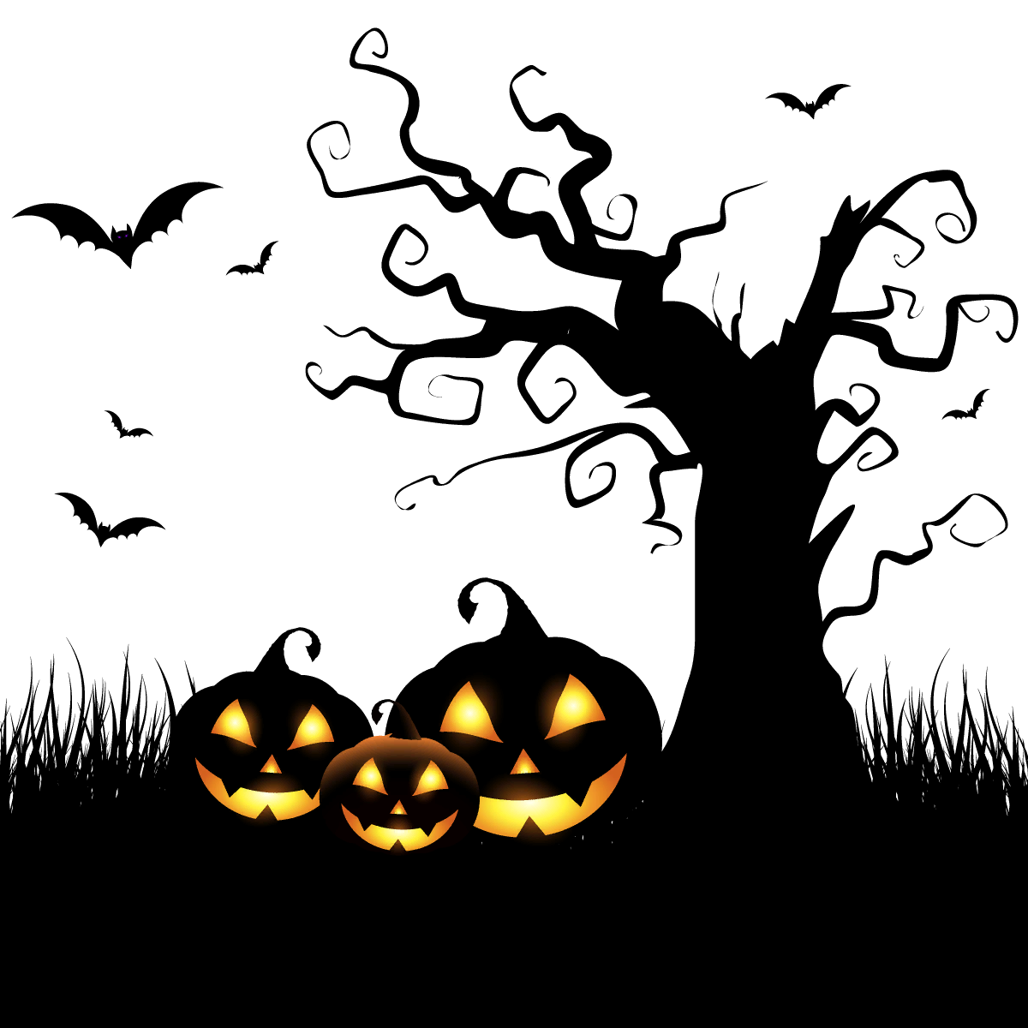
Holidays
50
Halloween

Slide 25
Vocabulary
10
Find the mistake and name the word correctly .
Cluod, frost, wind, storm

Slide 26
Vocabulary
10
cluod - cloud

Slide 27
Vocabulary
20
Find the odd word in each line.
1) Usual, typical, scary.
2) Sheep, duck, camel.
3) Tram, train, crossing.

Slide 28
Vocabulary
20
1) Usual, typical, scary.
2) Sheep, duck, camel.
3) Tram, train, crossing.

Slide 29
Vocabulary
30
Transform the verb into a noun.
write (писать)-___ (писатель)
2) cycle (ездить на велосипеде)- ____ (велосипедист)

Slide 30
Vocabulary
30
write (писать) - writer (писатель)
2) cycle (ездить на велосипеде)- cyclist (велосипедист)

Slide 31
Vocabulary
40
Match antonyms:
early
cheap
heavy
expensive
late
c) light

Slide 32
Vocabulary
40
early - b) late
cheap - a) expensive
heavy - c) light

Slide 33
50

Slide 34
Vocabulary
50
Put the letters in order to make
the nouns
atelb
geroan
umesum

Slide 35
Vocabulary
50
atelb - table
geroan - orange
umesum - museum

Slide 36
10

Slide 37
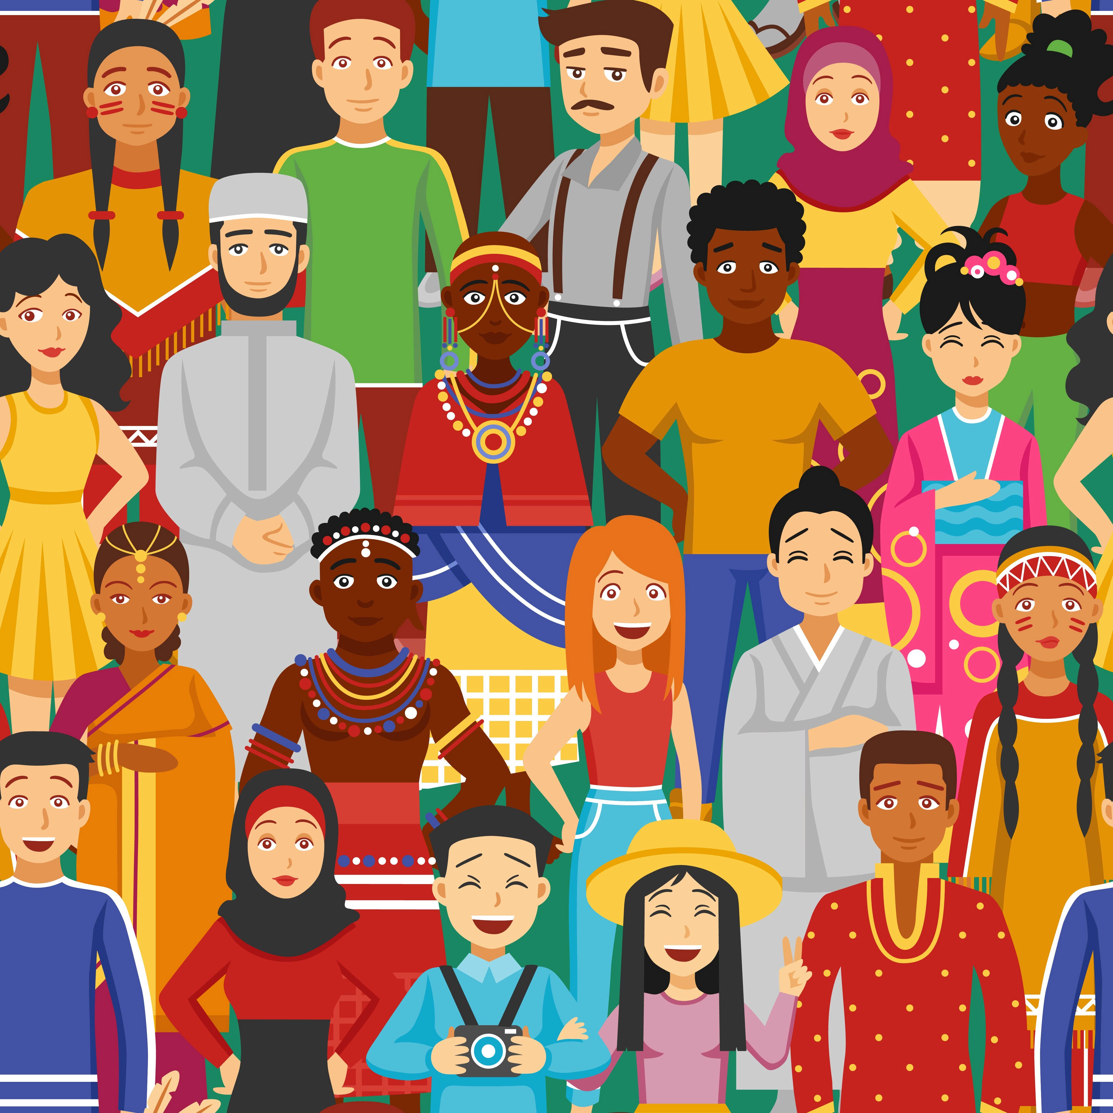
Around the world
10
Name the nationalities of these countries.
1) Britain-___
2) China-___
3) Russia-___

Slide 38
Around the world
10
1) Britain - British
2) China - Chinese
3) Russia -Russian

Slide 39
Around the world
20
Match the writers to their works.
Sir Arthur Conan
Doyle
2) R. Kipling
3) Joanne Rowling
a) Mowgli
b)Sherlock Holmes
c) Harry Potter

Slide 40
Around the world
20
Sir Arthur Conan Doyle - Sherlock Holmes
2) R. Kipling - Mowgli
3) Joanne Rowling - Harry Potter

Slide 41
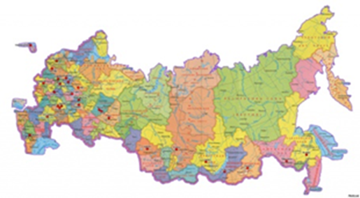
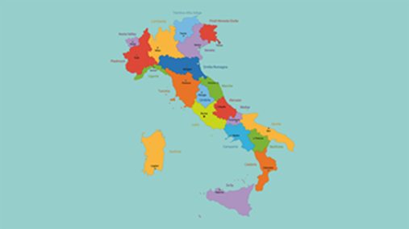
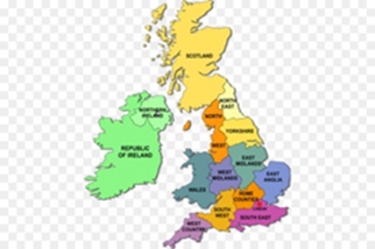
Around the world
30
Choose the map of the UK
a) b) c)

Slide 42
Around the world
30
c) The UK

Slide 43
Around the world
40
Mexico is situated in the continent…
a) South America
b) North America
c) Africa

Slide 44
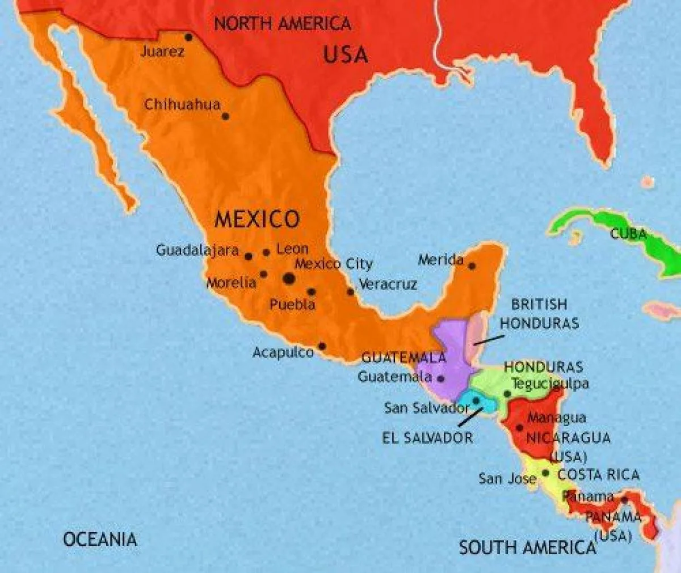
Around the world
40
Mexico is situated in the continent North America

Slide 45
Around the world
50
The highest mountain in Great Britain is______
a) Everest
b) Ben Nevis
c) Himalayas

Slide 46
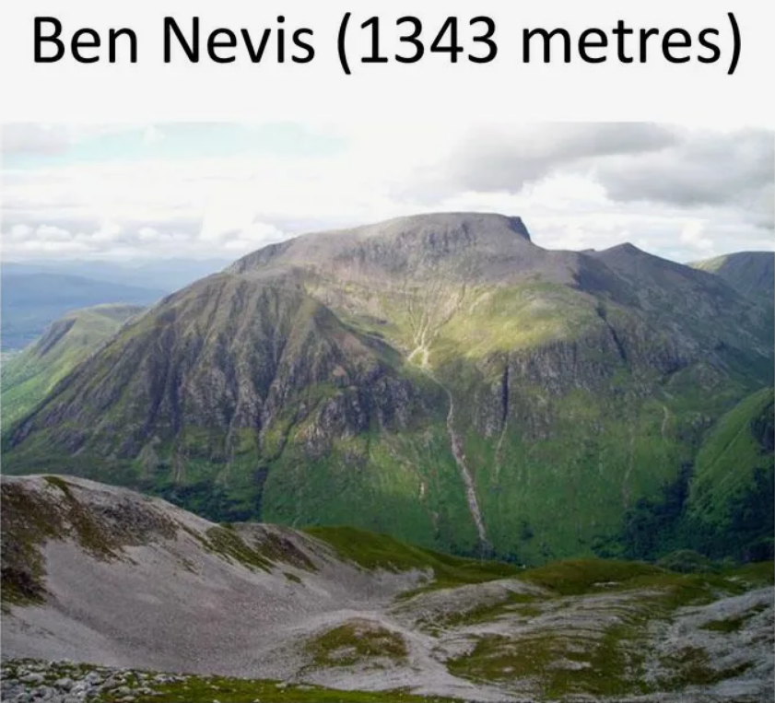
Around the world
50
The highest mountain in Great Britain is Ben Nevis

Slide 47
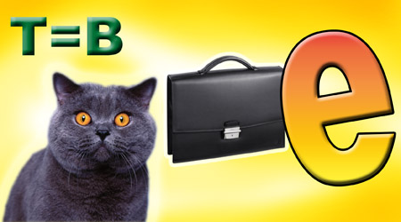
Rebus
10

Slide 48
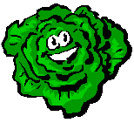
Rebus
10
CABBAGE

Slide 49
20

Slide 50
Rebus
20

Slide 51
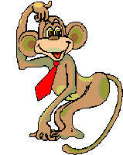
Rebus
20
MONKEY

Slide 52
Rebus
30

Slide 53
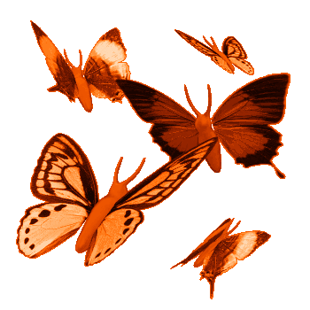
Rebus
30
SUMMER

Slide 54
Rebus
40

Slide 55
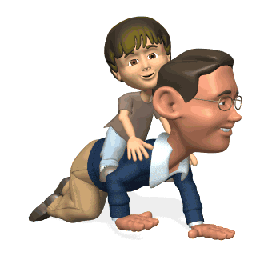
Rebus
40
PARENT

Slide 56
Rebus
50

Slide 57
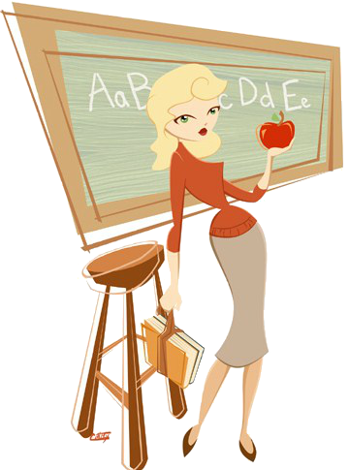
Rebus
50
TEACHER

