Slide 1
Sport: the history of Olympic games.
Поготовил:
ученик 8 класса МКОУ ЦО №5
МО Ефремовский
муниципального округа Тульской области
Губарев Кирилл.
Руководитель: учитель английского языка
Федорова Наталья Николаевна

Slide 2
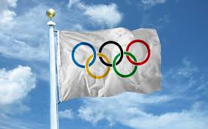
Olympic games
Proverb: A sound mind in a sound body.

Slide 3
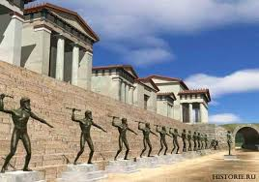
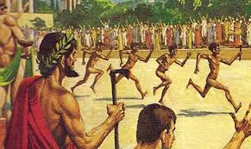
The tradition of holding the Olympic games, which existed in Ancient Greece, originated as part of a religious cult. Games were held from 776 BC to 394 ad, there were 293 of the Olympics in Olympia, considered among the Greeks as a sacred place. From Olympia comes the name of the Game.

Slide 4
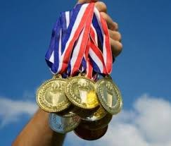
Modern Olympic games — largest international complex sport competitions, which are held every four years under the auspices of the International Olympic Committee. Medal won at the Olympic Games, is considered one of the highest achievements in the sport.

Slide 5
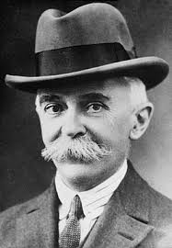
Modern Olympic games were revived in the late XIX century French philanthropist Pierre de Coubertin. Olympic games, also known as the summer Olympic games were held every four years since 1896, except for years have come on the world war.

Slide 6
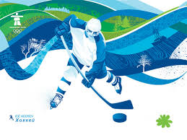
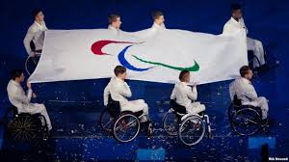
In 1924 were established Olympic winter games, which were originally carried out in the same year, that summer. However, since 1994, the time of the winter Olympics shifted by two years relative to the time of the summer Games. In the same places of holding the Olympic games a few days later, the Paralympic games are held for people with disabilities.

Slide 7
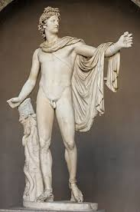

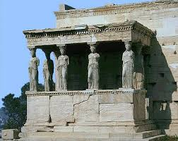
The Olympic games of Ancient Greece were a religious and sports festival, held at Olympia. Information about the origin of games lost, but preserved several myths that describe the event. From the history we have reached a number of documents, buildings and sculptures of the period. If you look closely, you will notice that all the statues of the period show bodies of people, and not just any body, and beautiful.

Slide 8
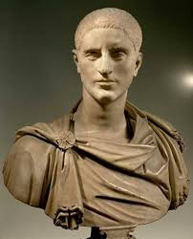

At the time of the Games was declared a sacred truce at that time it was impossible to wage war, although it has been repeatedly violated. The Olympic games significantly lost its importance with the arrival of the Romans. After Christianity became the official religion, the game came to be regarded as a manifestation of paganism, and in 394 BC they were banned by Emperor Theodosius I.

Slide 9
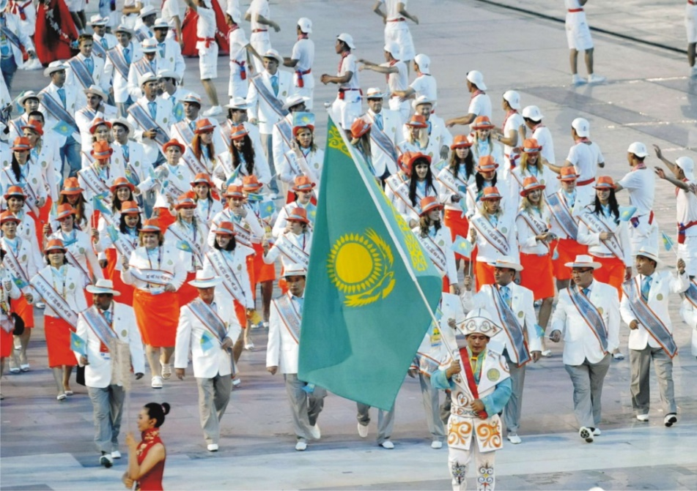

Principles, rules and regulations of the Olympic games are defined by the Olympic Charter, whose bases are affirmed by International sport Congress in Paris in 1894, it adopted the proposal of the French teacher and public figure of Pierre de Coubertin, the decision to organize the Games on the model of the antique and the establishment of the International Olympic Committee . According to the Charter, the Olympic games "...unite the athletes of all countries in fair and equal competitions. In relation to countries and individuals, no discrimination on racial, religious or political motives...".

Slide 10
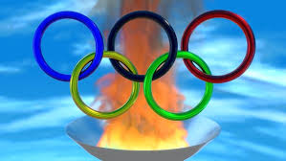
The symbol of the Olympic games — the Olympic rings, five fastened rings, symbolizing the Union of the five inhabited continents in the Olympic movement. The color of the rings in the top row — blue, black and red. In the bottom row is yellow and green. Contrary to the common version, each of the rings is not related to any particular continent. The Olympic movement has its own emblem and flag, approved by the IOC upon the proposal Coubertin in 1913. Emblem — Olympic rings. Motto — faster, higher, stronger.

Slide 11
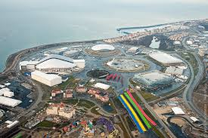
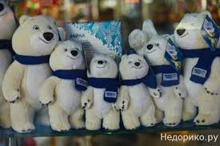
From 1932 the city-the organizer is building the "Olympic village" — a complex of residential facilities for participants of the games. The organizers of the Games developing the Olympic symbols: the official emblem and mascot of the Games. The emblem typically has a unique design, designed in accordance with the characteristics of the country. The emblem and the mascot Games are an integral part of souvenir products manufactured in Azerbaijan in large numbers. Revenues from sales of Souvenirs can make up a large part of the revenues from the Olympics, but they do not always cover the costs.

