Slide 1
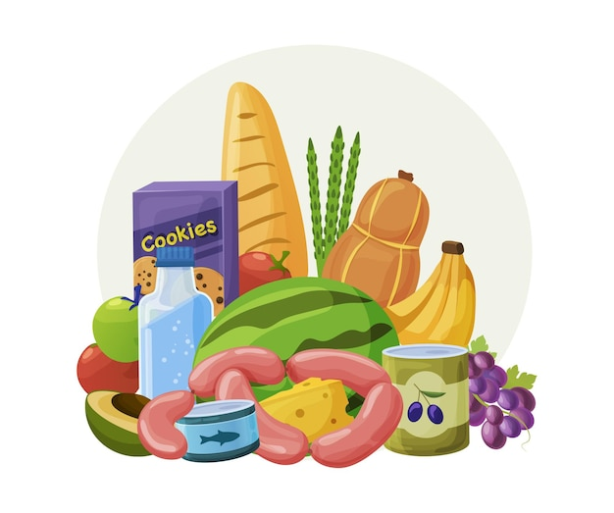
What is the topic of the lesson?
The topic of the lesson is ………

Slide 2
The topic of the lesson is FOOD

Slide 3
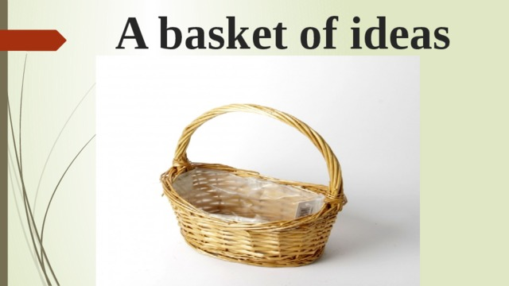
Выбрать нужные цели к уроку и поместить в «корзину»
Play football Draw speak English
Read about Food Listen to stories about Food
Play volleyball Play tennis do sums
Learn new words Play games Speak about Food

Slide 4

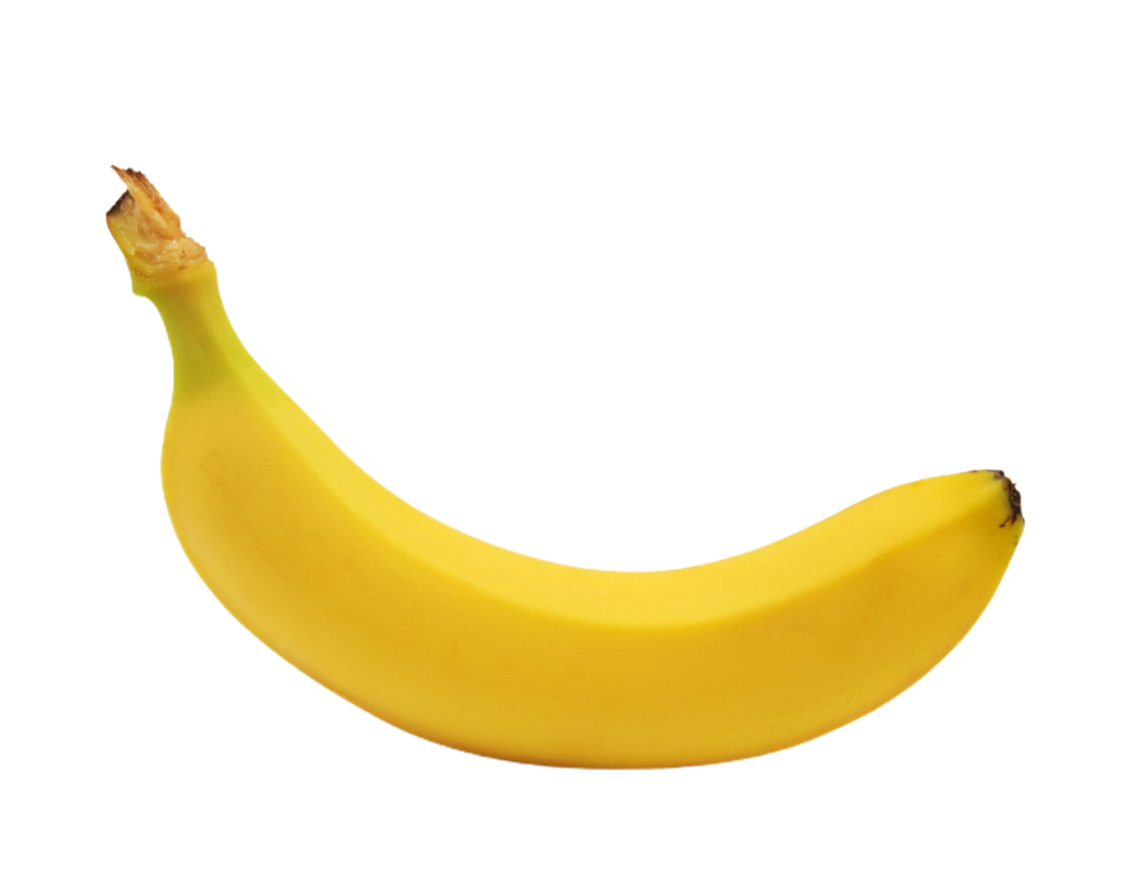
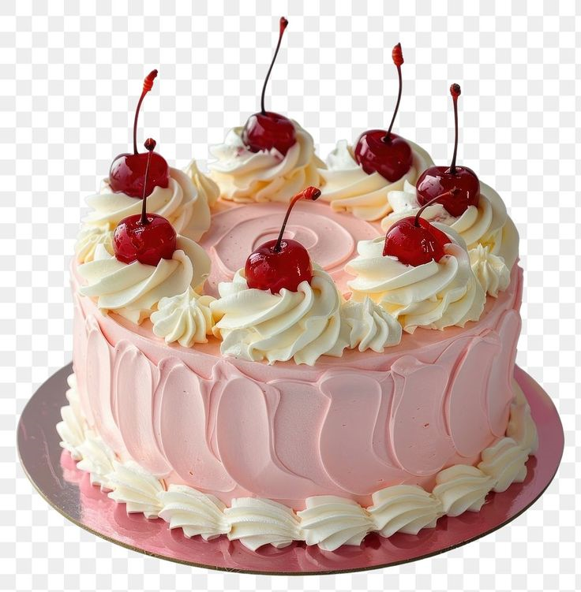
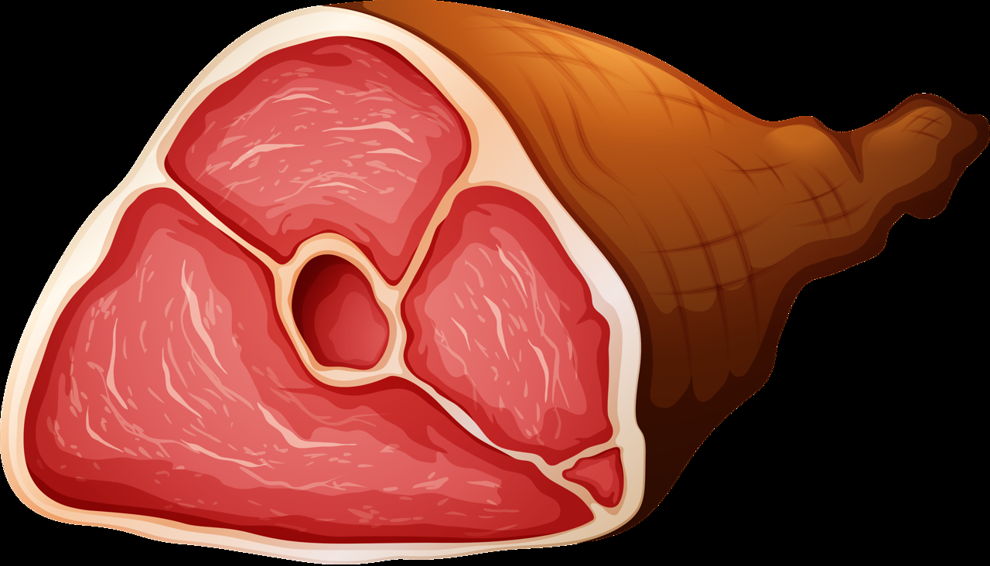
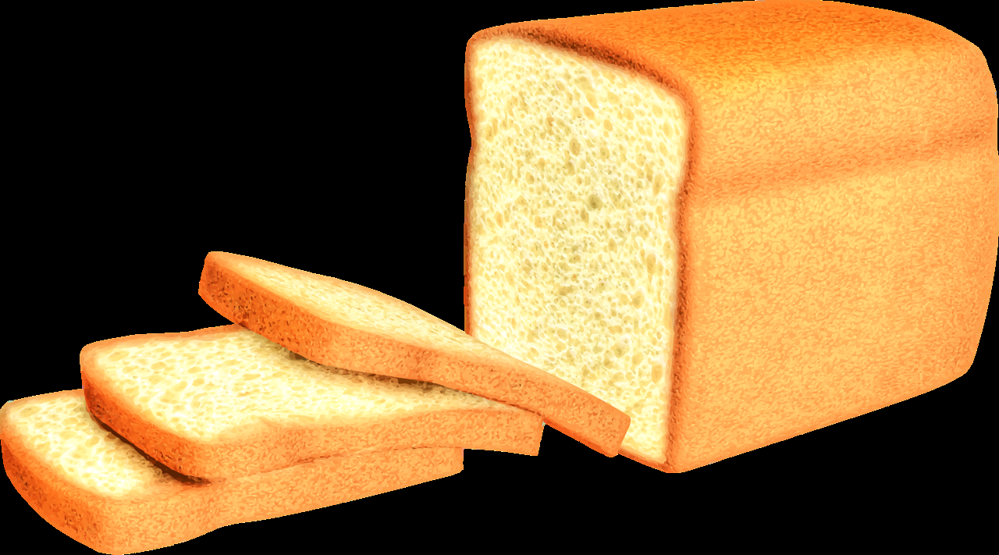

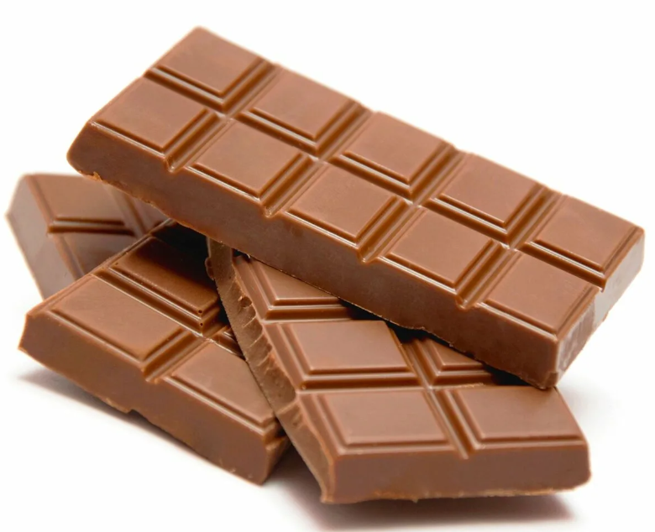

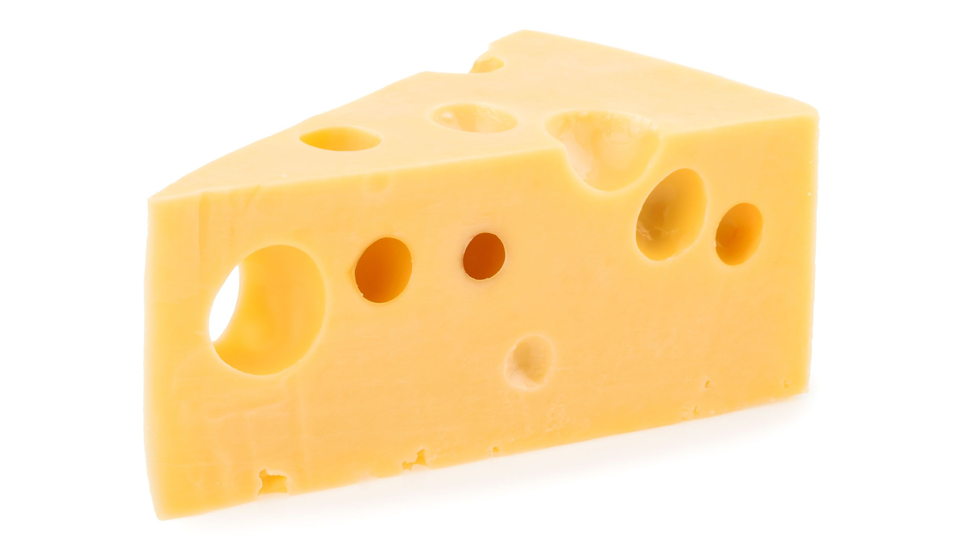



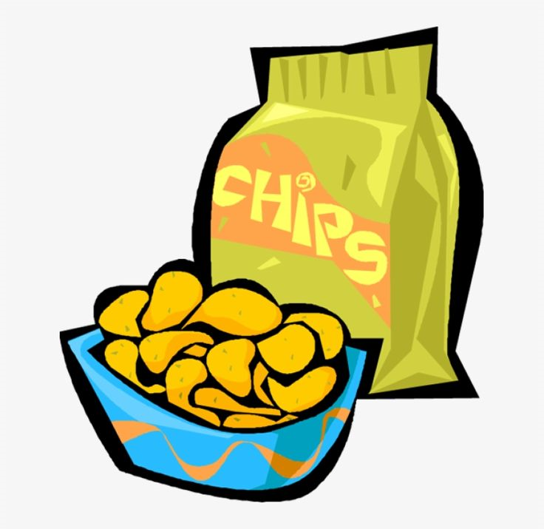
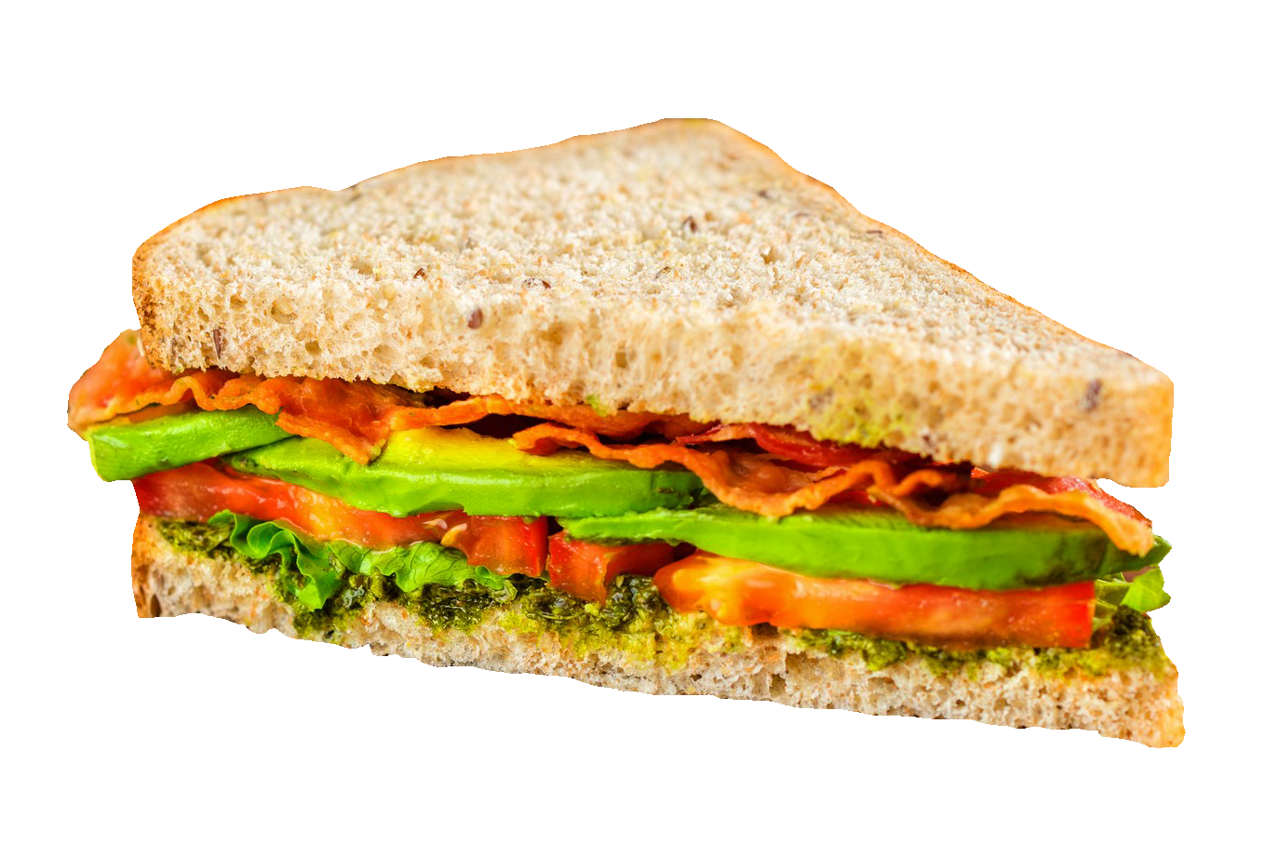

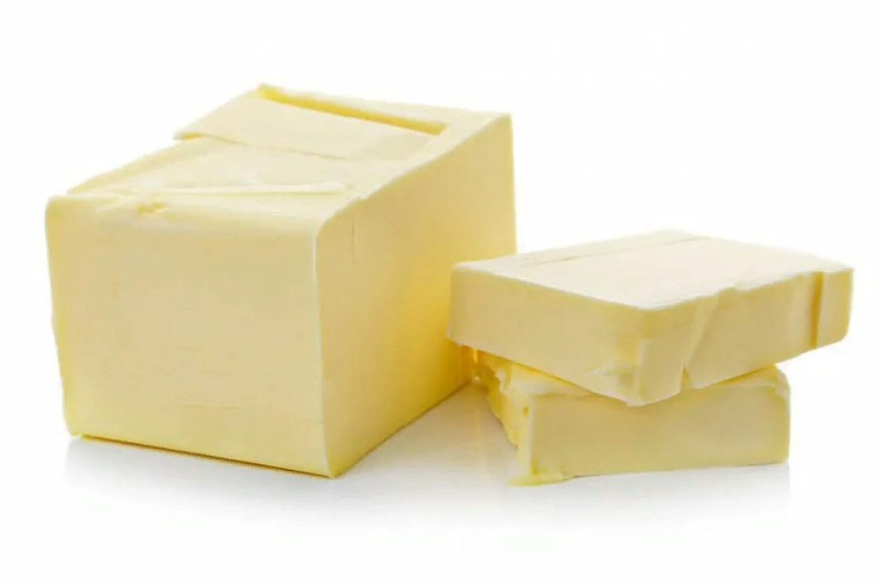

Slide 5
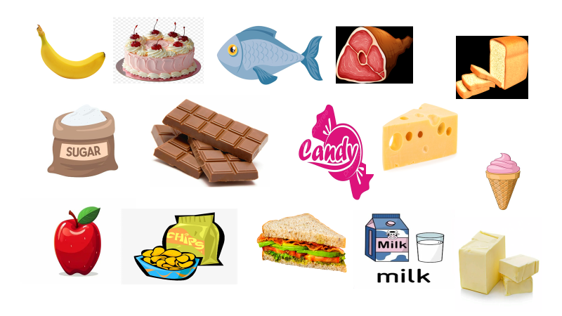
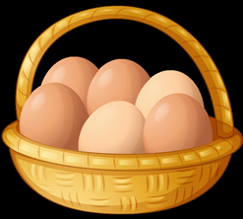
What food do you like? I like ……..
What food does your friend like. My friend likes…..
What is your favourite food? My favourite food …

Slide 6


Slide 7
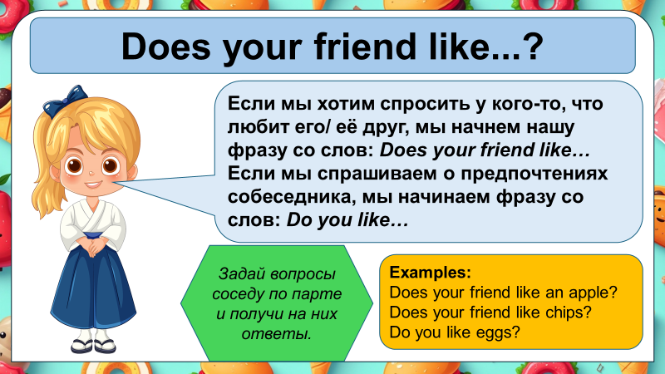

Slide 8
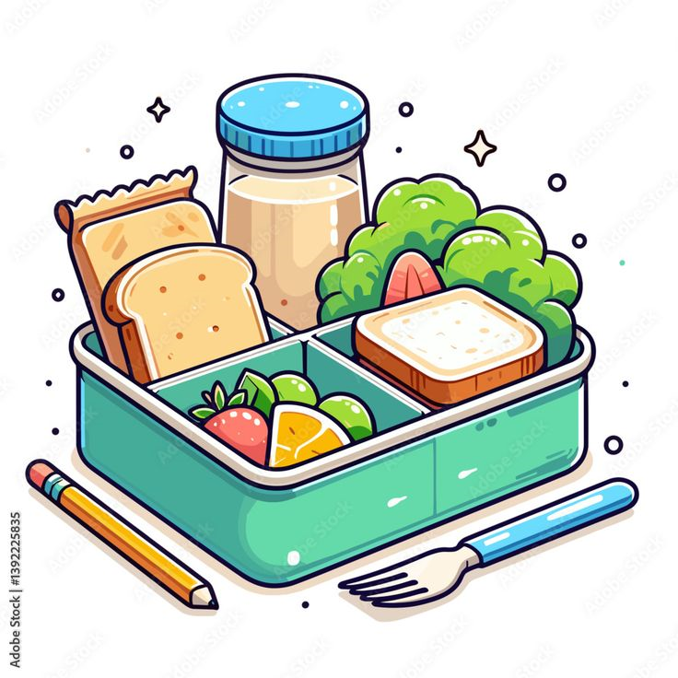
Работа в командах . Давайте соберём
Lunch –box

Slide 9
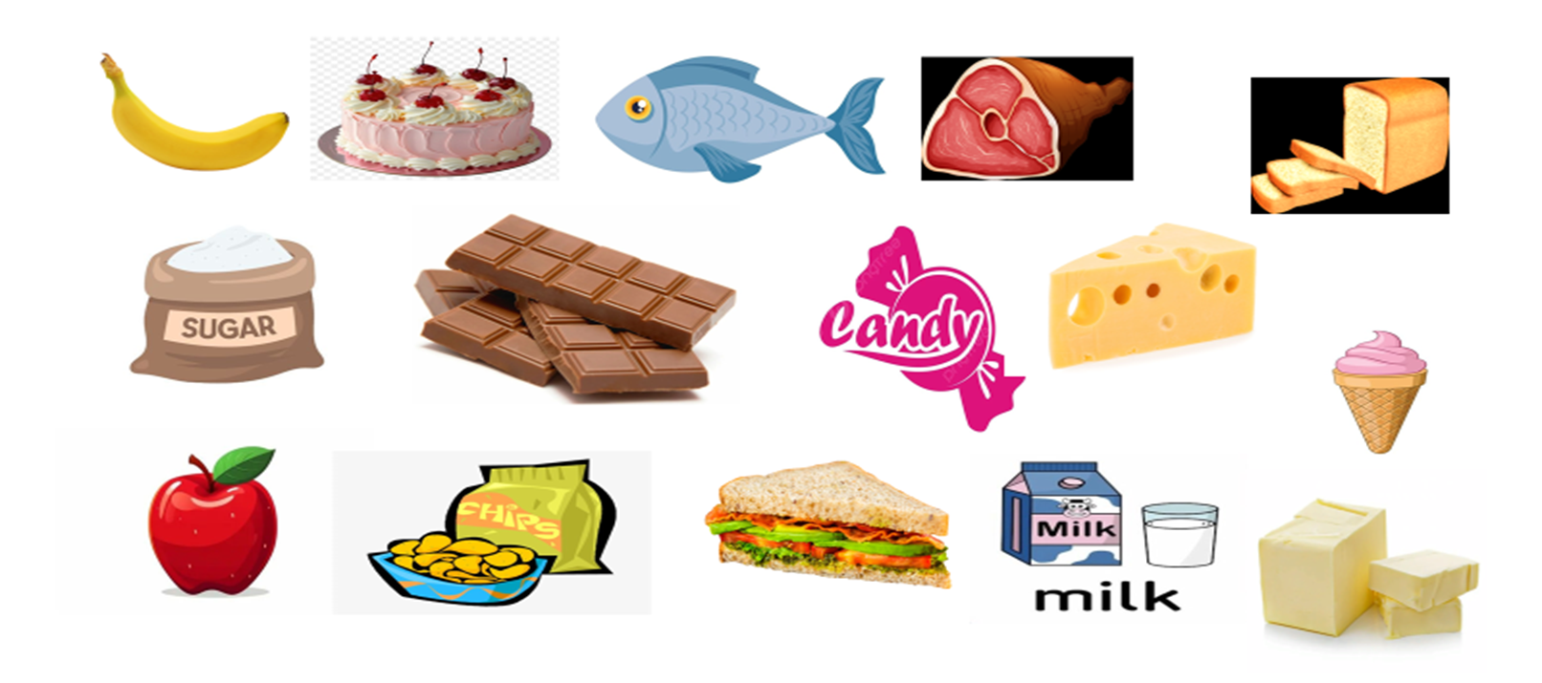
Choose healthy food and put it in your box

Slide 10
