Slide 1
The 3rd of September, Monday
Good morning
Good afternoon
Good evenening

Slide 2
Let’s remember (Давайте вспомним)
Read, write, run, jump, swim, ride a bike, dance, sing, take pictures, play games, skip, do sports
New words (новые слова)
Morning
Evening
Afternoon
Head – голова
Hair - волосы
Nose - нос
Eye - глаз
Fair – светлый, белокурый

Slide 4
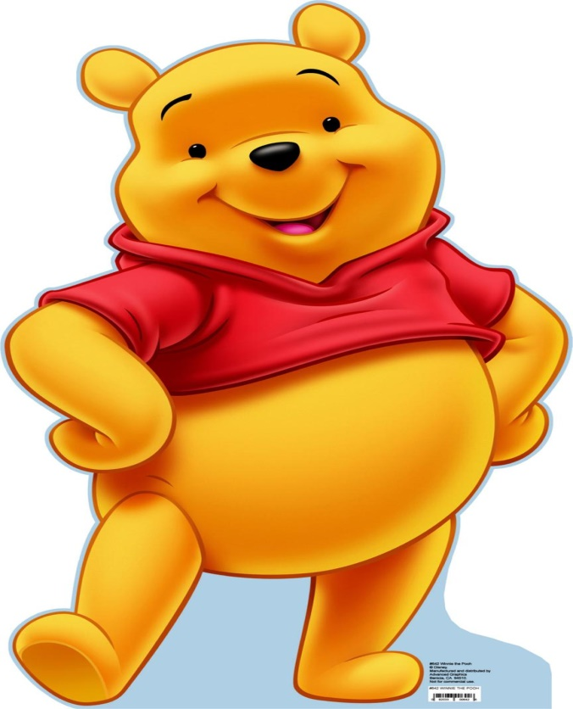
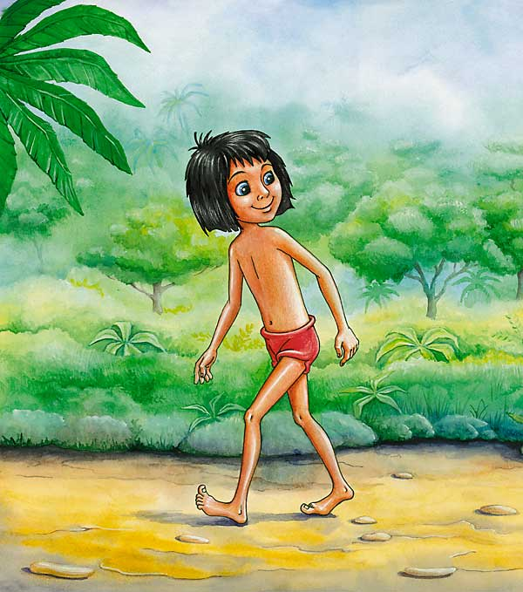
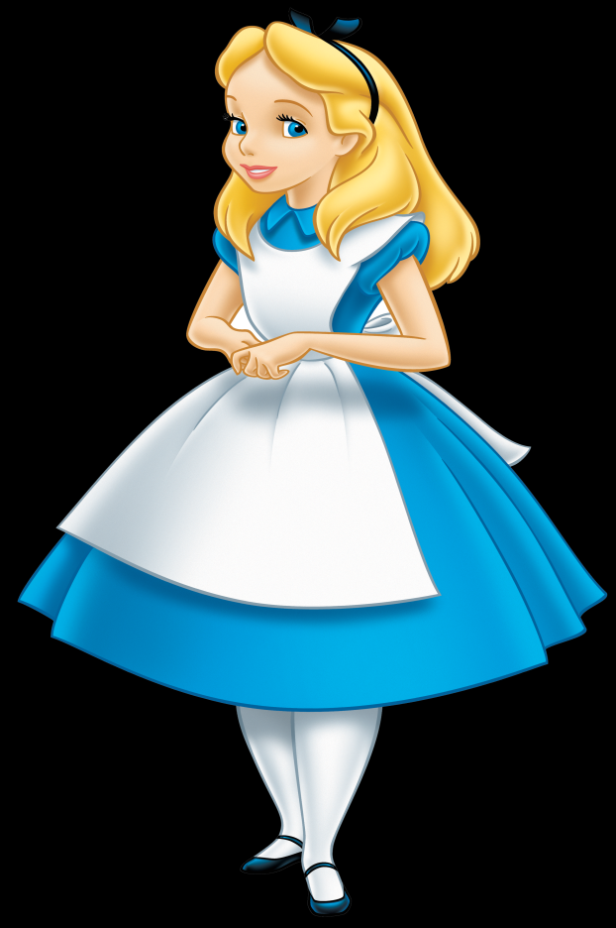
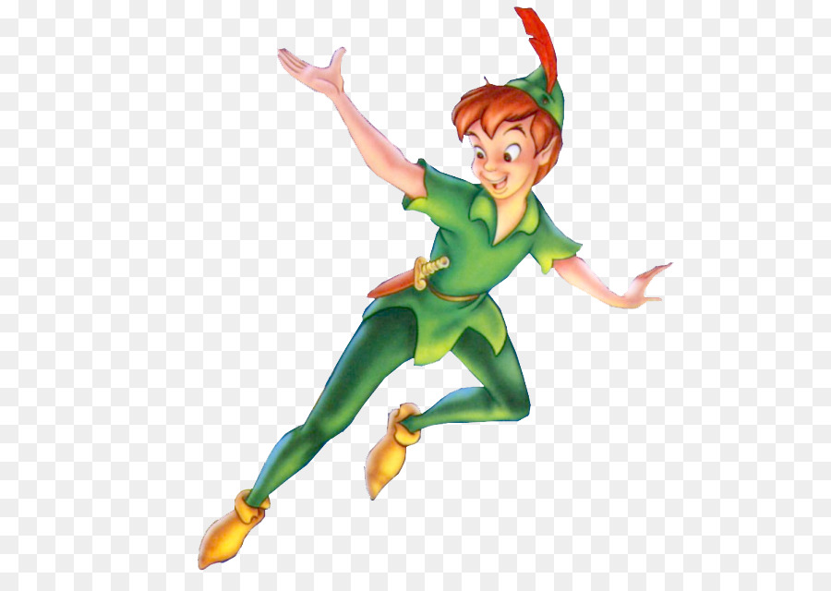
Who is that?
It’s …

Slide 6
HOMEWORK
Слова в словарь+учить, У. с 7 упр 5б, флешка.

