Slide 1
Madonna Louise Ciccone Ritchie

Slide 2
Early life
Madonna Louise Ciccone was born in Bay City, Michigan. She was the third of six children (Martin, Anthony, Christopher, Paula, Melanie, Mario & Jennifer) born to Silvio "Tony" Ciccone, an Italian-American Chrysler engineer whose parents originated from Pacentro, and Madonna Louise Fortin, who was of Quebecois descent.
She was raised in a Catholic family in the Detroit suburbs of Pontiac and Avon Township (now Rochester Hills). Madonna's mother died of breast cancer at age 30 on December 1, 1963. Her father later married the family housekeeper, Joan Gustafson, and they had two children together.

Slide 3
While performing as a dancer for the French disco artist Patrick Hernandez on his 1979 world tour, Madonna became involved with the musician Dan Gilroy, with whom she later formed her first rock band, the Breakfast Club. In it, she sang and played drums and guitar before forming the band Emmy in 1980 with drummer and former boyfriend Stephen Bray. She and Bray wrote and produced dance songs that brought her local attention in New York dance clubs. DJ and record producer Mark Kamins was impressed by her demo recordings, so he brought them to the attention of Sire Records founder Seymour Stein.

Slide 4
Her debut album, Madonna, a collection of dance songs, was primarily produced by Reggie Lucas, but in the process both realized they could not work well together. After initial production on the album was completed, Madonna took the record to her then boyfriend, John "Jellybean" Benitez, who remixed and rearranged it. It reached number eight on the U.S. albums chart and contained three successful Hot 100 singles, "Holiday", "Borderline", and "Lucky Star". At the time of its release, Madonna sold three million copies worldwide, one million of those in the U.S. It has since been certified with current sales of thirteen million worldwide.

Slide 5
Later that year she appeared in the commercially and critically successful film Desperately Seeking Susan, with her comedic performance winning her positive reviews. The film introduced the dance song "Into the Groove", which was released as a B-side to her single "Angel", peaking at number five in the US and becoming a major hit internationally, and her first number one in the UK.
In 1985, Madonna entered mainstream films, beginning with a brief appearance as a club singer in the film Vision Quest. The soundtrack to the film contained her second number one pop hit, the Grammy-nominated ballad "Crazy for You", as well as the UK hit "Gambler"

Slide 6
Madonna embarked on her first concert tour in the U.S. in 1985 titled The Virgin Tour, with opening act The Beastie Boys.

Slide 7
Relationships and family

Slide 8
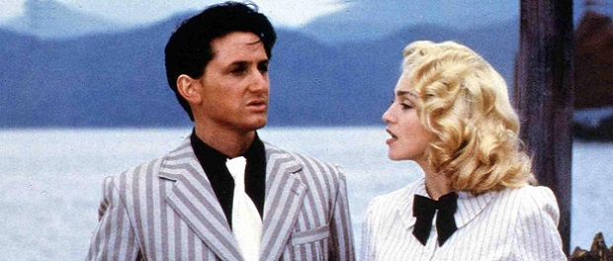
While filming the music video for "Material Girl" in 1985, Madonna began dating actor Sean Penn. The two were married later that year on Madonna's twenty-seventh birthday. Their relationship was marred by Penn's frequent outbursts against the press, leading the couple to be dubbed the “Poison Penns.” After filing and withdrawing divorce papers in December 1987, Madonna and Penn separated on New Year's Eve of 1988 after allegations of abuse on Penn's part, and were officially divorced in September 1989. Of her marriage to Penn, Madonna later told Tatler, "I was completely obsessed with my career and not ready to be generous in any shape or form."

Slide 9
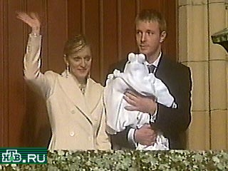
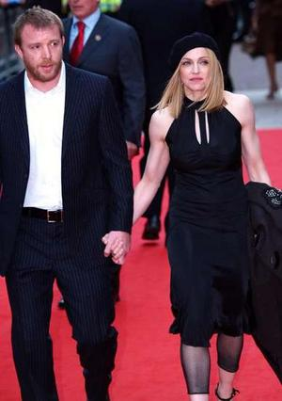
On August 11, 2000, Madonna gave birth to a son, Rocco John Ritchie, with Guy Ritchie, whom she had met in 1999 through mutual friends Sting and his wife, Trudie Styler. On December 22, 2000, Madonna and Ritchie were married in Scotland. As of 2007, Madonna resides in London and her country estate in Wiltshire, with Ritchie and their children. Because of Malawi laws, Madonna and Guy Ritchie remain David Banda's foster parents for the required eighteen-month period.

Slide 10
Political views
Madonna does not support United States President George W. Bush. She endorsed Wesley Clark's Democratic nomination for the 2004 United States presidential election in an impassioned letter to her fans, saying at the time that "the future I wish for my children is at risk." In the autumn of 2006, she expressed her support for Hillary Clinton in the 2008 election Most recently she stated that she would be behind Al Gore if he decided to run for the 2008 elections after seeing his documentary on global warming, An Inconvenient Truth.

Slide 11
Criticism
Moments of her career in which Madonna has been heavily criticized include her 1989 music video for "Like a Prayer", the publication of the book Sex and album Erotica in 1992, her 2006 performance of "Live to Tell" during the Confessions Tour, and her adoption of Malawian infant David Banda in 2006.
Much of her career has seen rebellion against the Roman Catholic Church, which has generated criticism in the past. In 1990, when Madonna toured Italy with the Blond Ambition Tour, the Pope encouraged citizens not to attend the concert. The Pope accused Madonna of blasphemy against the Catholic Church (a crime in Italy), and attempted to have her banned from stepping foot on Italian soil[citation needed]. A private association of devout Roman Catholics, called Famiglia Domani, also boycotted the show for many of the same displays of sexual innuendos and eroticism the Pope had denounced.

Slide 12
Many critics, however, see Madonna as a talented vocalist and songwriter. She received good reviews for "Love Don't Live Here Anymore" cover on which her performance was described as a "heartfelt vocal". Her vocals on "Live to Tell" were considered her best at the time by some, and the song's lyrics have been described as "poignant.

Slide 13
Thank you for your attention!

