Slide 1



Good morning!

Slide 2

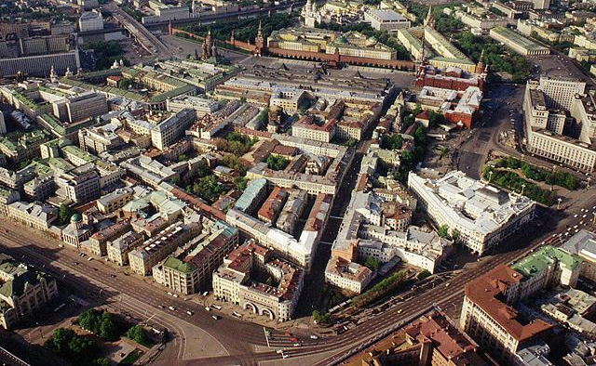

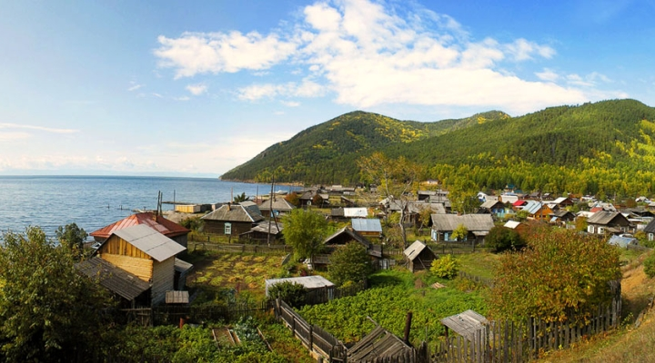

SEPTEMBER | JUNE | JANUARY | APRIL
AND | THE | ARE | RENT
JULY | FEBRUARY | MAY | NOVEMBER
COUN | THEY | : | CITY
MARCH | DECEMBER | OCTOBER | AUGUST
DIFFE | ? | THE | TRY
large
a city
ARE
THEY
DIFFE
RENT
:
THE
COUN
TRY
AND
THE
CITY
?
small
a country

Slide 3


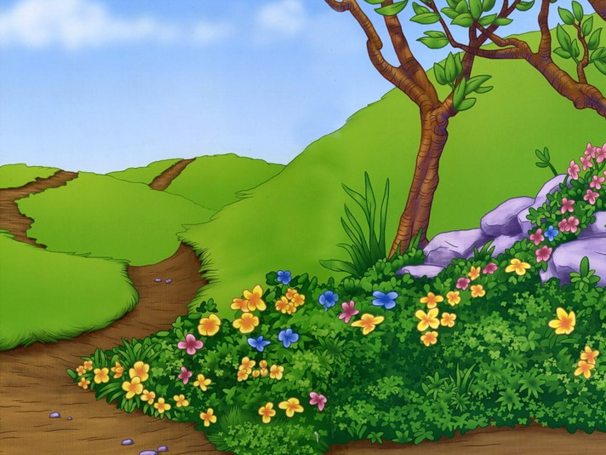

a road
a river
the hills
the country Adjectives

Slide 4
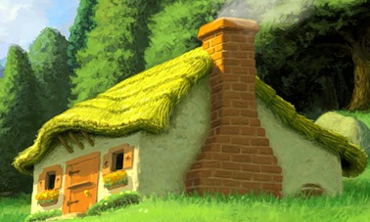
weather
погода
cloudy
облачно, облачный
sunny
солнечно, солнечный
windy
ветрено, ветреный
cold
холодно, хололный
rainy
дождливо, дождливый
warm
тепло, теплый
hot
жарко, жаркий
snowy
снежно, снежный
What a pity! Как жаль!

Slide 6
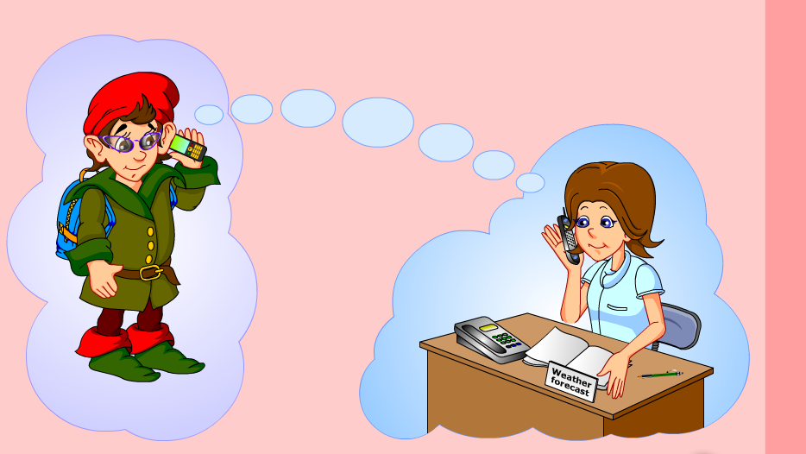

Slide 7
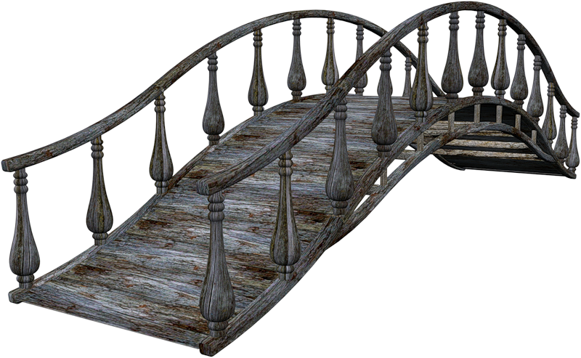

Slide 8
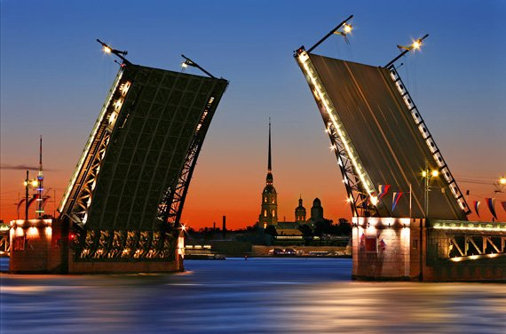
St Petersburg [sǝnt ‘pi:tǝz,bɜ:g]

Slide 9
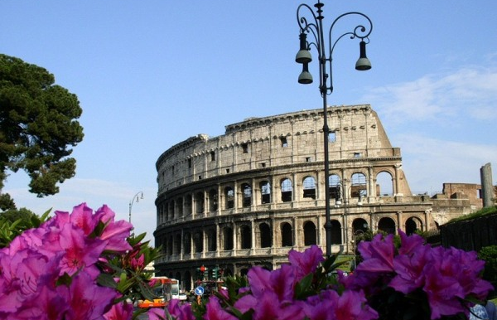
Rome [rǝum]

Slide 10
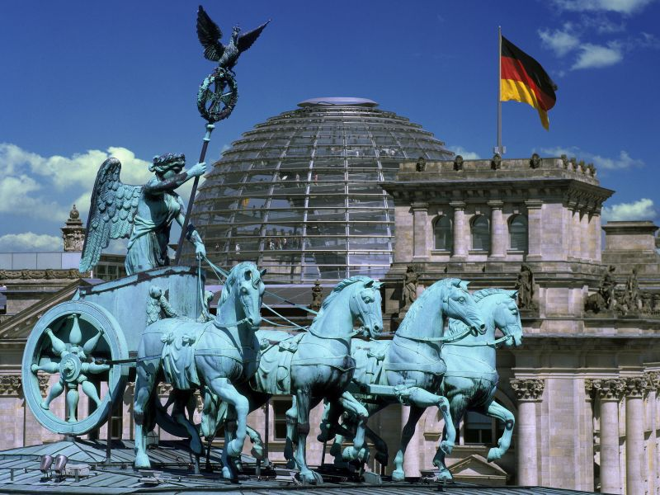
Berlin [bɜ:’lin]

Slide 11
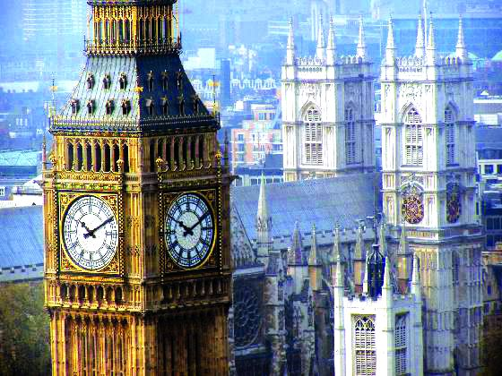
London [‘lʌndǝn]

Slide 12
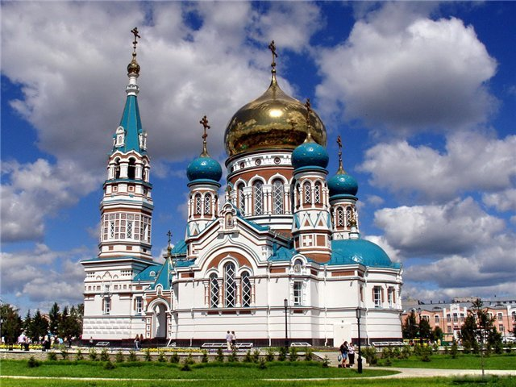
Omsk [omsk]

Slide 13
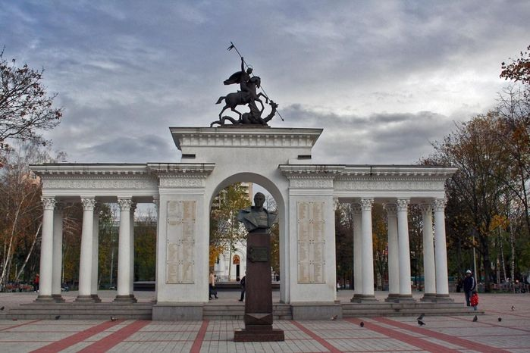
Krasnodar [,kra:snǝ’da:]

Slide 14
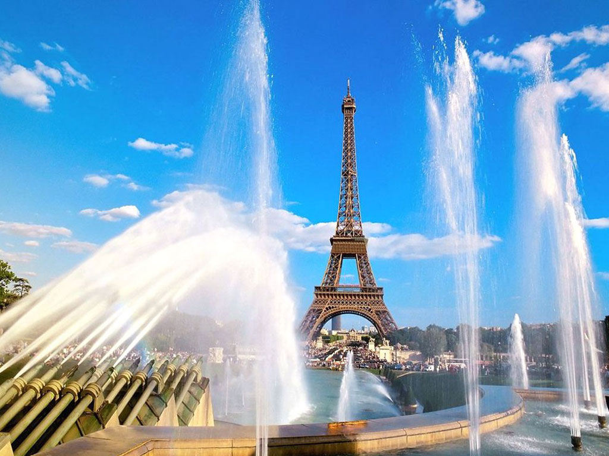
Paris [‘pæris]

Slide 15
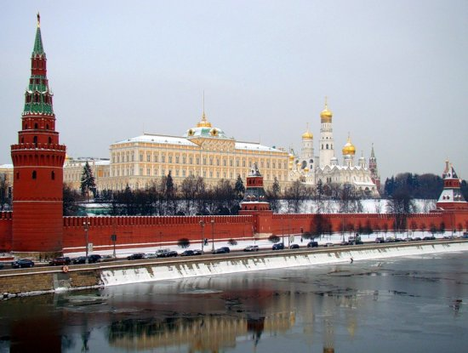
Moscow [‘moskǝu]

Slide 16

St Petersburg [sǝnt ‘pi:tǝz,bɜ:g]
Rome [rǝum]
Berlin [bɜ:’lin]
London [‘lʌndǝn]
Omsk [omsk]
Krasnodar [,kra:snǝ’da:]
Paris [‘pæris]
Moscow [‘moskǝu]
- What is the weather like in …?
- It’s …

Slide 17
Adjectives

Slide 18
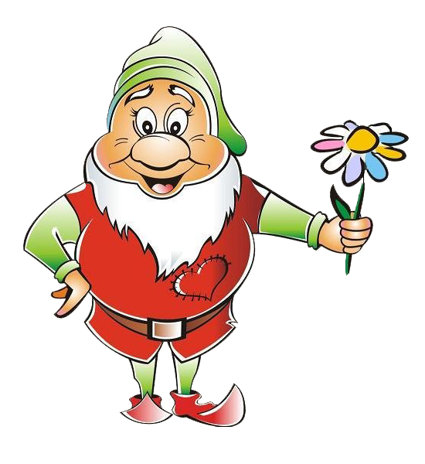
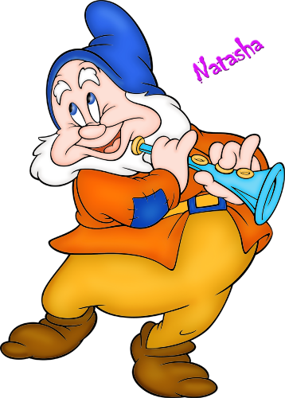
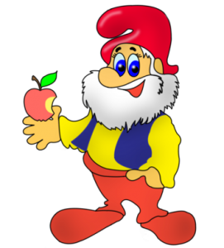
- er
the
- est

Slide 19

The Superlative degree
The Сomparative degree
the
-est
-er

Slide 20
- er
the
- est
small
the
small
er
est
small

Slide 21
- er
the
- est
bigg
er
the
bigg
est
big

Slide 22
_________+ er/est = _____________er/est long- longer – (the) longest
_________e + er/est = ___________e er/est nice – nicer – (the) nicest
согл₁ +гласн + согл₂ ₊ er/est = согл₁ +гласн + согл₂ ₊ согл₂ er/est big – bigger – (the) biggest
________согл +у + er/est = ___________согл + у i er/est happy – happier – (the) happiest

Slide 24
easier
happier
the hottest
the happiest
the bravest
colder
Positive degree | Comparative degree | Superlative degree
1. cold |  | the coldest
2. brave | braver
3. hot | hotter
4. easy |  | the easiest
5. happy

Slide 25

take off [teik of] - снимать
coat [kǝut] - пальто
“Which is stronger?”
The Sun is stronger!

Slide 26

p.22 ex.6(wb)
p. 38 learn the rule

Slide 27

You are the smartest pupils!
The lesson is over. Good bye!

