Slide 1

Типы вопросов
Работу выполнила:
Учитель английского языка
Бирючина Е.С.
МБОУ Урывская СОШ
2016-2017 учебный год

Slide 2
5 Types of Questions:
The General Question (общий вопрос)
Вспомогат. гл. + подлежащ. + сказуемое в I форме … ?
II. Who – Question (вопрос к подлежащему)
Who + сказуемое в 3 л. ед.ч. … ?
III. The Special Question (специальный вопрос)
Вопросит. слово + вспомогат. гл. + подлежащ. + сказуемое в I ф…?
IV. The Alternative Question (альтернативный вопрос)
Вспомогат. гл. + подлежащ. + сказуемое в I ф. + … or … ?
V. The Tag - Question (разделительный вопрос)
, вспом.гл. + not + местоимение, замена
not , вспом.гл. + местоимение, замена

Slide 3
We clean the room every day.
Do we clean the room every day?
Who cleans the room every day?
When do we clean the room?
Do we clean the room every day or every evening?
We clean the room every day, do not we?

Slide 4
My sister reads very well.
Does my sister read very well ?
Who reads very well ?
What does my sister read ?
Does my sister read or write very well ?
My sister reads very well, does not she ?

Slide 5
Домашнее задание
- What are you going to do tomorrow / tonight / next week?
- I’m going to visit some friends next weekend.
- What shall we do this evening?
- Let’s go see a film.
- Why don’t we go out / play tennis / visit friends tonight?
- Yes, that sounds like a good idea.

Slide 6
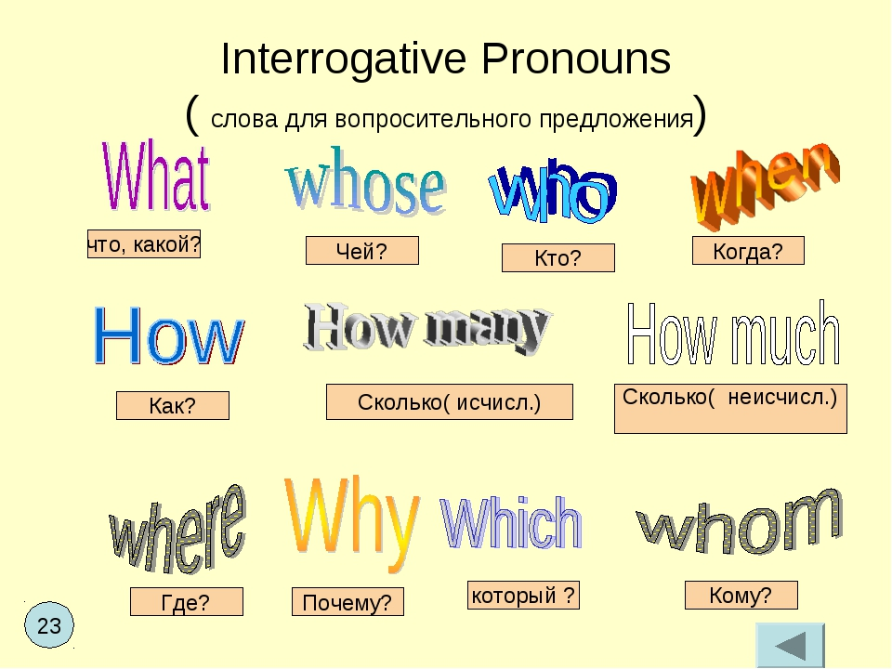
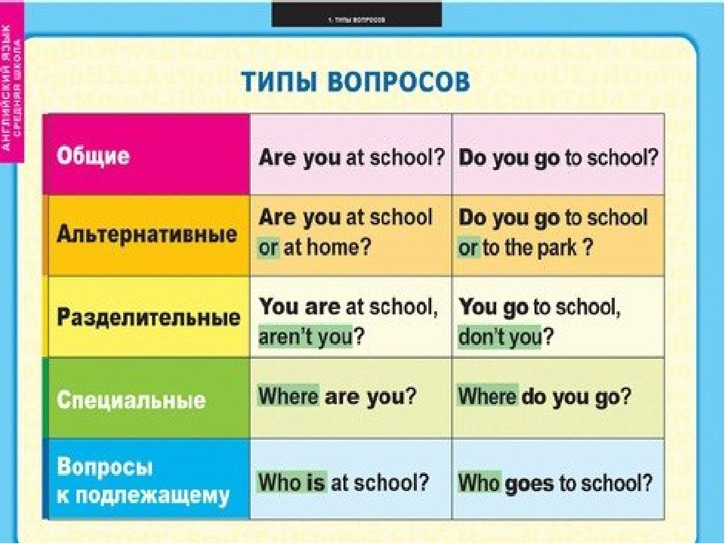
Запомни!

Slide 7

THANK YOU!

