Slide 2
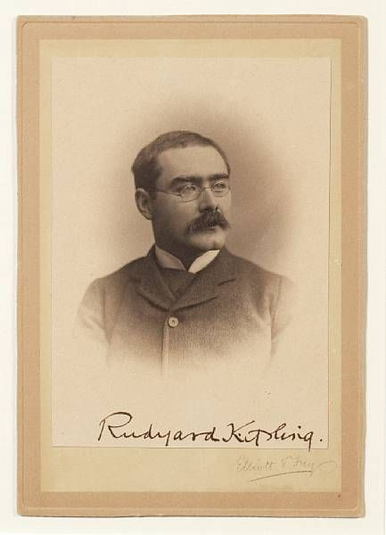
Rudyard Kipling
I keep six honest serving-men…
I keep six honest serving-men (They taught me all I knew); Their names are What and Why and When And How and Where and Who.

Slide 6
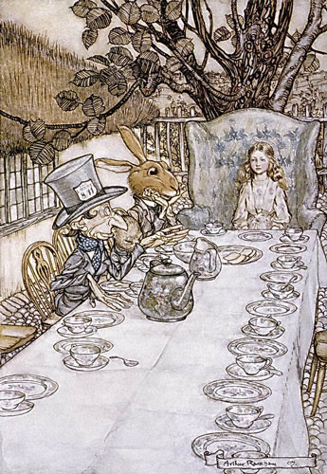
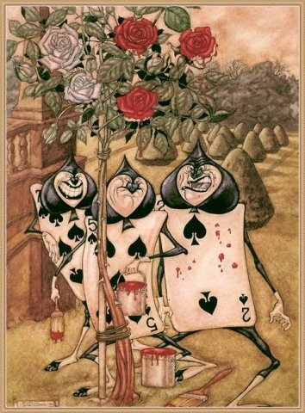
Lewis Carroll “Alice in wonderland”

Slide 7
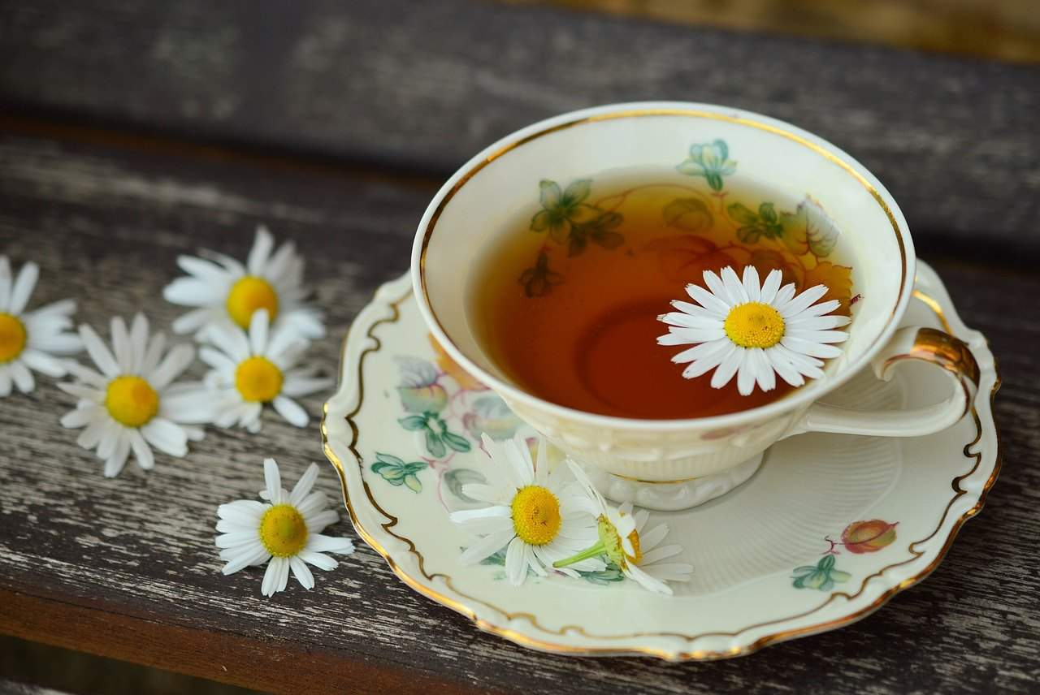
Do you like tea?

Slide 8
appeared [əˈpɪəd] -появился
brought [brɔːt] -привезли
to boil [bɔɪl] -кипятить
Tatar |ˈtɑːtə| -
bun [bʌn] - булочка
piala [ˈpɪlə]-
in a hurry [ˈhʌrɪ] -в спешке
to unite[juːˈnaɪt]-объединять
to prefer [prɪˈfɜː]-предпочитать

Slide 9
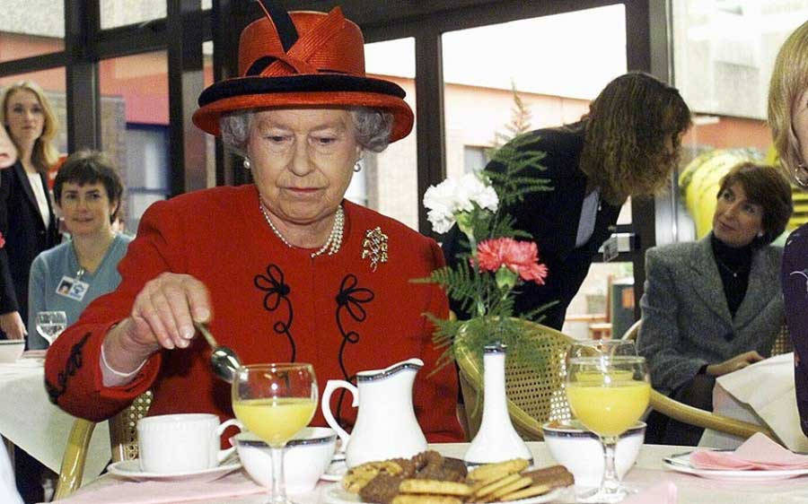

Slide 10
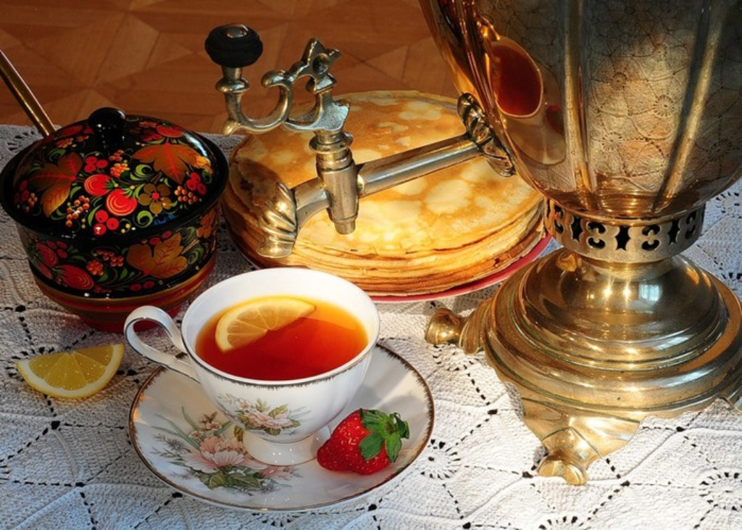

Slide 11
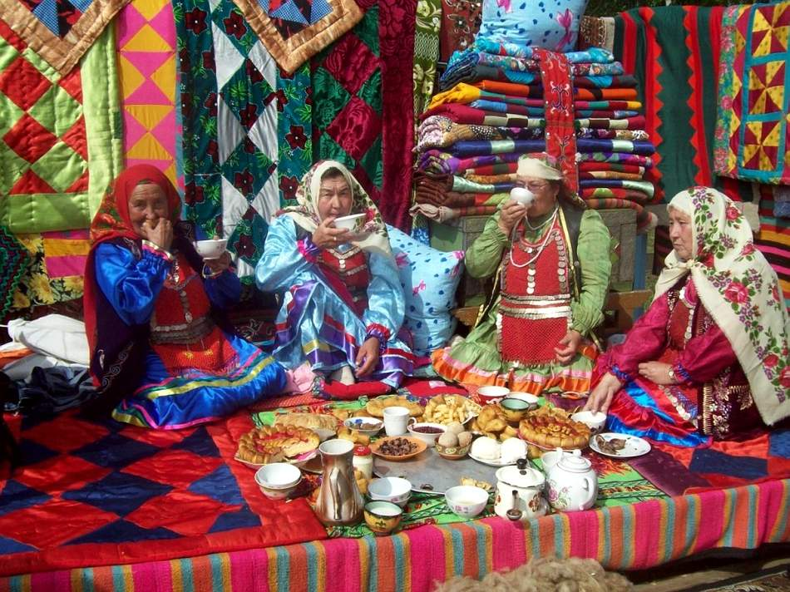

Slide 12
The Present Simple Tense Questions
When
do I, they, you
we
he
she
does
Where
?
Why
What
How
?
Who

Slide 13
Test

Slide 14
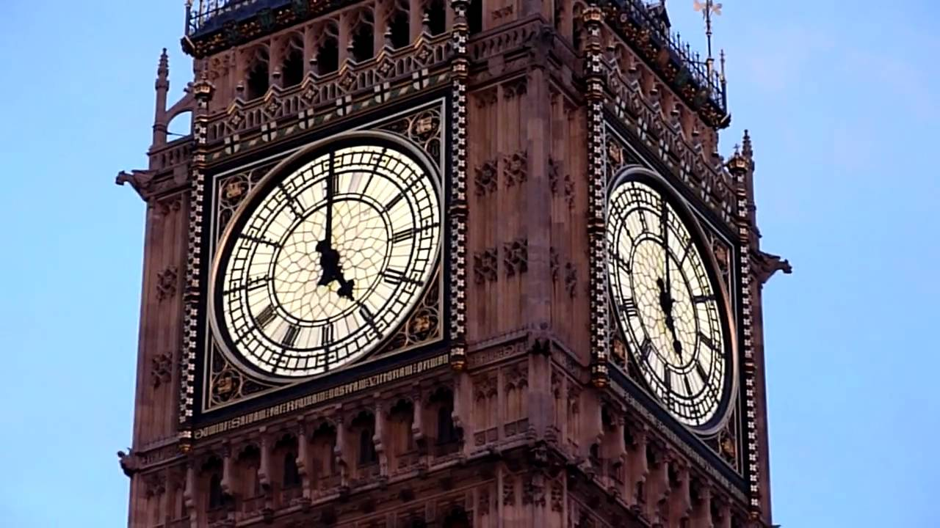

Slide 15
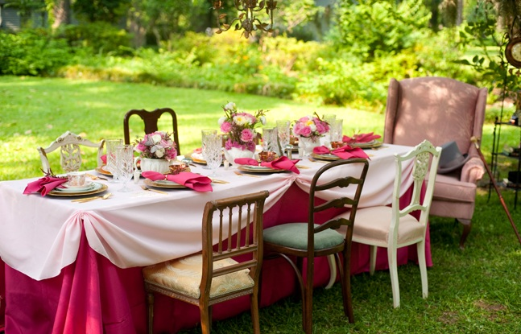

Slide 16
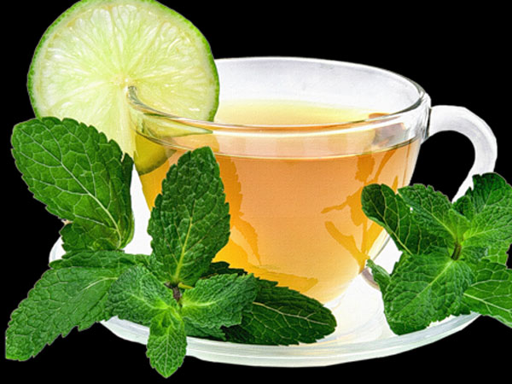
Your home task is to find interesting facts about tea and send me by
e-mail: alice51@yandex.ru

Slide 17
Do you like tea?

