Slide 1
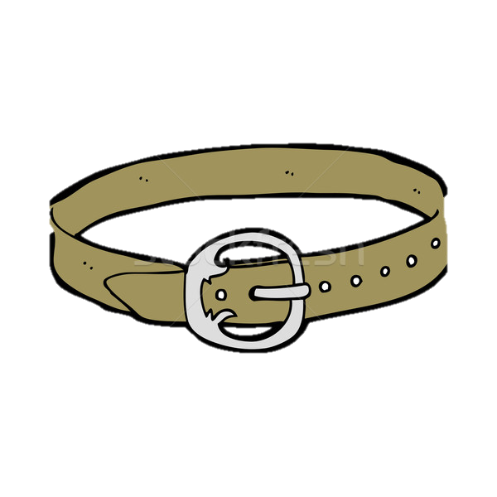
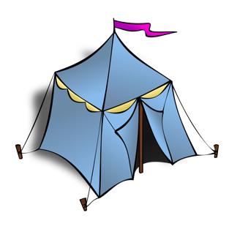
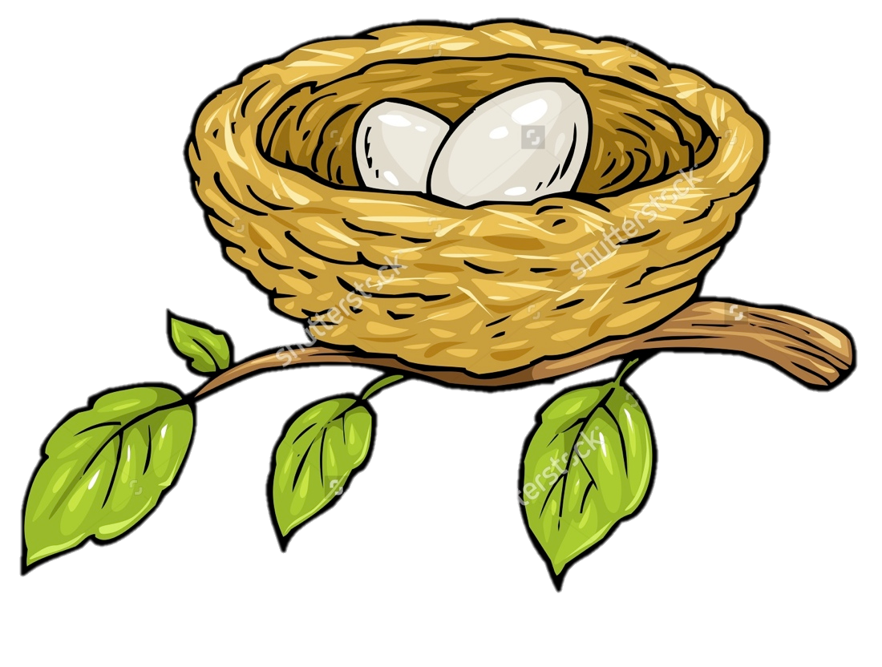
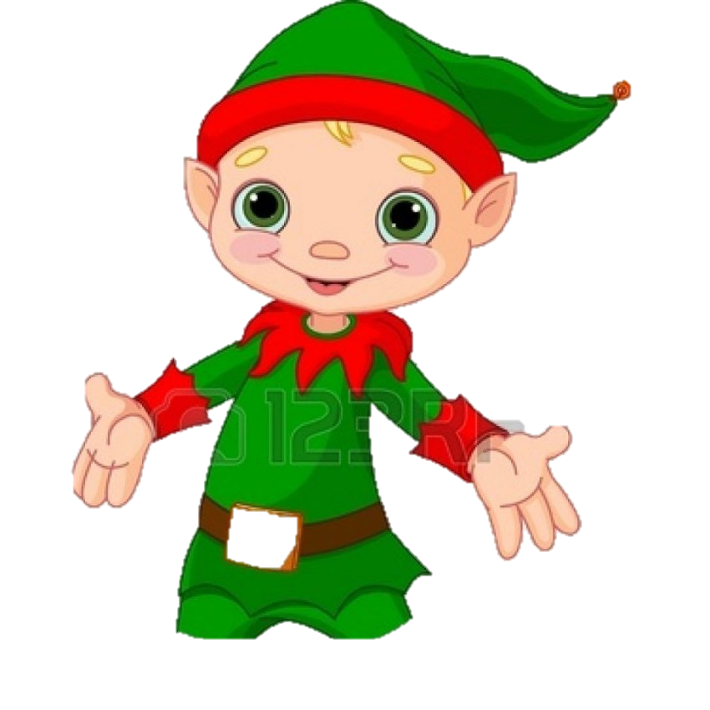
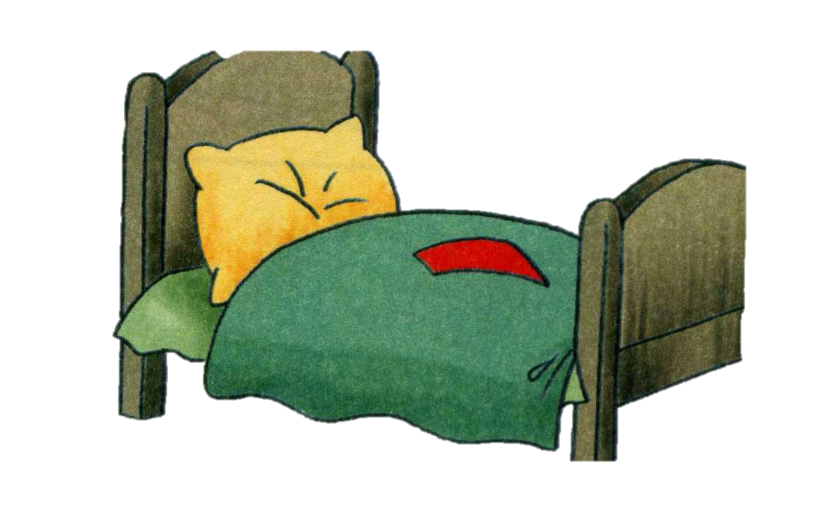

Slide 5
NET

Slide 6
B B

Slide 7
B B
BELL

Slide 9
EGG

Slide 11
BELT

Slide 13
NEST

Slide 14
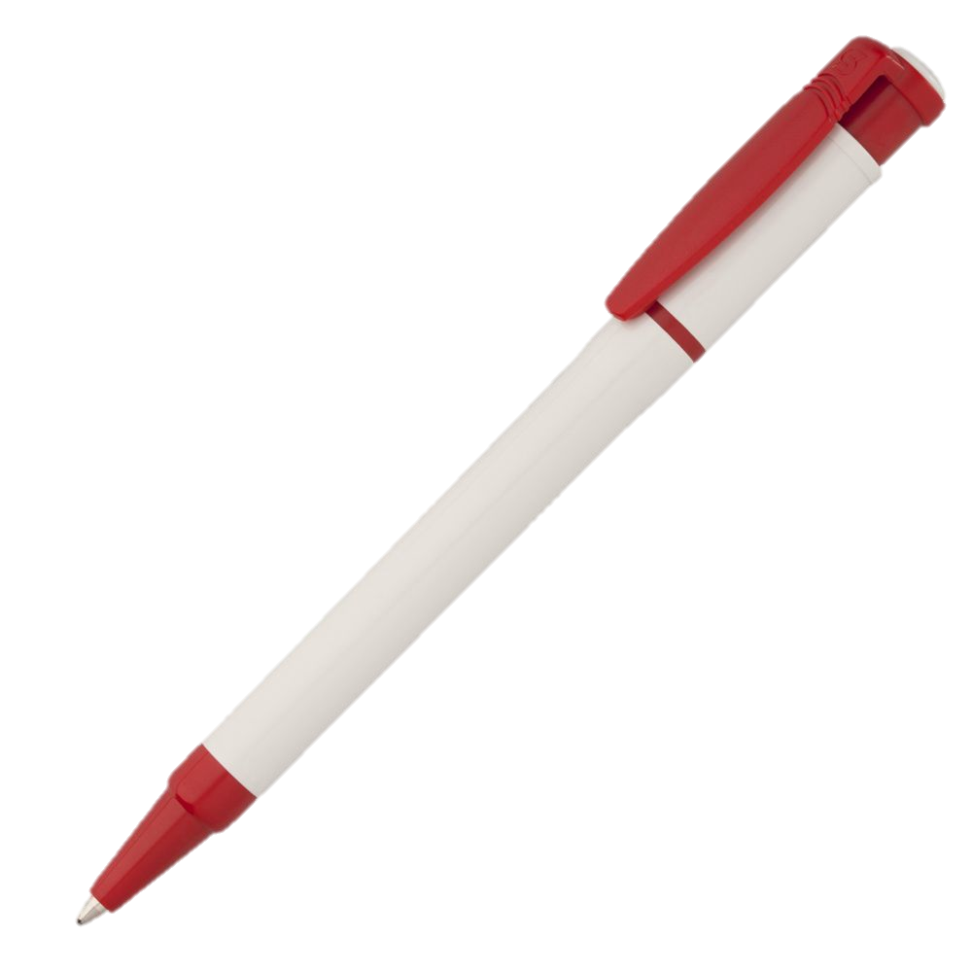

Slide 15
PEN

Slide 17
TENT

Slide 19
TEN

Slide 21
ELF

Slide 23
DESK

Slide 24
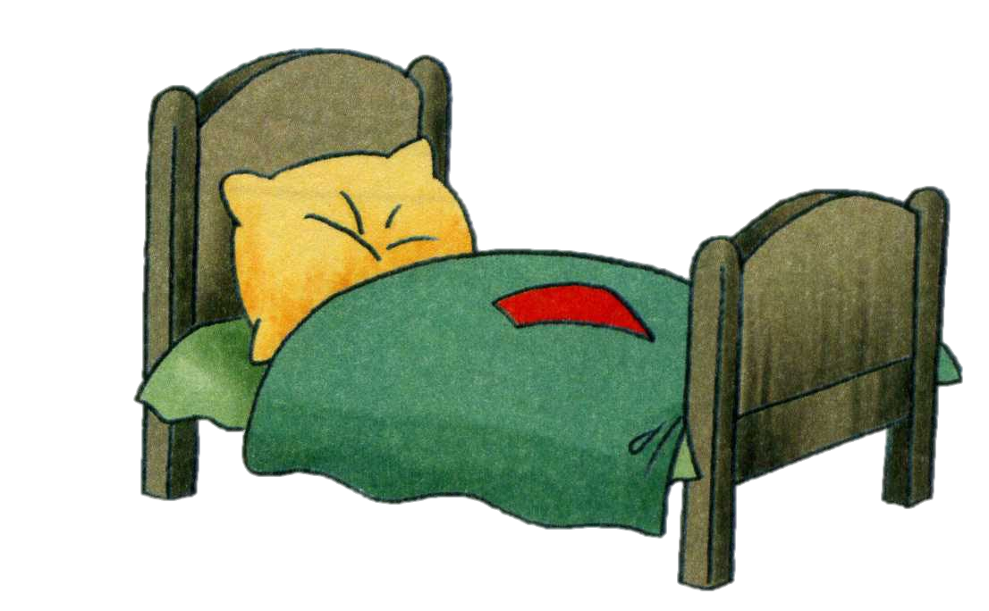

Slide 25
BED

Slide 26
