Slide 1
^{Nice to meet you!}

Slide 2
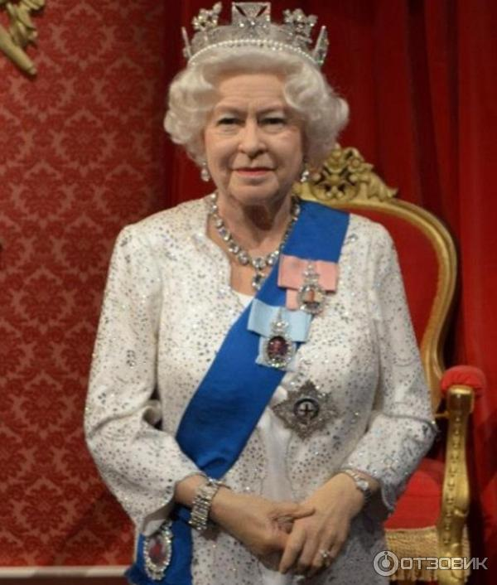
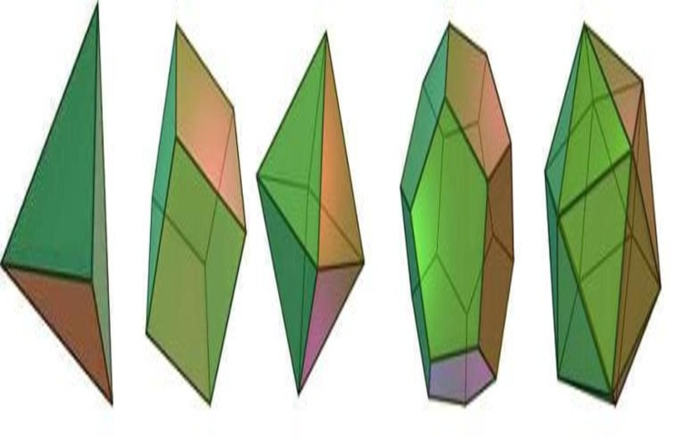
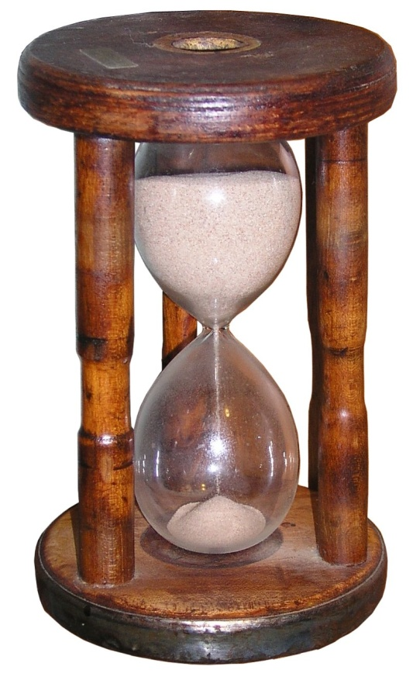
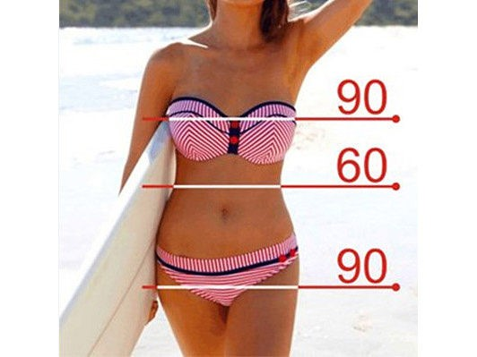
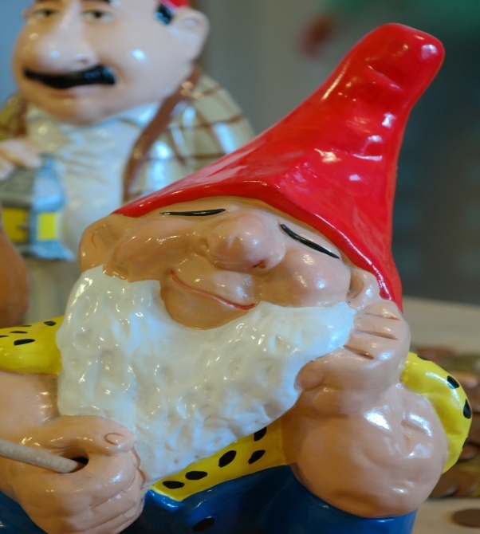
FIGURE

Slide 3
FIGURE
SPORT
MATHS
ART
FAMOUS
PERSON

Slide 4
Divide the following words into three categories:
BIG TRIANGULAR SOFT TALL HARD ROUND FAT SMALL SQUARE SLIM HIGH
SIZE
BIG
SMALL
FAT
SLIM
HIGH
TALL
FORM
TRIANGULAR
SQUARE
MATERIAL
HARD
SOFT

Slide 5
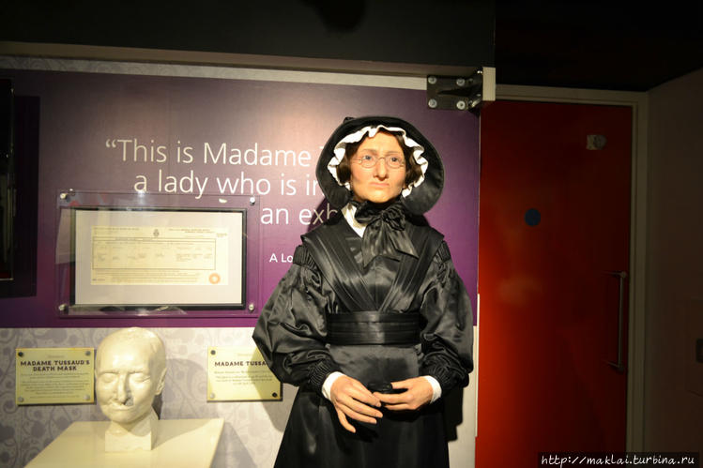
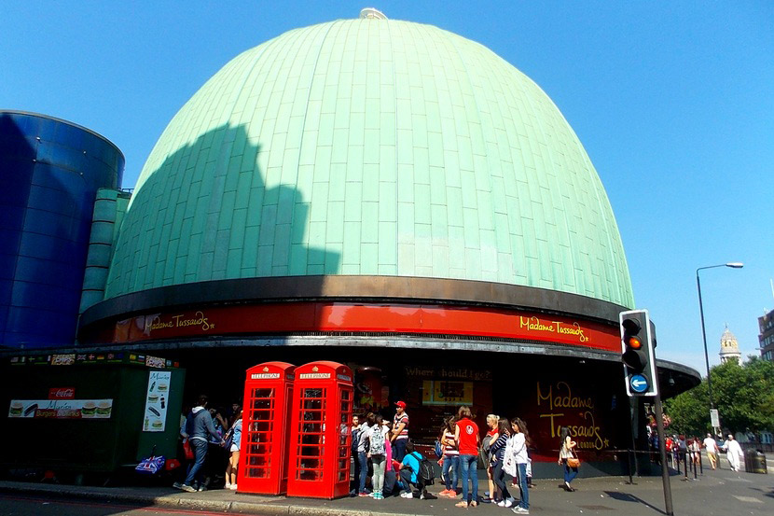

Slide 6
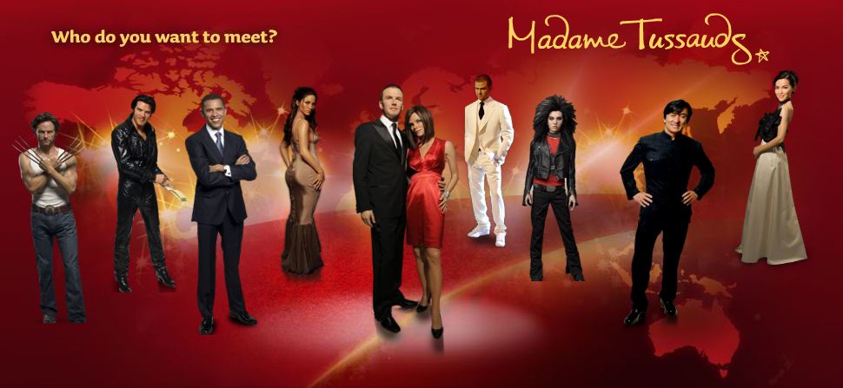

Slide 7
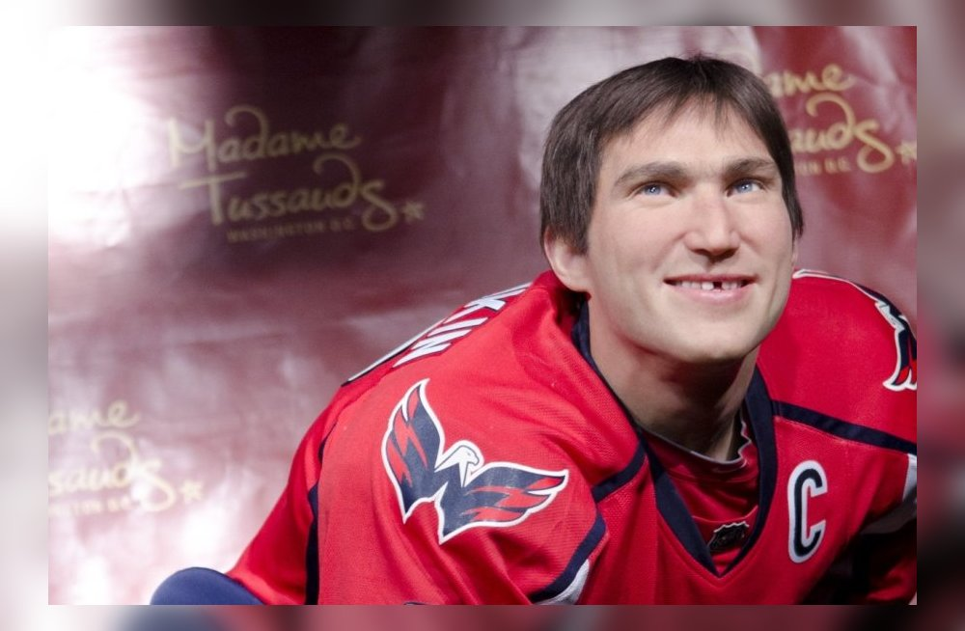
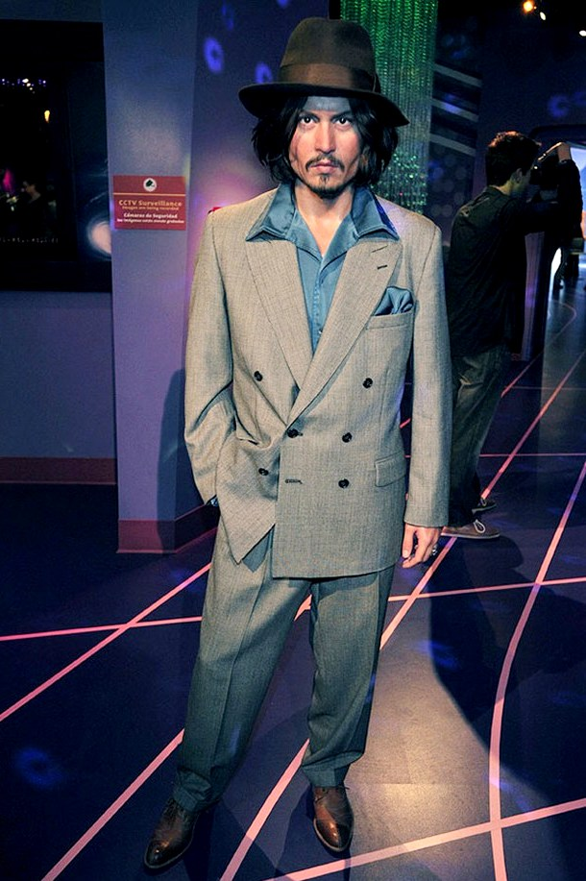
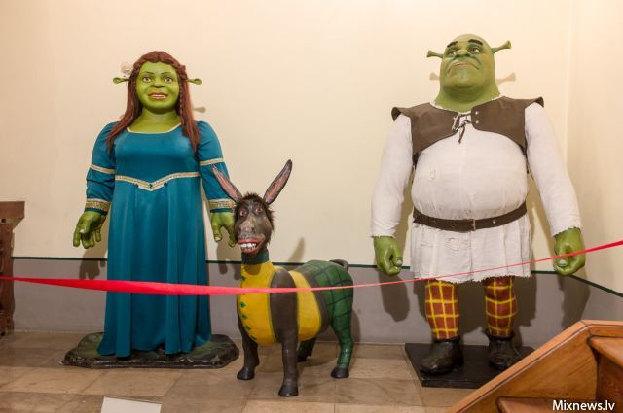
ALEXANDER OVECHKIN
JOHNY DEPP
SHREK AND FIONA

Slide 8
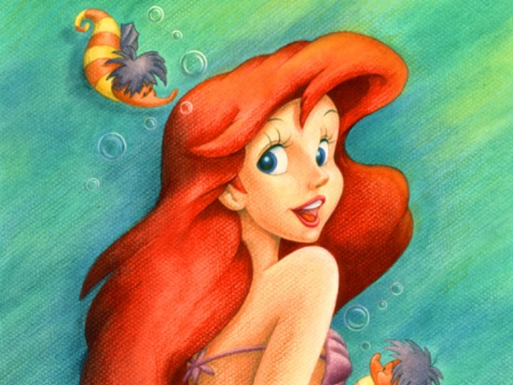
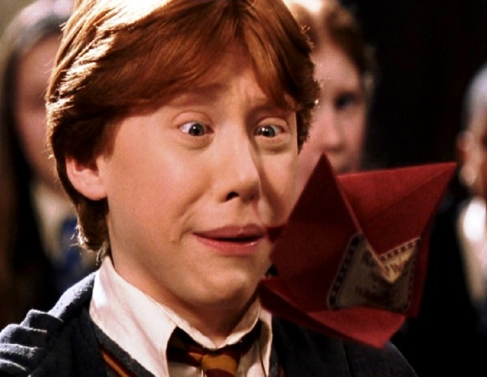
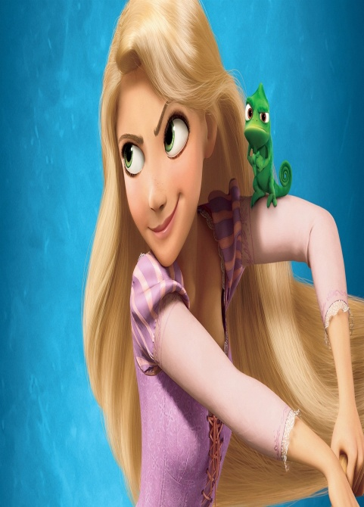
COMPLETE THE SENTENCES
Ariel has got … .
She is … and … .
Ron is … .
He has got … .
Rapunzel has got … .
She is … and … .

Slide 9
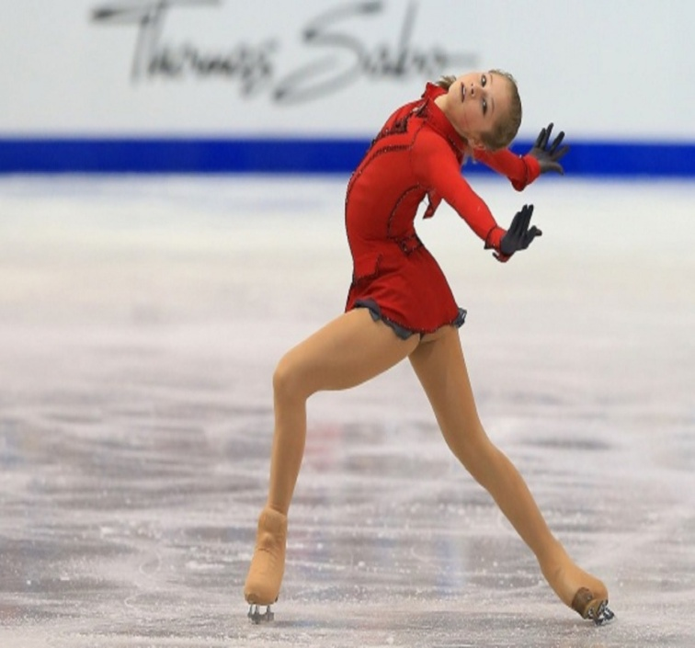
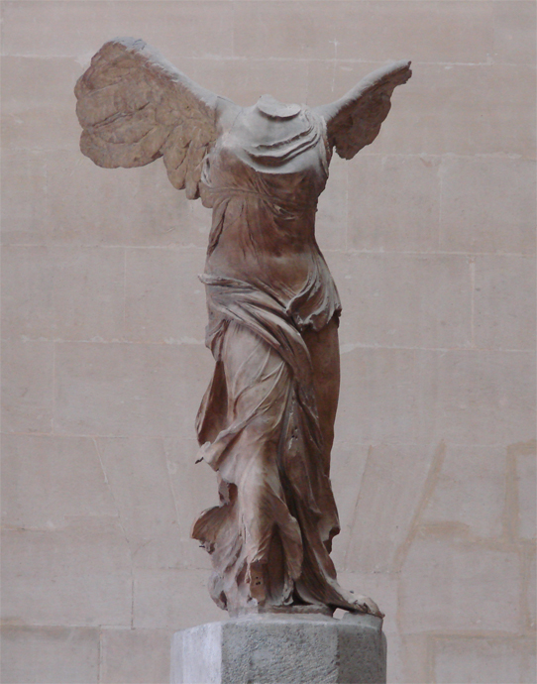

How do you understand “FIGURE”?

Slide 10
HOMETASK
LEVEL 1 – SB p. Ex.
LEVEL 2 – FIND FAMOUS RUSSIAN FIGURES IN TUSSAUD’S MUSEUM
LEVEL 3 - FIND FAMOUS RUSSIAN
FIGURES IN TUSSAUD’S MUSEUM AND DESCRIBE THEM

Slide 11

THANK YOU FOR THE LESSON!

